Slide 1
6.s080 Lecture 5: Data Integration
Key Ideas:
Schema Matching
Entity Resolution
Jaccard Similarity
Blocking And LSH
Lab 1 Due
Project Groups Due
Lab 2 Out

Slide 2
What is data integration
Given two or more data sets, create a unified dataset from them
Challenges:
Data sets may be in different formats
XML vs JSON vs CSV
Data sets may have different schemas
Different number of attributes
Different attribute names
Data sets may contain overlapping entities
How to determine which entities are the same?
Data sets may represent data differently
Different formats, units, representations
Functional
interoperability
Structural
interoperability
Semantic
interoperability

Slide 3
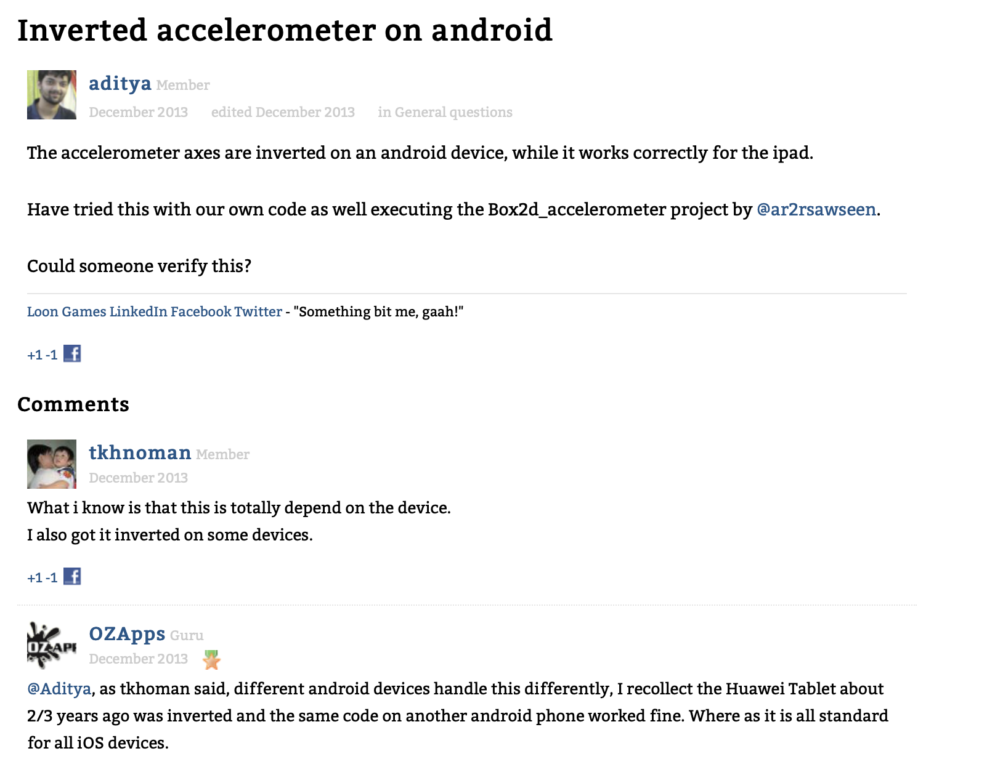
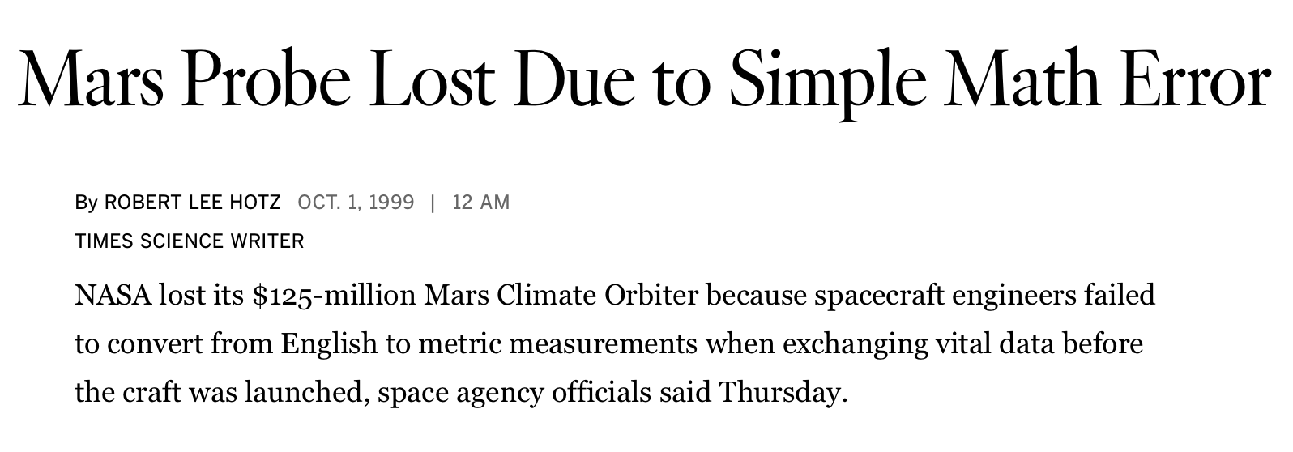
Why is this hard/important
Frequently arises when working with data “in the wild”
Economics –
E.g., US stock returns vs Asian stock returns
Medicine –
E.g., study across multiple hospitals or patients
“blood pressure 120/80” – what does this mean?
E-commerce –
comparison shopping, supply chain
Software interoperability –
data dictionaries for APIs
Science – different collaborative teams

Slide 4
Outline
Today
Monday
Schema Matching
Structural
Entity Resolution
Semantic
Data Cleaning & Fusion
Semantic
Schema Alignment
deduplication, entity clustering, merge/purge, fuzzy match, record linkage, approximate match...
missing value imputation, distribution tests, integrity and check constraints, disguised missing values, …

Slide 5
Schema matching
Goal is to match columns from two tables, to produce a single table with the same schema
Complicated because people use different names for columns
Typical approach: find columns with a similar name, the same data type, and high overlap in values
Measuring similarity and overlap are problems we will need to address in entity resolution as well …

Slide 6
Naïve entity resolution approach
Two tables, T1, T2, with same schema
Goal merged into one table without duplicates
For each record R1 in T1:
For each record R2 in T2:
s = similar(R1, R2)
if (s > thresh)
emit (R1, R2)

Slide 7
It’s complicated

Slide 8
real world data
select count(*)
from customer
- How many customers do I have?
Wrong answer because of duplicate records!
- How many customers by state?
select count(*)
from customer
group by state
State | Count
AL | 60
… | …
… | …
WA | 1200
Washington | 50
Wasington | 2
What about if you give this data to a ML algorithm?

Slide 9
entity resolution
“[The] problem of identifying and linking/grouping different manifestations of the same real world object.”
Challenges
Fundamental ambiguity
Diversity in representations (format, truncation, ambiguity)
Errors
Missing data
Records from different times
Relationships in addition to equality

Slide 10
Some other problems
For each record R1 in T1:
For each record R2 in T2:
s = similar(R1, R2)
if (s > thresh)
emit (R1, R2)
What similarity function to use?
This lecture: text similarity
Comparing every record to every other record may take a long time?
This lecture: blocking and LSH

Slide 11
text similarity

Slide 12
textual similarity
String Similarity function:
  𝑆𝑖𝑚(𝑠𝑡𝑟𝑖𝑛𝑔, 𝑠𝑡𝑟𝑖𝑛𝑔) → 𝑛𝑢𝑚𝑒𝑟𝑖𝑐 𝑣𝑎𝑙𝑢𝑒
A “good” similarity function:
  Strings representing the same concept ⇒ high similarity
  Strings representing different concepts ⇒ low similarity

Slide 13
edit distance
EditDistance(s1, s2):
  Minimum number of edits to transform s1 to s2
Edit:
  Insert a character
  Delete a character
  Substitute a character
  Note: EditDistance(s1, s2) = EditDstance(s2, s1)
  “Distance” = opposite of similarity

Slide 14
Edit Distance
EditDistance (“Provdince”, “Providence”) = 2
Provdince Providence Providence
EditDistance(“Seattle”, “Redmond”) = 6
Seattle Reattle Redttle
Redmtle Redmole Redmone
Redmond
Notes:
Can you think of problems with editdistance

Slide 15
edit distance Problems
115th Waterman St., Providence, RI
EditDistance = 1
110th Waterman St., Providence, RI
Waterman Street, Providence, RI
EditDistance = 4
Waterman St, Providence, RI
Character Level vs. Word Level Similarity?

Slide 16
Edit Distance Problems

Slide 17
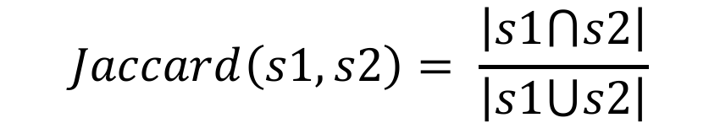
jaccard similarity
Statistical measure
Originally defined over sets
String = set of words
Range of values = [0,1]
$$Jaccard\left(s1,s2\right)= \frac{\left|s1⋂s2\right|}{\left|s1⋃s2\right|}$$

Slide 18
jaccard similarity

Slide 19
jaccard similarity

Slide 20
Clicker
What is the Jaccard Similarity between:
iPad Two 16GB WiFi White
iPad 2nd generation 16GB Wifi White
3 / 8
4 / 11
4 / 7
Notes:
3 / 8

Slide 21
Clicker:
Which jaccard similarity is Wrong
Microsoft Corporation
Jaccard = 1/3
Microsoft Corp
Microsoft Corporation
Jaccard = 1/3
Oracle Corporation
Waterman 115 St
Jaccard = 1/4
115 Waterman Street
A)
B)
C)

Slide 22
What can we do about?
Microsoft Corporation
Microsoft Corp
Microsoft Corporation
Oracle Corporation

Slide 23
jaccard similarity

Slide 24
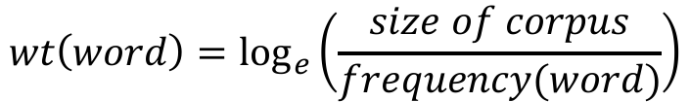
IDF WEIGHTED
IDF: Inverse Document Frequency
frequency(word) = defined using some “corpus”:
  large table of records
  Wikipedia?
$$wt\left(word\right)=\log_{e}\left(\frac{size of corpus}{frequency(word)}\right)$$

Slide 25
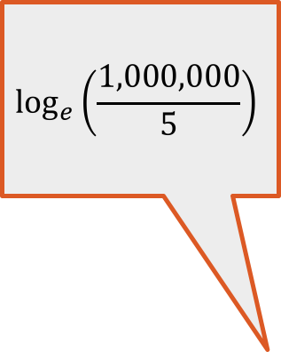
idf weighted JACCARD
Microsoft Corporation
WtJaccard = 12.21 / ( 12.21 + 4.21 + 4.38)
= 12.21/20.8 = 0.59
Microsoft Corp
Microsoft Corporation
WtJaccard = 4.21/26.57 = 0.16
Oracle Corporation
$$\log_{e}\left(\frac{1,000,000}{5}\right)$$

Slide 26
other similarity functions
Affine edit distance
Cosine similarity
Hamming distance
Generalized edit distance
Jaro distance
Monge-Elkan distance
Q-gram
Smith-Warerman distance
Soundex distance
TF/IDF
…many more
No universally good similarity function
Choice of similarity function depends on domains of interest, data instances, etc.

Slide 27
Using jaccard for entity resolution
Two tables, T1, T2, and we want to merged based on similarity in some field f
For each record R1 in T1:
For each record R2 in T2:
js = jaccard(R1.f, R2.f)
if (js > t)
emit (R1, R2)
Problems:
want similarity in more fields than just f?
how to choose t?
have to compare every record to every other record (scalability)

Slide 28
record matching Problems

Slide 29
combining similarity functions

Slide 30
learning-based approach

Slide 31
learning based approach

Slide 32
learning based approach

Slide 33
Scaling issues
Product | Mfg | Price
Apple Sauce | Fun Co | 1.00
Cherry Pie | Bad Co | 1.25
Blue Gum | Happy Co | 3.15
Red Ball | Sad Co | 95.00
Product | Mfg | Price
Apple Pie | Co Inc | 3.00
Cherry P | Bad Co | 1.57
Gum, Blue | Happy Inc | 5.00
Cross product!
10000 x 10000 = 100M!
Product_x | Product_y | … | Jaccard
Apple Sauce | Apple Pie |  | .33
Apple Sauce | Cherry P |  | 0
Apple Sauce | Gum, Blue |  | 0
Cherry Pie | Apple Pie |  | .33
Cherry Pie | Cherry P |  | .33
Cherry Pie | Gum, Blue |  | 0
How can we avoid this?

Slide 34
Handling quadratic scaling
Basic idea: Blocking, i.e. partition the tables into similar records, and only compare the partitions
Many different blocking methods, e.g.,
k-means clustering,
records with at least one word,
split records by value of some attribute
Two methods: value-based partitioning and LSH

Slide 35
Value based partitioning
Product_x | Mfg_x
Apple Sauce | Fun Co
Cherry Pie | Bad Co
Blue Gum | Happy Co
Red Ball | Sad Co
Brown Hat | Fun Co
Green Pie | Bad Co
Black Belt | Happy Co
Red Turtle | Sad Co
Orange Fish | Fun Co
Tiny Monkey | Bad Co
Happy Squirrel | Happy Co
Angry Bird | Sad Co
Product_y | Mfg_y
Apple Sauce | F Inc
White Wall | Bad Co
Gum, Blue | Happy Inc
Smelly Sock | F Inc
Black Pie | Bad Co
Happy Monkey | Happy Inc
Cool | F Inc
Cherry P | Bad Co
Orange Rat | Happy Inc
Tiny Squirrel | F Inc
Happy Bird | Bad Co
Red Hat | Happy Inc
Naïve work: 12 x 12 = 144 comparisons

Slide 36
Value based partitioning
Product_x | Mfg_x
Apple Sauce | Fun Co
Cherry Pie | Bad Co
Blue Gum | Happy Co
Red Ball | Sad Co
Brown Hat | Fun Co
Green Pie | Bad Co
Black Belt | Happy Co
Red Turtle | Sad Co
Orange Fish | Fun Co
Tiny Monkey | Bad Co
Happy Squirrel | Happy Co
Angry Bird | Sad Co
Product_y | Mfg_y
Apple Sauce | F Inc
White Wall | Bad Co
Gum, Blue | Happy Inc
Smelly Sock | F Inc
Black Pie | Bad Co
Happy Monkey | Happy Inc
Cool | F Inc
Cherry P | Bad Co
Orange Rat | Happy Inc
Tiny Squirrel | F Inc
Happy Bird | Bad Co
Red Hat | Happy Inc
Idea: apply Jaccard similarity to Mfg columns – only 4 x 3 = 12 comparisons

Slide 37
Value based partitioning
Product_x | Mfg_x
Apple Sauce | Fun Co
Brown Hat | Fun Co
Orange Fish | Fun Co
Apply Jaccard on partitions that have similar mfg
Product_y | Mfg_y
Apple Sauce | F Inc
Smelly Sock | F Inc
Cool | F Inc
Tiny Squirrel | F Inc
Product_x | Mfg_x
Cherry Pie | Bad Co
Green Pie | Bad Co
Tiny Monkey | Bad Co
3x4
Product_y | Mfg_y
Gum, Blue | Happy Inc
Happy Monkey | Happy Inc
Orange Rat | Happy Inc
Red Hat | Happy Inc
Total work: 12 + 3x4 * 5 = 72 comparisons
Product_x | Mfg_x
Blue Gum | Happy Co
Black Belt | Happy Co
Happy Squirrel | Happy Co
3x4
3x4
Product_y | Mfg_y
White Wall | Bad Co
Black Pie | Bad Co
Cherry P | Bad Co
Happy Bird | Bad Co
3x4
Product_x | Mfg_x
Red Ball | Sad Co
Red Turtle | Sad Co
Angry Bird | Sad Co
3x4

Slide 38
Basic idea of LSH for Jaccard Similarity
Idea: find a may to hash items so that items with high jaccard similarity end up in same bucket
Suppose we have a hash function H, and two tables T1 and T2
H maps from an input string to a number in 1..k
For record r in T1:
min_hash_r = MAX_INT
for each word wi in r:
min_hash_r = min(min_hash_r, H(wi))
assign r to bucket min_hash_r
This is the minhash

Slide 39
Example
R1 = sam likes meat
R2 = tim likes fish
H(likes) = 0
H(tim) = 1
H(sam) = 2
H(meat) = 3
H(fish) = 4
Minhash(H, R1) = 0
Minhash(H, R2) = 0
Hash bucket | Records
0 | R1, R2
1
2
3
4
But we just got lucky! And they aren’t really 100% similar!

Slide 40
Idea: define a family of hashes
R1 = sam likes meat
R2 = tim likes fish
H1(likes) = 0
H1(tim) = 1
H1(sam) = 2
H1(meat) = 3
H1(fish) = 4
Minhash(H1, R1) = 0
Minhash(H1, R2) = 0
H1(likes) = 1
H1(tim) = 0
H1(sam) = 2
H1(meat) = 3
H1(fish) = 4
Minhash(H1, R1) = 1
Minhash(H1, R2) = 0
H1(likes) = 1
H1(tim) = 2
H1(sam) = 0
H1(meat) = 3
H1(fish) = 4
Minhash(H1, R1) = 0
Minhash(H1, R2) = 1
One hash function per permutation of the words
…
Hash bucket | Records
0 | R1, R2
1
2
3
4
Hash bucket | Records
0 | R2
1 | R1
2
3
4
Hash bucket | Records
0 | R1
1 | R2
2
3
4
…

Slide 41
MINHASH ➔ JACCARD SIMILARITY
Choose a random hash function from this set
Pr(minhash(R1) = minhash(R2)) =
words(R1) ⋂ words (R2)
Which is Jaccard similarity!
words(R1) ⋃ words (R2)
If we choose k random hash functions, an estimate of Jaccard similarity is thus:
1/k ∑ h_{i}(R1) = h_{i}(R2)
1<i<k

Slide 42
Putting it all together
Initialize k hash tables, one for each of k hash functions
For each record R:
for each hash table t:
store R in minhash(H_{t} (R))
For each record R, to compute records R has > 0 JS with:
Lookup k buckets R was hashed to
For each record R’ other than R in each of those buckets:
Compute
1/k ∑ bucket_{i}(R) in bucket_{i}(R’)
1<i<k
Complexity: R * k * records per bucket
If k * records per bucket is < R, we’ve saved work

Slide 43
EXAMPLE
Hash bucket | Records
0 | R1, R2
1
2 | R3, R4
3 | R5
4
Hash bucket | Records
0 | R2
1 | R1
2 | R3
3 | R4
4 | R5
Hash bucket | Records
0 | R1
1 | R2, R4
2 | R3
3 | R5
4
JS(R1, R2) ~= 1 + 0 + 0 / 3 = 1/3
JS(R1, R3) ~= 0 + 0 + 0 / 3 = 0
JS(R2, R4) ~= 0 + 0 + 1 / 3 = 1/3
…
K * records per bucket work to get JS of R1 and all other records

Slide 44
Integrating Non-Text Data
“Fuzzy matching”, e.g., using Jaccard, doesn’t work for categorical or numerical data
Will need some other method to resolve errors in such fields
Will talk more about this next time

Slide 45
Summary
Data Integration is messy, especially when dealing with semantic ambiguities
Determining if two columns are the same, or if two entities match, can be done using text similarity
One common metric: Jaccard Similarity, possibly weighted by term frequency
Can avoid quadratic complexity using blocking, e.g., on values or with LSH

