Slide 1
Sampling and Sketching
Sam Madden
6.s080 Lecture 17

Slide 2
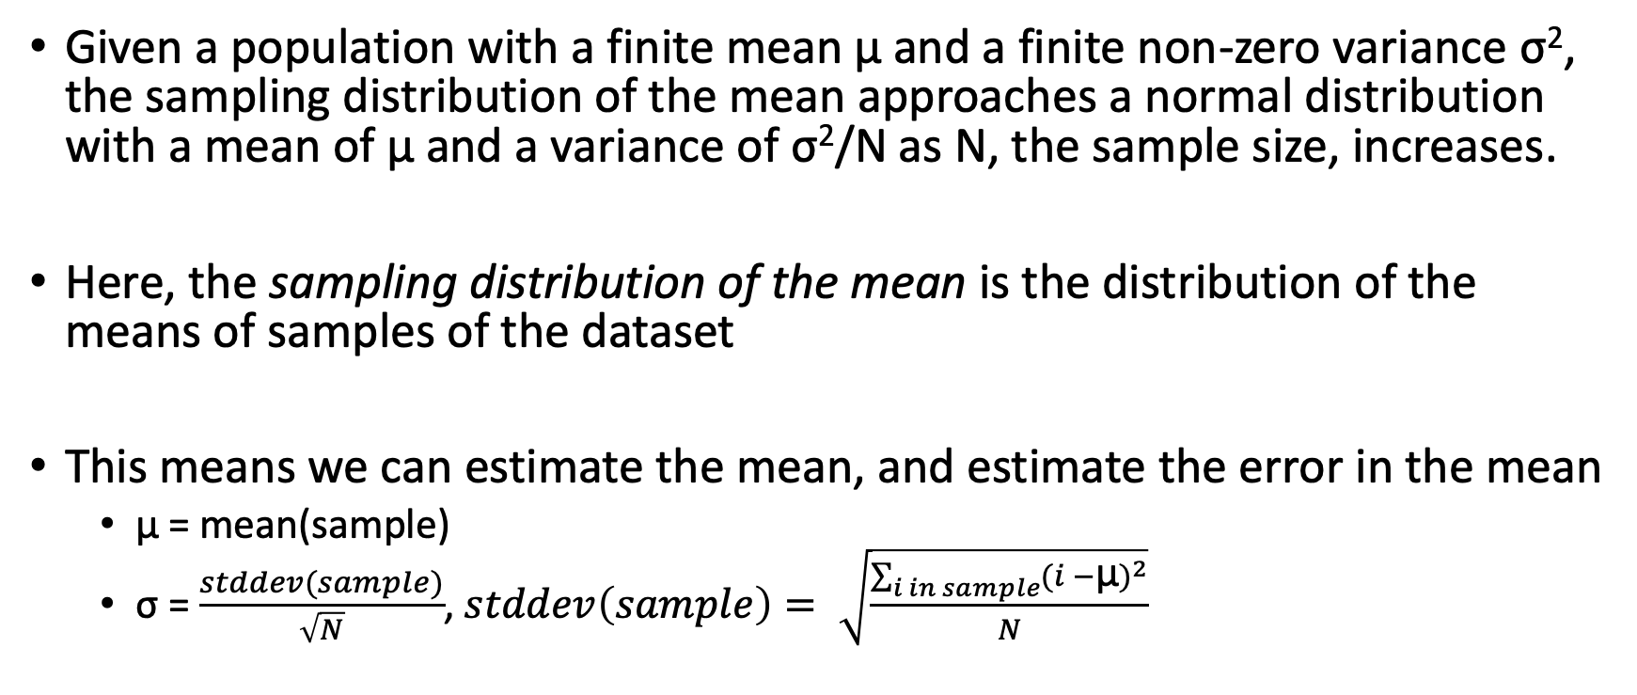
Central Limit Theorem
Given a population with a finite mean μ and a finite non-zero variance σ², the sampling distribution of the mean approaches a normal distribution with a mean of μ and a variance of σ²/N as N, the sample size, increases.
Here, the sampling distribution of the mean is the distribution of the means of samples of the dataset
This means we can estimate the mean, and estimate the error in the mean
  μ = mean(sample)
  σ = $\frac{stddev(sample)}{\sqrt{N}}$, $stddev\left(sample\right)= \sqrt{\frac{\sum_{i in sample}{{(i −\text{μ})}^{2}}}{N}}$

Slide 3
Bootstrap Method
Given a function F and a sample S of size N, with K bootstraps
Goal is +/- p confidence interval
For i in 1 .. K
  S_new = sample of size N of S with replacement
  Results[i] = F(S_new)
Sort results, return p, 1-p percentile of results

Slide 4
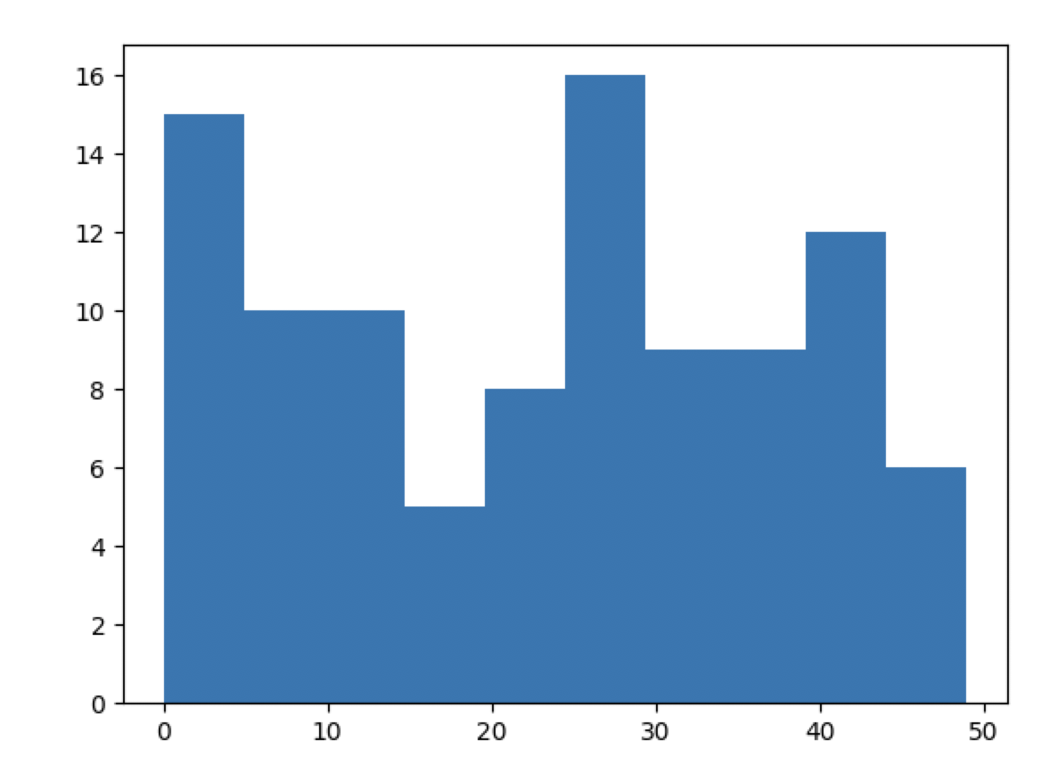
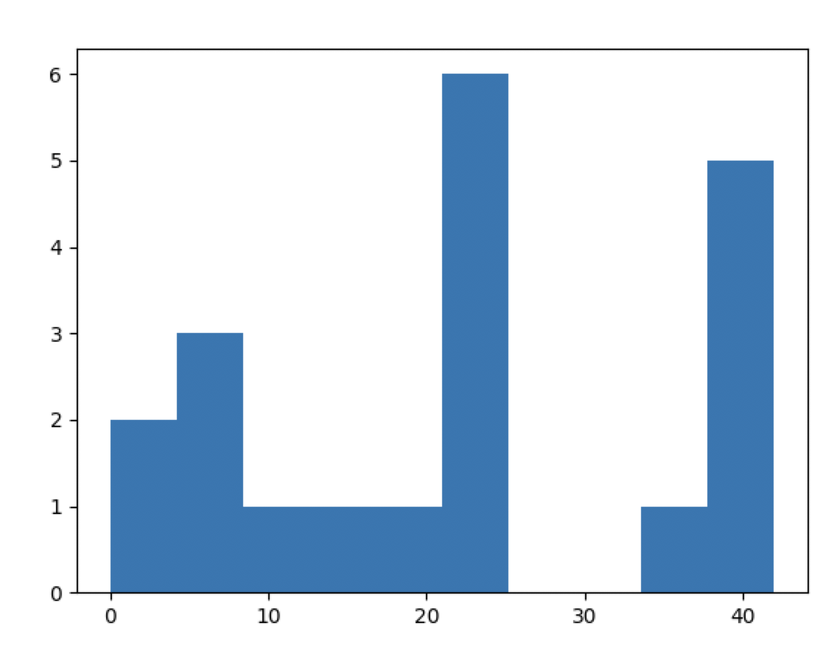
Example
Mean = 22.91
Data:
[36,23,7,25,27,31,27,10,11,8,21,4,41,0,20,5,0,36,40,10,12,31,24,2,28,8,9,25,48,43,40,2,26,0,25,32,9,0,10,33,1,23,7,39,18,32,16,40,4,42,28,28,26,42,0,45,25,10,13,31,3,11,28,25,23,16,31,22,6,34,19,48,27,48,39,40,6,3,28,26,19,34,38,42,1,47,22,7,36,38,35,35,42,49,41,40,11,10,1,1]
Sample:
[25,10,35,25,23,0,20,24,23,25,6,42,40,38,40,4,8,16,38,8]
Mean = 22.5
Resample 1: [42, 40, 8, 25, 0, 42, 24, 0, 16, 42, 23, 25, 25, 10, 40]
Mean = 24.1
Resample 2: [23, 25, 10, 42, 23, 0, 0, 24, 23, 23, 38, 25, 16, 35, 25]
Mean = 22.1
Resample 3: [6, 38, 40, 23, 23, 40, 23, 4, 8, 25, 4, 8, 25, 20, 0]
Mean = 19.13

Slide 5
Resulting Means after 100 runs
14.93, 15.27, 15.33, 15.47, 16.60, 17.40, 17.53, 17.60, 17.80, 18.20, 18.27, 18.47, 18.47, 18.93, 18.93, 19.07, 19.07, 19.07, 19.13, 19.13, 19.53, 19.80, 19.80, 19.93, 20.00, 20.00, 20.13, 20.27, 20.40, 20.47, 20.60, 20.73, 20.80, 20.80, 21.07, 21.13, 21.13, 21.13, 21.20, 21.27, 21.33, 21.40, 21.47, 21.47, 21.87, 21.87, 22.13, 22.20, 22.27, 22.33, 22.33, 22.40, 22.73, 22.73, 22.80, 22.87, 22.93, 22.93, 23.00, 23.07, 23.13, 23.20, 23.20, 23.47, 23.53, 23.67, 23.67, 23.73, 23.73, 23.80, 23.93, 23.93, 23.93, 23.93, 24.00, 24.20, 24.20, 24.27, 24.47, 24.67, 24.80, 24.87, 24.87, 25.00, 25.13, 25.47, 25.47, 25.53, 26.07, 26.07, 26.07, 27.13, 27.33, 28.20, 28.47, 28.87, 28.87, 30.00, 30.53, 32.40,
Confidence interval of mean 16.6 … 28.87

Slide 6
Why Does This Work
A random sample is an approximation of the distribution of the data
  If it’s big enough, it’s a good approximation
Resampling the sample is close to resampling from the original data
  Variation in those samples captures variation in the original data
  Of course, it will miss outliers, extrema, etc.
  But it will work well for a variety of descriptive statistics, including quantiles, regression errors, precision/recall estimates, etc.
Samples approximate the true distribution well

Slide 7
When Doesn’t This Work
Your sample needs to be big enough (N > 20 is a rule of thumb, but it will vary a lot depending on data)
It won’t work for extrema (e.g., min / max)
It won’t work well for highly structured data (i.e., you can’t randomly sample a graph, compute the average connectivity, and expect to get something meaningful)
It won’t work if your sample is not really truly random

Slide 8
BlinkDB
Sameer Agarwal, Barzan Mozafari, Aurojit Panda, Henry Milner, Samuel Madden, Ion Stoica. BlinkDB: Queries with Bounded Errors and Bounded Response Times on Very Large Data. In ACM EuroSys 2013
Notes:
QuicksilverDB, a interactive query processing frameworks that provides answers with bounded errors to queries that may operate on unbounded data. This is joint work with…

Slide 9

Ultimate Goal of BlinkDB
Observation: Many applications can tolerate quick, approximate answers over data
Trade-off: few percent error for up orders of magnitude in efficiency
Acceptable in decision support, recommendation system, diagnosis, root cause analysis

Slide 10
Overview
Problem
Users are overwhelmed by data volumes AND increasingly want to compute sophisticated statistics over their data. Existing database systems do not satisfy their needs.
Our Goal
Provide interactive ad-hoc analytical (SQL) queries over very large data sets.
Basic Approach
Run queries over stored/precomputed samples, providing answers with bounded errors for arbitrary functions.

Slide 11
Challenges/Solutions
Generality: Accurate error estimates for complex SQL statements and user-defined functions
  Investigating techniques like bootstrap and jack knife for providing error estimates for arbitrary user-defined (differentiable) functions
Flexibility/Reliability: Accurate estimations of response times for ad hoc queries (including over small domains)
  Using stratified sampling rather than random sampling
Parallelism/Scalability: Sub-second latencies for parallel queries running on hundreds of machines
  Not doing online aggregation, but pre-computing samples
  Optimization problem!
Notes:
While we leverage a lot of these prior work, designing an interactive and general approximate query processing framework has 3 key challenges:
1.Typical data analysis queries range from anywhere between common aggregation operations to fairly sophisticated machine learning algorithms. Hence providing <> is a challenge
2.Due to an abundance of ad hoc queries, we require <>
3. Third, Just reading a petabyte of data takes about 30 minutes on a 10,000 node cluster. Hence in order to achieve sub-second que <> and effective use of in-memory caching.

Slide 12
System Architecture
TABLE
Original
Data

Slide 13
System Architecture
Offline-sampling: multiple data samples at various granularities and across different dimensions (columns)
…
…
TABLE
…
…
Sampling Module
Original
Data
…
…

Slide 14
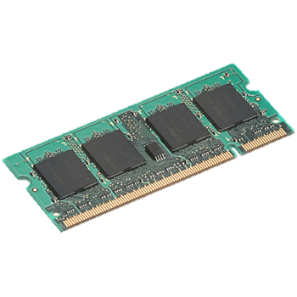
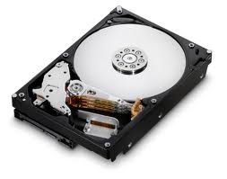
Initial Prototype
Samples striped over 100s or 1,000s of machines both on disks and in-memory (i.e., RDDs)
…
…
TABLE
…
…
Sampling Module
Original
Data
…
…
On-Disk
Samples
In-Memory
Samples

Slide 15
System Architecture
SELECT
foo (*)
FROM TABLE;
Query Plan
Sample Selection
HiveQL/SQL
Query
Predict cost and error for ad-hoc queries using smaller samples and historical context
…
…
TABLE
…
…
Sampling Module
Original
Data
…
…
On-Disk
Samples
In-Memory
Samples

Slide 16
System Architecture
SELECT
foo (*)
FROM TABLE;
Query Plan
Sample Selection
HiveQL/SQL
Query
Online sample selection to pick best sample(s) based on query latency and accuracy requirements
…
…
TABLE
…
…
Sampling Module
Original
Data
…
…
On-Disk
Samples
In-Memory
Samples

Slide 17
System Architecture
SELECT
foo (*)
FROM TABLE;
Query Plan
Error Bars & Confidence Intervals
Sample Selection
Hive
HiveQL/SQL
Query
…
…
Result
182.23 ± 5.56
(95% confidence)
TABLE
…
…
Sampling Module
Parallel query execution on multiple samples striped across multiple machines
Original
Data
…
…
On-Disk
Samples
In-Memory
Samples

Slide 18
System Architecture
SELECT
foo (*)
FROM TABLE;
Query Plan
Error Bars & Confidence Intervals
Sample Selection
Hive
HiveQL/SQL
Query
…
…
Result
182.23 ± 5.56
(95% confidence)
TABLE
…
…
Sampling Module
Error Bars & Confidence
intervals using
Original
Data
…
…
On-Disk
Samples
In-Memory
Samples

Slide 19
Handling Joins
Typical data warehouse: one large fact table
  - ad impressions, click streams, pages served, ...
Fact table may need to be joined with other dimension tables using foreign-keys. Arbitrary joins and self-joins on the fact tables not allowed.
Dimension tables fit in the aggregate memory of the nodes in the cluster
  - customers, media, or locations.

Slide 20
Handling Rare Values
Some values in tables much less popular
Q1: SELECT avg(Salary) FROM employees WHERE city=‘New York’
Q2: SELECT avg(Salary) FROM employees WHERE city=‘Cambridge’
Solution: Stratified sampling – only sample values that appear more than K times; preserve other values

Slide 21
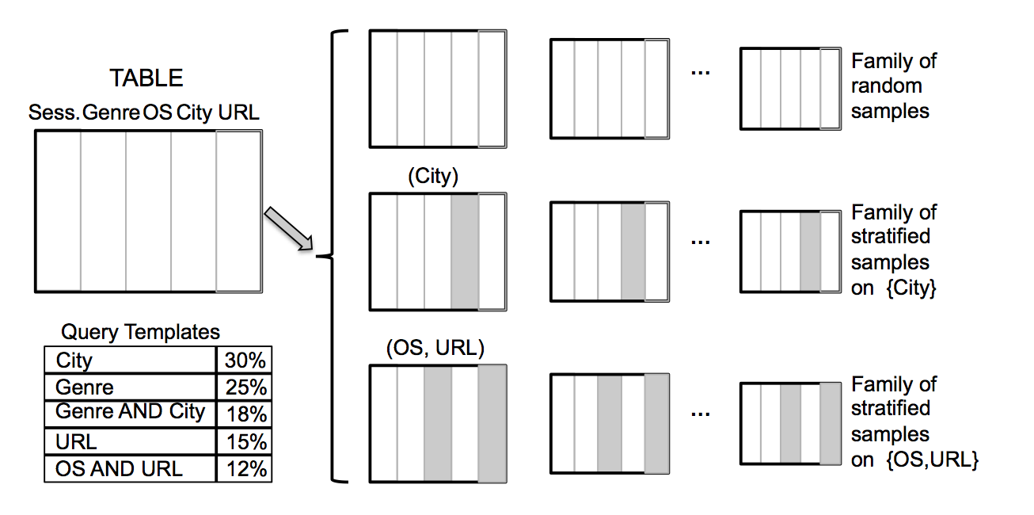
Example

Slide 22
What Samples to Create
Always maintain a uniform sample
For stratified samples, start from past “query templates”
Choose the combinations of columns that are “best” for those templates
  Favor Non-uniform columns
Avoid “over-fitting” the past workload
  Favor sample families useful for answering queries not captured by exiting templates

Slide 23
Experimental Setup
30-day log of media accesses by users from a video analytics company. Raw data 17 TB, partitioned this data across 100 nodes.
Log of 20,000 queries (a sample of 200 queries had 42 templates).

Slide 24
Results

Slide 25
BlinkDB – Summary
A massively parallel DB that supports ad-hoc queries with error and response-time bounds.
An optimal strategy for building & maintaining multi-dimensional, multi-granularity samples
Dynamic Query Cost Estimation and Sample Selection
Next steps:
  Supporting User-Defined Aggregates via general methods (e.g., bootstrap)
  Making optimization robust

Slide 26
Sketching Algorithms
Count distinct: hyperloglog
Heavy hitters (top K): countmin
Quantiles (median): quantile sketch
…
Today : hyperloglog

Slide 27
How many samples on average until there are k trailing zeros?
25 0b110010
10 0b101000
35 0b100011
25 0b110010
23 0b101110
0 0b000000
20 0b101000
24 0b110000
23 0b101110
25 0b110010
6 0b110000
42 0b101010
40 0b101000
38 0b100110
40 0b101000
4 0b100000
8 0b100000
16 0b100000
38 0b100110
8 0b100000
Clicker:
a. k
b. 1
c. 2^{k}
d. k²

Slide 28
How many samples on average until there are k trailing zeros?
25 0b110010
10 0b101000
35 0b100011
25 0b110010
23 0b101110
0 0b000000
20 0b101000
24 0b110000
23 0b101110
25 0b110010
6 0b110000
42 0b101010
40 0b101000
38 0b100110
40 0b101000
4 0b100000
8 0b100000
16 0b100000
38 0b100110
8 0b100000
Clicker:
a. k
b. 1
c. 2^{k}
d. k²

Slide 29
Hyperloglog Algorithm – Approach 0
Given a vector of values, V, compute H(v) for all v in V
  H is a hash function that goes from v to a large random integer
MaxZeros = 0
For each h in H(v):
  Zeros = count the number of leading zeros in h
  MaxZeros = max(Zeros, MaxZeros)
Distinct vals = 2^{MaxZeros}

Slide 30
Discussion
This is an accurate estimator, but it is noisy
We can do better by averaging a bunch of estimators

Slide 31
Hyperloglog Algorithm – Approach 1
Idea: split hash value into m “bucket” bits and 128-m “value” bits; store 2^{m} max’s
Given a vector of values, V, compute H(v) for all v in V
  H is a hash function that goes from v to a large random integer
MaxZeros = [0, 0, ..] // length 2^m
For each h in H(v):
bucket = bits 0 … m-1 of h
value = bits m-1 … 128 of h
    zeros = count the number of leading zeros in h_1
    MaxZeros[bucket] = max(zeros, MaxZeros[bucket])
Distinct vals = avg(2^{MaxZeros[0]}, …, 2^{MaxZeros[2^m]})

Slide 32
Algorithm 1 Discussion
Paper shows that taking the harmonic mean of the estimates, instead of the average, results in a better estimate.
Error is 1.04/sqrt(m), where m is the number of maximums we maintain
Discarding outlier buckets also helps
Also can be updated – i.e., merged with another set of counters to get a new estimate of the cardinality

