Slide 1
Data Layouts
6.S080 Lecture
Sam Madden
10/23/2019

Slide 2
Last Time: Performance
Python vs pandas vs C vs SQL
Quantifying performance: BW, Latency, etc
Finding & fixing performance issues
Indexing & join algorithms

Slide 3
This Time: Data Layouts
Key ideas:
  Data Locality
  Horizontal and Vertical Partitioning
  Multi-dimensional Layouts
  Compression
  Sparse Data
  Log-structured Merge Trees

Slide 4
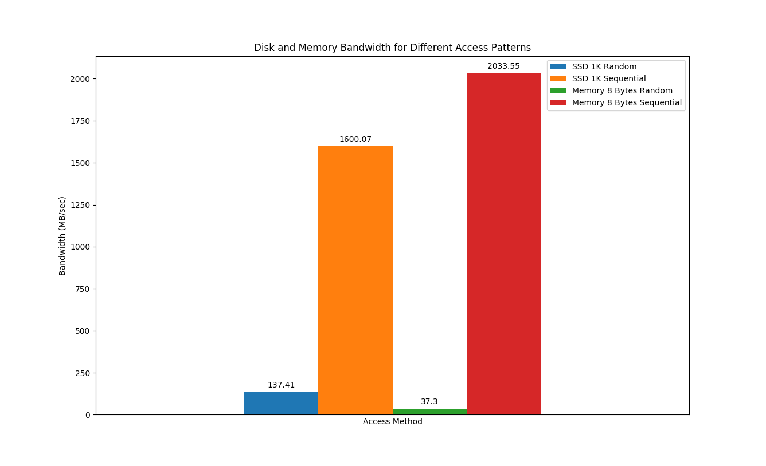
Random vs Sequential Matters

Slide 5
Linearizing a Table – Row store
Memory/Disk (Linear Array)
R1 C1
R1 C2
R1 C3
R1 C4
R1 C5
R1 C6
C1 | C2 | C3 | C4 | C5 | C6
R2 C1
R2 C2
R2 C3
R2 C4
R2 C5
R2 C6
R3 C1
R3 C2
R3 C3
R3 C4
R3 C5
R3 C6
R4 C1
R4 C2
R4 C3
R4 C4
R4 C5
R4 C6

Slide 6
Linearizing a Table –
Vertical Partitioning – aka ”Column Store”
Memory/Disk (Linear Array)
R1 C1
R2 C1
R3 C1
R4 C1
R5 C1
R6 C1
C1 | C2 | C3 | C4 | C5 | C6
R1 C2
R2 C2
R3 C2
R4 C2
R5 C2
R6 C2
R1 C3
R2 C3
R3 C3
R4 C3
R5 C3
R6 C3
R1 C4
R2 C4
R3 C4
R4 C4
R5 C4
R6 C4

Slide 7

Query Processing Example
SELECT avg(price)
FROM tickstore
WHERE symbol = ‘GM’
AND date = ‘1/17/2007’
Traditional Row Store
AVG
price
Complete tuples
SELECT
date=’1/17/07’
Complete tuples
SELECT
sym = ‘GM’
Complete tuples
Disk
GM | 30.77 | 1,000 | NYSE | 1/17/2007
GM | 30.77 | 10,000 | NYSE | 1/17/2007
GM | 30.78 | 12,500 | NYSE | 1/17/2007
AAPL | 93.24 | 9,000 | NQDS | 1/17/2007
Notes:
Disco picture/hippie joke

Slide 8

Query Processing Example
Basic Column Store
“Early Materialization”
SELECT avg(price)
FROM tickstore
WHERE symbol = ‘GM’
AND date = ‘1/17/2007’
Complete tuples
AVG
price
Complete tuples
Row-oriented plan
SELECT
date=’1/17/07’
Complete tuples
Construct Tuples
SELECT
sym = ‘GM’
GM | 30.77 | 1/17/07
Disk
GM
GM
GM
AAPL
30.77
30.77
30.78
93.24
1,000
10,000
12,500
9,000
1/17/2007
1/17/2007
1/17/2007
1/17/2007
Fields from same tuple at same index (position) in each column file
NYSE
NYSE
NYSE
NQDS

Slide 9
Query Processing Example
AVG
Much less data flowing through memory
C-Store
  “Late Materialization”
Prices
Position Lookup
Position Bitmap
(1,1,1,0)
AND
Position Bitmap
(1,1,1,0)
Position Bitmap
(1,1,1,1)
Pos.SELECT
sym = ‘GM’
Pos.SELECT
date=’1/17/07’
Disk
GM
GM
GM
AAPL
30.77
30.77
30.78
93.24
1,000
10,000
12,500
9,000
NYSE
NYSE
NYSE
NQDS
1/17/2007
1/17/2007
1/17/2007
1/17/2007
See Abadi et al
ICDE 07
Notes:
Reread IQ papers on bitmap indexes and index ANDing

Slide 10
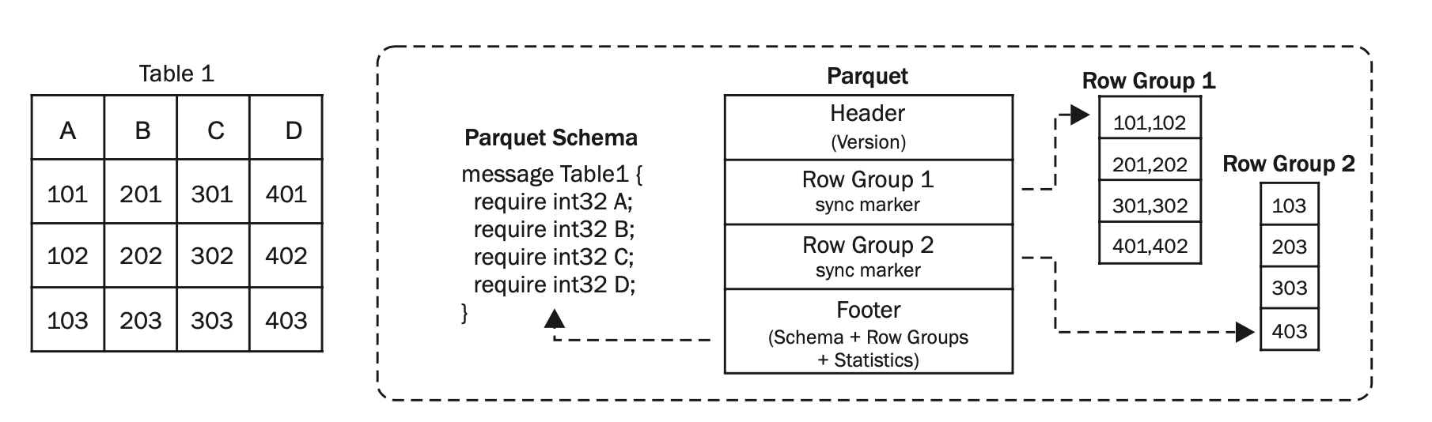
Parquet Layout
From “A Cost-based Storage Format Selector for Materialization in Big Data Frameworks”, Faisal et al

Slide 11
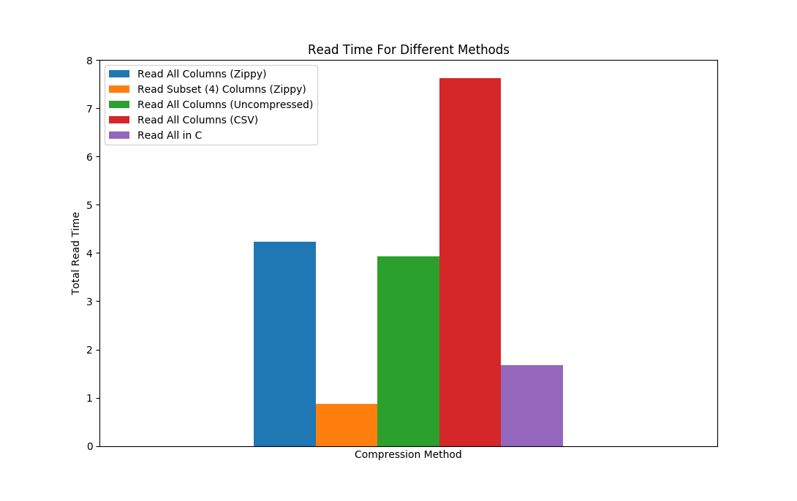
Parquet vs CSV Load Times

Slide 12
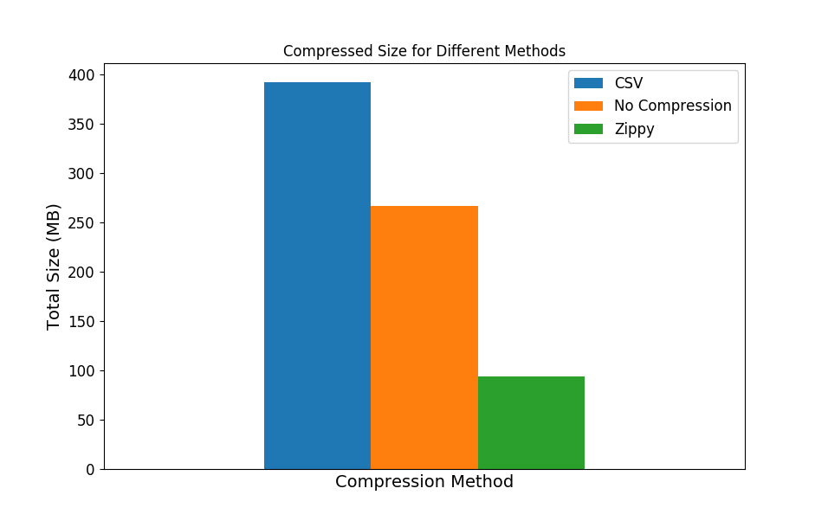
Parquet vs CSV File Sizes

Slide 13
Horizontal Partitioning
Date | Region | Profit
1/1/2019 | NE
Slice dataset according to some attribute
Date | Region | Profit
1/2/2019 | NE
1/2/2019 | SW
1/2/2019 | SE
1/2/2019 | NW
Date | Region | Profit
1/1/2019 | NE
1/2/2019 | NE
1/2/2019 | SW
1/2/2019 | SE
1/2/2019 | NW
1/3/2019 | NE
1/3/2019 | SW
1/3/2019 | SE
1/4/2019 | SE
1/4/2019 | NW
1/4/2019 | NE
Date | Region | Profit
1/3/2019 | NE
1/3/2019 | SW
1/3/2019 | SE
Date | Region | Profit
1/4/2019 | SE
1/4/2019 | NW
1/4/2019 | NE

Slide 14
Sorting
Can also order data according to some attribute
Date | Region | Profit
1/1/2019 | NE
1/2/2019 | NE
1/2/2019 | SW
1/2/2019 | SE
1/2/2019 | NW
1/3/2019 | NE
1/3/2019 | SW
1/3/2019 | SE
1/4/2019 | SE
1/4/2019 | NW
1/4/2019 | NE
Date | Region | Profit
1/1/19 | NE
1/2/19 | NE
1/3/19 | NE
1/4/19 | NE
1/2/19 | NW
1/4/19 | NW
1/2/19 | SE
1/3/19 | SE
1/4/19 | SE
1/2/19 | SW
1/3/19 | SW

Slide 15
Can both sort & partition
Date | Region | Profit
1/1/2019 | NE
Date | Region | Profit
1/2/2019 | NE
1/2/2019 | NW
1/2/2019 | SE
1/2/2019 | SW
E.g., partition on date, sort by region in each partition
  Or vice versa
Best choice depends on how we plan to access data, and on how much scanning we can avoid
  If new data is arriving in some order (e.g., time) easy to write partitions in that order
Date | Region | Profit
1/3/2019 | NE
1/3/2019 | SE
1/3/2019 | SW
Date | Region | Profit
1/4/2019 | NE
1/4/2019 | NW
1/4/2019 | SW

Slide 16
Quad-Tree
y
x

Slide 17
Quad-Tree
Recursively subdivide
y
x

Slide 18
Quad-Tree
Index stores boundaries of rectangles, and pointers on disk
Until partitions are of some maximum size
.25
.5
A
B
.25
E
X1 | X2 | Y1 | Y2 | Part
0 | .25 | 0 | .25 | A
0 | .25 | .25 | .5 | C
.25 | .5 | 0 | .25 | B
.25 | .25 | .25 | .5 | D
.5 | 1 | 0 | .5 | E
0 | .5 | .5 | 1 | F
…
y
C
D
.5
.5
G
H
F
.75
I
J
x
.75

Slide 19
ZOrder
X
Y

Slide 20
ZOrder
X
Page of Records
Y

Slide 21
ZOrder
X
Page of Records
Y
Where X = 2 or Z = 2
Read 7 Pages
14 False Positive Records

Slide 22
Vs Row
Order
X
Page of Records
Y
Where X = 2 or Z = 2
Read 9 Pages
21 False Positive Records

Slide 23
Compression Methods
Entropy coding, e.g., gzip
  General purpose, good overall compression
Delta encoding
  Encode differences, e.g., 1, 2, 3, 4 -> 1, +1, +1, +1
Run length encoding
  Suppress duplicates, e.g., 2, 2, 2, 3, 4, 4, 4, 4, 4, -> 2x3, 3x1, 4x5
Bit packing
  Use fewer bits for short integers
  Pairs well with delta coding
Some compression can be directly operated on, e.g., RLE
As with sorting, modifying compressed data in place is difficult

Slide 24
Source “Efficient Data Storage for Analytics with Apache Parquet 2.0”, Julian Le Dem

Slide 25
Source “Efficient Data Storage for Analytics with Apache Parquet 2.0”, Julian Le Dem

Slide 26
Source “Efficient Data Storage for Analytics with Apache Parquet 2.0”, Julian Le Dem

Slide 27
Source “Efficient Data Storage for Analytics with Apache Parquet 2.0”, Julian Le Dem

Slide 28
Source “Efficient Data Storage for Analytics with Apache Parquet 2.0”, Julian Le Dem

Slide 29
Compression, Con’t: Dictionary Encoding
Column
Red
Purple
Turquoise
Red
Red
Turquoise
Purple
Encoded Column
1
2
3
1
1
3
2
Dictionary encoding replaces long, frequent values (e.g., strings) with an integer value stored in a dictionary
Entropy coding methods use this internally but often helpful to do this explicitly
Helpful to reduce data sizes, also increases access efficiency because it eliminates variable size data
Dictionary
Val | Decoding
1 | Red
2 | Purple
3 | Turquoise

Slide 30
Compression, Con’t: Sparse Data
Table with a lot of NULLs ({})
Arises frequently in ML apps
A | B | C | D | E | F
X | {} | {} | {} | {} | Z
{} | {} | {} | {} | {} | Y
{} | {} | {} | {} | {} | U
{} | {} | {} | K | {} | {}
{} | {} | {} | {} | {} | {}
If we represent NULLs as a value (e.g., -999999), will waste a lot of space
Idea, if > x% of data is NULL, store data as a list of non-null tuples, e.g.:
1A: X, 1F: Z, 2F: Y, 3F:U, 4D: K
Need to store row/column identifiers explicitly, but can be much more compact
1
2
3
4
5

Slide 31
Handling New Data
In most data science applications, we don’t update existing data
Do need need to deal with new data that is arriving
If we have a complex data layout, e.g., sorted, partitioned, columns, inserting that data will be slow, because we’ll have to rewrite all data
Idea: just create a new partition for new data, and write your program to merge results from all partitions

Slide 32
Problem: Lots of Partitions
Performance will degrade as you get many partitions
Idea: merge some partitions together, but how?
Log structured merge tree: arrange so partitions merge a logarithmic number of times
P1
P2
P3

Slide 33
Problem: Lots of Partitions
Performance will degrade as you get many partitions
Idea: merge some partitions together, but how?
Log structured merge tree: arrange so partitions merge a logarithmic number of times
P1-2
P3
P4
P5

Slide 34
Problem: Lots of Partitions
Performance will degrade as you get many partitions
Idea: merge some partitions together, but how?
Log structured merge tree: arrange so partitions merge a logarithmic number of times
P1-2
P3-4
P5
P6
P7

Slide 35
Problem: Lots of Partitions
Performance will degrade as you get many partitions
Idea: merge some partitions together, but how?
Log structured merge tree: arrange so partitions merge a logarithmic number of times
P1-2
P3-4
P5-6
P7

Slide 36
Problem: Lots of Partitions
Performance will degrade as you get many partitions
Idea: merge some partitions together, but how?
Log structured merge tree: arrange so partitions merge a logarithmic number of times
P1-4
P5-6
P7
P1 has merged 2 times, but won’t merge again until after 8 more partitions arrive

Slide 37
Log Structure Merge Tree
Exponentially Larger & Less Frequent Merges
1-4
1-2
3-4
5-6
7-8
P1
P2
P3
P4
P5
P6
P7
P8

Slide 38
Summary

