Slide 1
Scaling Beyond Python
Sam Madden
madden@csail.mit.edu

Slide 2
Overview
High level tools like Python are fine for many problems but may be too slow, especially as you scale up problem size
Typically requires optimization and redesign
Some strategies
  Buy more hardware
  Use a different runtime
  Improve implementation
Today we will focus on some simple data-oriented improvements; parallelism and algorithmic tricks in later lectures

Slide 3
Performance metrics
Client
Server
…
Client
Performance metrics:
  Throughput: request/time for many requests
  Latency: time / request for single request
Latency = 1/throughput?
  Often not; e.g., server may have two CPUs

Slide 4
Heavily-loaded systems
Latency
Throughput
bottleneck
users
users
Once system busy, requests queue up

Slide 5
Approaches to finding bottleneck
300 MB file
df = pd.read_csv(PATH, delimiter='|’,
header=None, names=header)
print df[df['NAME'].str.contains("MADDEN”)
Measure utilization of each resource
  CPU is 100% busy, disk is 20% busy
  CPU is 50% busy, disk is 50% busy, alternating
Model performance of your approach
  What performance do you expect?
Guess, check, and iterate
  Don’t prematurely optimize

Slide 6
Some Tools
print statements / timing
top / system profilers
code profilers

Slide 7
Python code profile
python –m cProfile script.py
snakeviz script.py

Slide 8
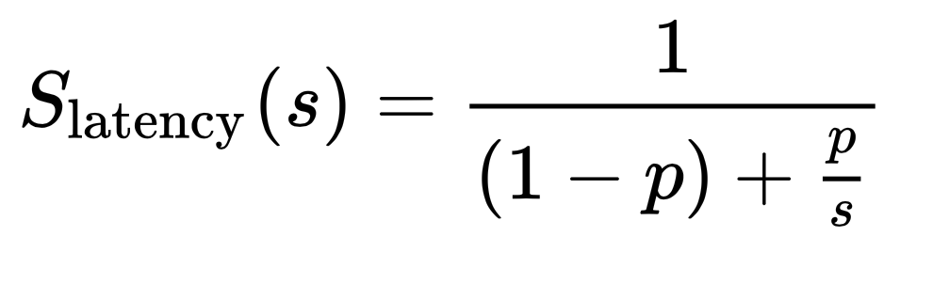
What Improvement Can We Expect
Always keep Amdahl’s law in mind
S_{latency} is the over all speedup in all stages of a task
s is the speedup on a stage of the task that we optimize
p is the original proportion of the stage that was optimized

Slide 9
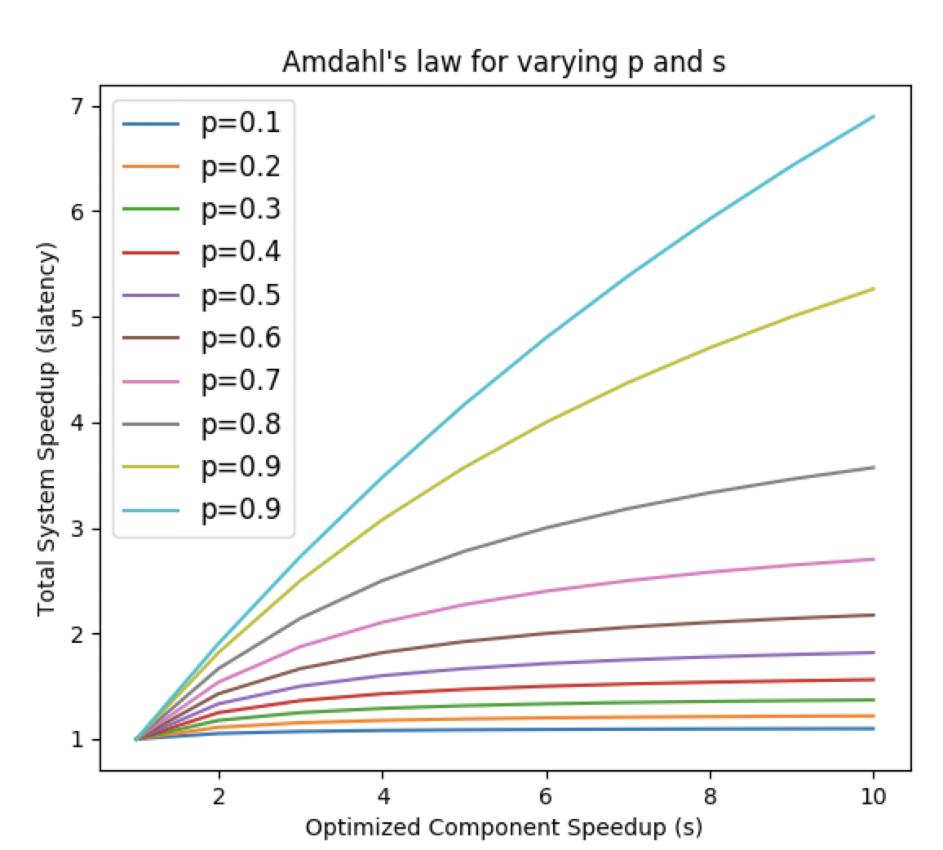

Slide 10
Disk Primer
Two main types of disks; hard disks(HDD) and solid state disks (SSD)
Hard disks are rotating platters; cheaper and slower
Both are block oriented, i.e., they allow reading or writing of blocks (usually a few KB)
Unlike RAM, which is byte oriented

Slide 11
Solid State Disk (SSD)
Faster storage technology than disk
  Flash memory that exports disk interface
  No moving parts
Modern Apple 2TB SSD
  Sequential read: 2.5 GB/sec
  Sequential write: 250 MB/sec
  Random 4KB read: 100K+/s (>400 GB/s)
    See next slides
  Random 4KB write: 10K+/s (>40 MB/s)

Slide 12
SSD Random Reads
2014 Numbers
https://www.anandtech.com/show/8104/intel-ssd-dc-p3700-review-the-pcie-ssd-transition-begins-with-nvme/3

Slide 13
SSD Random Writes

Slide 14
SSDs and writes
Writes performance is slower:
  Flash can erase only large units (e.g, 512 KB)
Writing a small block:
  Read 512 KB
  Update 4KB of 512 KB
  Write 512 KB
Controllers try to avoid this using logging

Slide 15
SSD versus HDD
HDD: ~$100 for 4 TB
  $0.025 per GB
SSD: ~$200 for 2 TB
  $1.00 per TB
  HDD increasingly less common
Many performance issues still the same:
  Both SSD and Disks much slower than RAM
  Avoid random small writes using batching

Slide 16
SSD (Flash) vs Disk
 | 1TB Flash (Samsung 840 EVO) | 3TB Disk
Sequential Read | 540 MB/sec | ~100 MB/sec
Sequential Write | 540 MB/sec | ~100 MB/sec
Random Reads / Sec | 98,000 | ~100
Random Writes / Sec | 90,000 | ~100
Price | ~$600 | ~$100

Slide 17
Important numbers
Latency:
  0.000001 ms: instruction time (1 ns)
  0.0001 ms: DRAM load (100 ns)
  0.1 ms: LAN network packets (100 usec)
  0.2 ms: SSD random I/O (variable)
  10 ms: random HDD I/O
  25 ms: Internet east -> west coast
Throughput:
  10,000 MB/s: DRAM
  4,000 MB/s: sequential SSD
  1,000 Mbits/s: Gbit LAN (or ~100 MB/s)
  500 MB/s: sequential HDD, or random SSD
  1 MB/s: random disk I/O

Slide 18
Fixing a bottleneck
Get better hardware
Use better execution environment
Find better algorithm
Write better implementation; strategies
  Indexing
  Predicate push down
  Early projection
  Caching
  Efficient joins
  Partitioning & parallelism -- not today

Slide 19
Incommensurate Scaling: Latency improves slowly
Moore’s law (~70% per year)
Improvement wrt year #1
Speed of light
(0% per year)
DRAM access latency
(~7% per year)
Year #

Slide 20
Clicker Question
Which do you think is going to result in best performance:
rewrite to use lower level python instead of pandas, e.g., loops w/ readlines
rewrite in C
rewrite to use a relational database
none of these, pandas is best

Slide 21
Why is Python So Slow
Virtual machine (VM) implementation is a loop that reads an instruction, and jumps to the code to execute the instruction
On modern CPUs this is very inefficient, because it results in many branch misses and poor processor cache locality

Slide 22
Trigrams
1 23456
MADDEN -> MAD, ADD, DDE, DEN …
Index:
Trigram | Start Offset
ADD | 2, …
DDE | 3, …
DEN | 4, …
MAD | 1, …
…
Sorted List
Lookup: MAD -> 1, DEN -> 4
These are consecutive, so found a match

Slide 23
Tree Index
A .. C | D … G | G .. P | P ... Z

Slide 24
Tree Index
A .. C | D … G | G .. P | P ... Z
AA..BCD | BCF..BZ | CAA..CF | CF…CZ
…
ADD: {2, …}

Slide 25
Tree Index
A .. C | D … G | G .. P | P ... Z
AA..BCD | BCF..BZ | CAA..CF | CF…CZ
…
…
…
ADD: {2, …}
DDE: {3, ...}
{MAD: 1, …}
DEN: {4, …}
What are advantages of tree organization over sorted list?

Slide 26
Caching often cannot help writes
Writes often must to go disk for durability
  After power failure, new data must be available
Result: disk performance dominates write-intensive workloads
Worst case: many random small writes
  Mail server storing each message in a separate file
Logging can help
  Writing data to sequential log (see later in semester)

Slide 27
I/O concurrency motivation
Simple server alternates between waiting for disk and computing:
CPU: --- A --- --- B ---
Disk: --- A --- --- B ---

Slide 28
Use several threads to overlap I/O
Thread 1 works on A and Thread 2 works on B, keeping both CPU and disk busy:
CPU: --- A --- --- B --- --- C --- ….
Disk: --- A --- --- B --- …
Other benefit: fast requests can get ahead of slow requests
Downside: need locks, etc.!

Slide 29
Scheduling
Suppose many threads issuing disk requests:
71, 10, 92, 45, 29
Naïve algorithm: random reads (8-15ms seek)
Better: Shortest-seek first (1 ms seek):
  10, 29, 45, 71, 92
  High load -> smaller seeks -> higher throughput
  Downside: unfair, risk of starvation
Elevator algorithm avoids starvation

Slide 30
Parallel hardware
Use several disks to increase performance:
  Many small requests: group files on disks
    Minimizes seeks
  Many large requests: strip files across disks
    Increase throughout
Use many computers:
  Balance work across computers?
  What if one computer fails?
  How to program? MapReduce?

Slide 31
Summary
Python is often slow
Identifying performance bottlenecks is an art
  Figure out if you have an I/O or CPU problem
  Estimate expected performance
  Remember Amdahl’s law!
Rewriting in low level languages can help
Using more efficient data accesses can help

