Slide 1
Visualization
Emanuel Zgraggen
Many slides borrowed from Drucker, Agrawala, Heer, Stasko, etc. References at the end.

Slide 2
How much data is produced every day?
2.5 exabytes
530,000,000 songs
150,000,000 iPhones
5,000,000 Laptops
250,000 Libraries
90 Years of HD video
[http://www.northeastern.edu/levelblog/2016/05/13/how-much-data-produced-every-day/]

Slide 3
How do we make sense of all this data?
How do we use data in decision-making processes?
How do we avoid being overwhelmed?

Slide 4
Challenge
Transform the data into understanding and insight thus making it useful to people

Slide 5


Slide 6
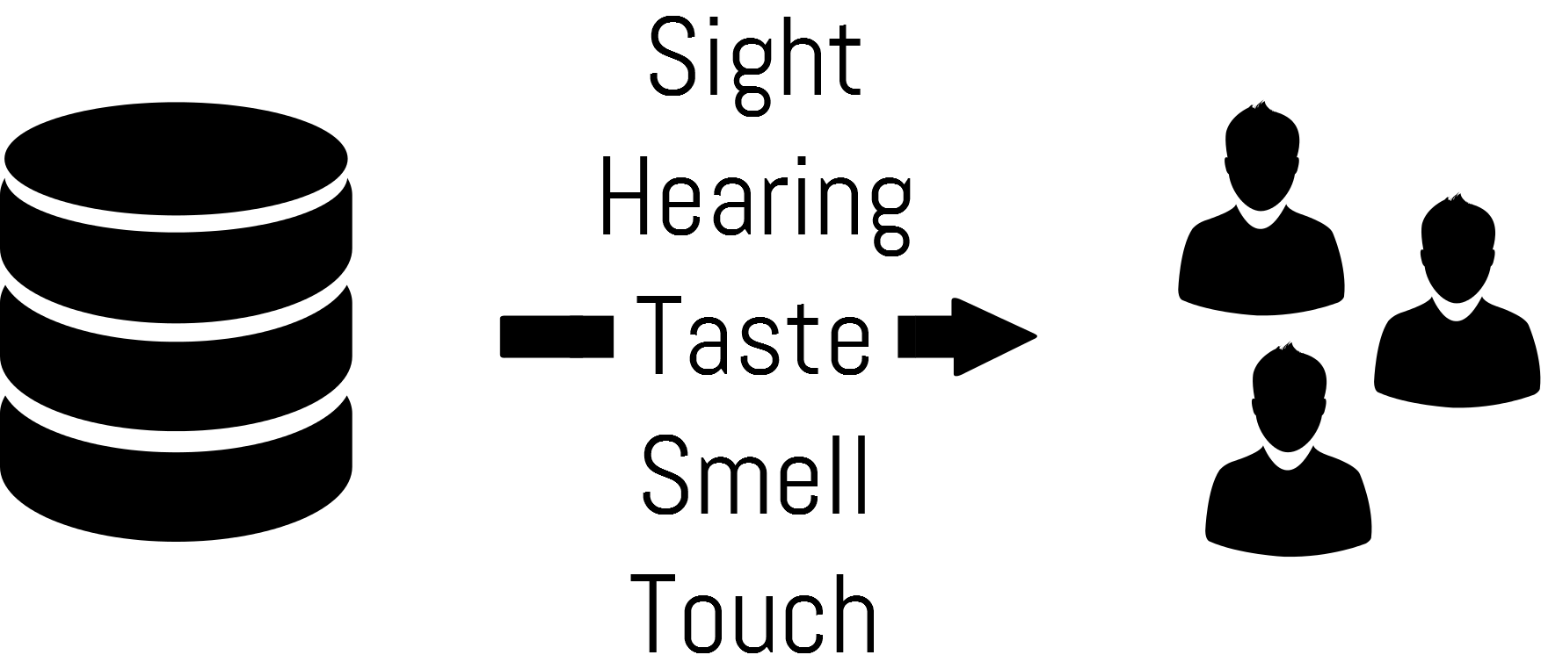

Slide 7
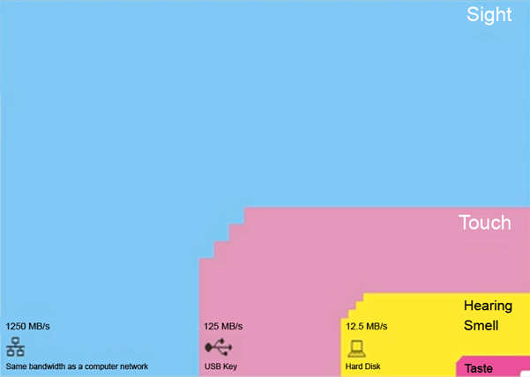
[Tor Nørretranders]
Notes:
Small white box in the corner which is 0.7% is what we are aware of when all this processing is happening

Slide 9
Human Vision
Highest bandwidth sense
Fast, parallel
Pattern recognition
Pre-attentive
Extends memory and cognitive capacity
People think visually

Slide 10
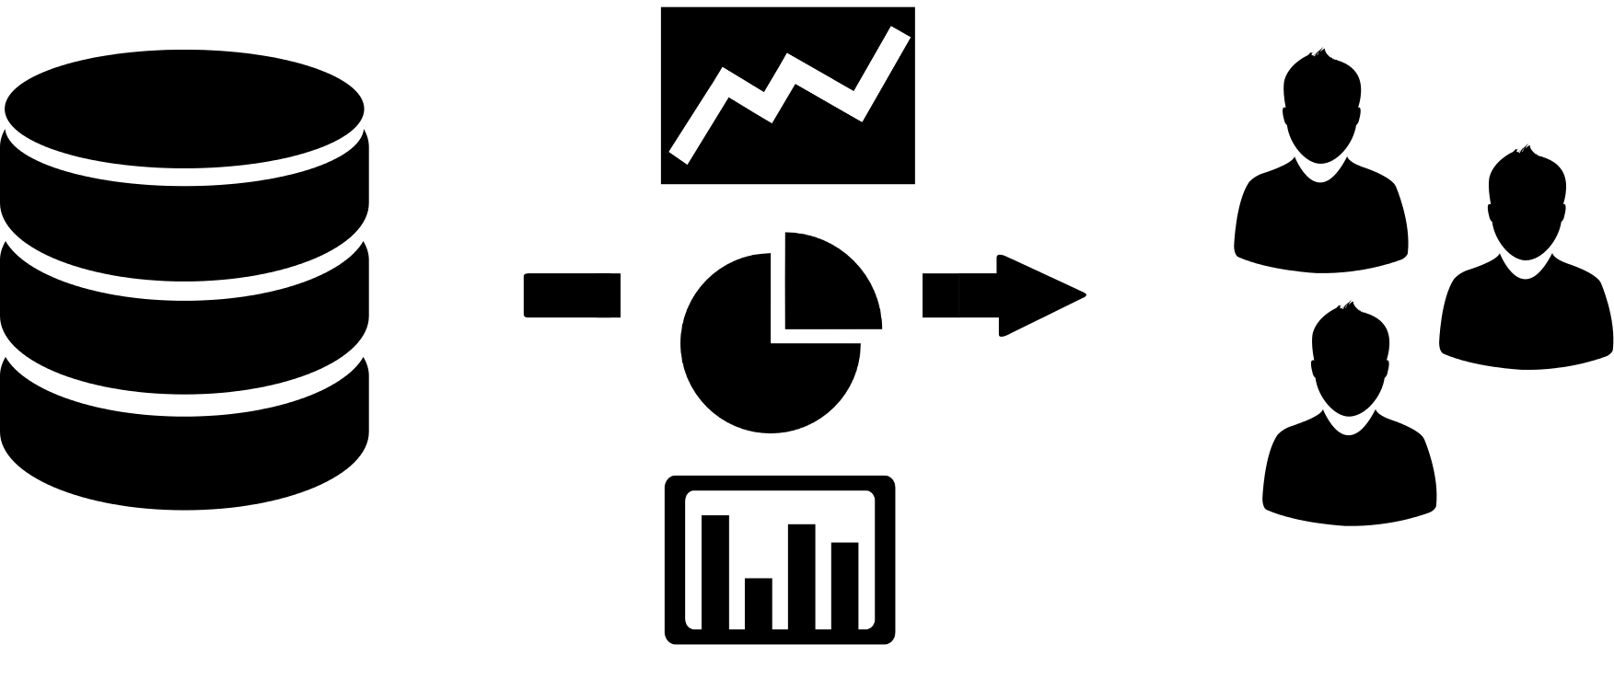
Notes:
Encode data visually so that it takes advantage of the human visual system

Slide 11
What is a Visualization?
“The use of computer-generated, interactive, visual representations of data to amplify cognition.”
[Card, Mackinlay, & Shneiderman 1999]
“Transformation of the symbolic into the geometric.”
[McCormick et al. 1987]
“... finding the artificial memory that best supports our
natural means of perception.”
[Bertin 1967]

Slide 12
Why create visualizations?
Notes:
Why not just use text

Slide 13
I |  |  | II |  |  | III |  |  | IV
x | y |  | x | y |  | x | y |  | x | y
10 | 8.04 |  | 10 | 9.14 |  | 10 | 7.46 |  | 8 | 6.58
8 | 6.95 |  | 8 | 8.14 |  | 8 | 6.77 |  | 8 | 5.76
13 | 7.58 |  | 13 | 8.74 |  | 13 | 12.74 |  | 8 | 7.71
9 | 8.81 |  | 9 | 8.77 |  | 9 | 7.11 |  | 8 | 8.84
11 | 8.33 |  | 11 | 9.26 |  | 11 | 7.81 |  | 8 | 8.47
14 | 9.96 |  | 14 | 8.1 |  | 14 | 8.84 |  | 8 | 7.04
6 | 7.24 |  | 6 | 6.13 |  | 6 | 6.08 |  | 8 | 5.25
4 | 4.26 |  | 4 | 3.1 |  | 4 | 5.39 |  | 19 | 12.5
12 | 10.84 |  | 12 | 9.13 |  | 12 | 8.15 |  | 8 | 5.56
7 | 4.82 |  | 7 | 7.26 |  | 7 | 6.42 |  | 8 | 7.91
5 | 5.68 |  | 5 | 4.74 |  | 5 | 5.73 |  | 8 | 6.89
[Anscombe’s Quartet]

Slide 14
Mean of x in each case | 9
Mean of y in each case | 7.50
Sample variance of x in each case | 11
Sample variance of y in each case | 4.122 or 4.127
Correlation between x and y in each case | 0.816
Linear regression line in each case | y = 3.00 + 0.500x
[Anscombe’s Quartet]

Slide 15
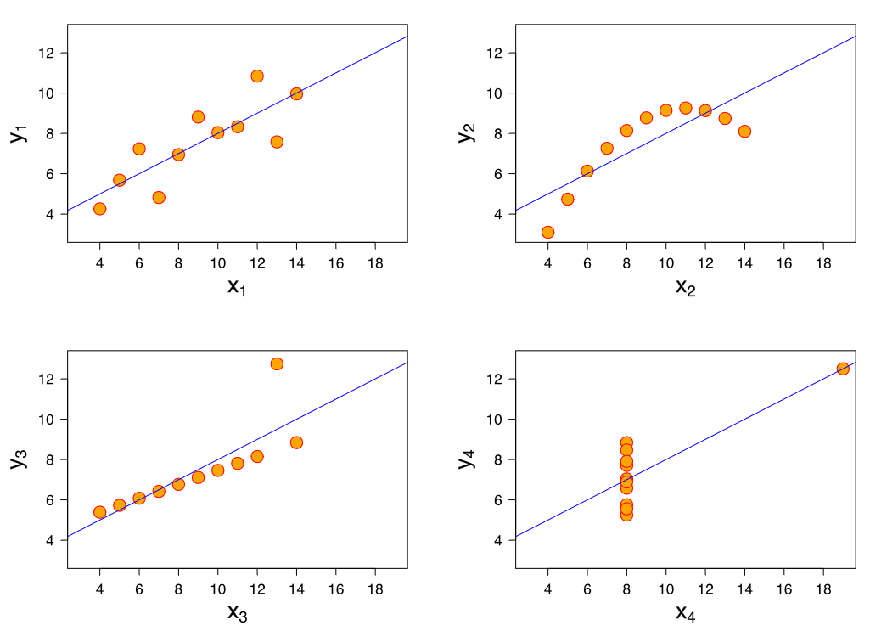
Find patterns
[Anscombe’s Quartet]
Notes:
The quartet is still often used to illustrate the importance of looking at a set of data graphically before starting to analyze according to a particular type of relationship, and the inadequacy of basic statistic properties for describing realistic datasets

Slide 16
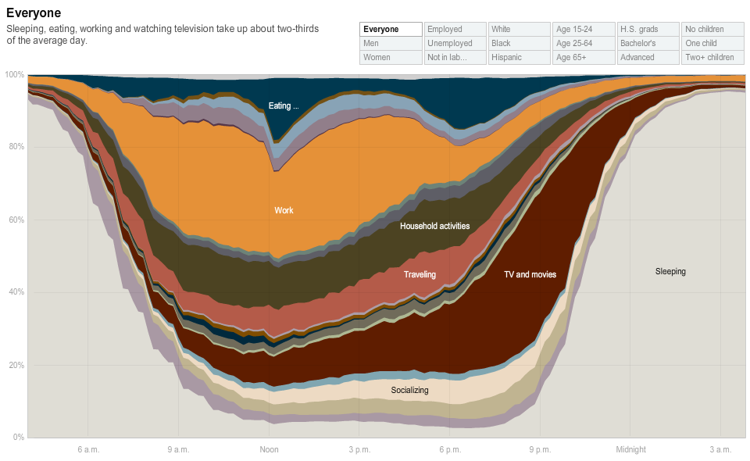
Answer a question
[New York Times]

Slide 17
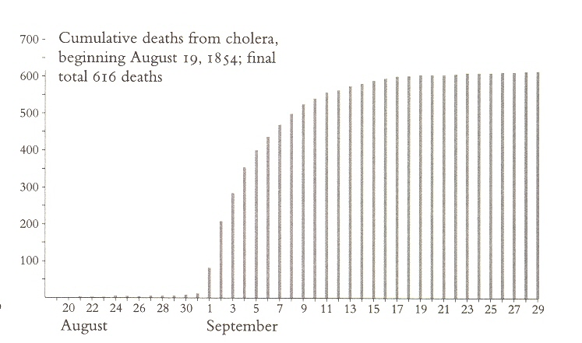
Notes:
Cholera Epidemic in London, 1854
Original data was victim’s names, ordered by date of death.
Dr. John Snow
Snow had theory about cause of cholera, collected data to support his theory.

Slide 18
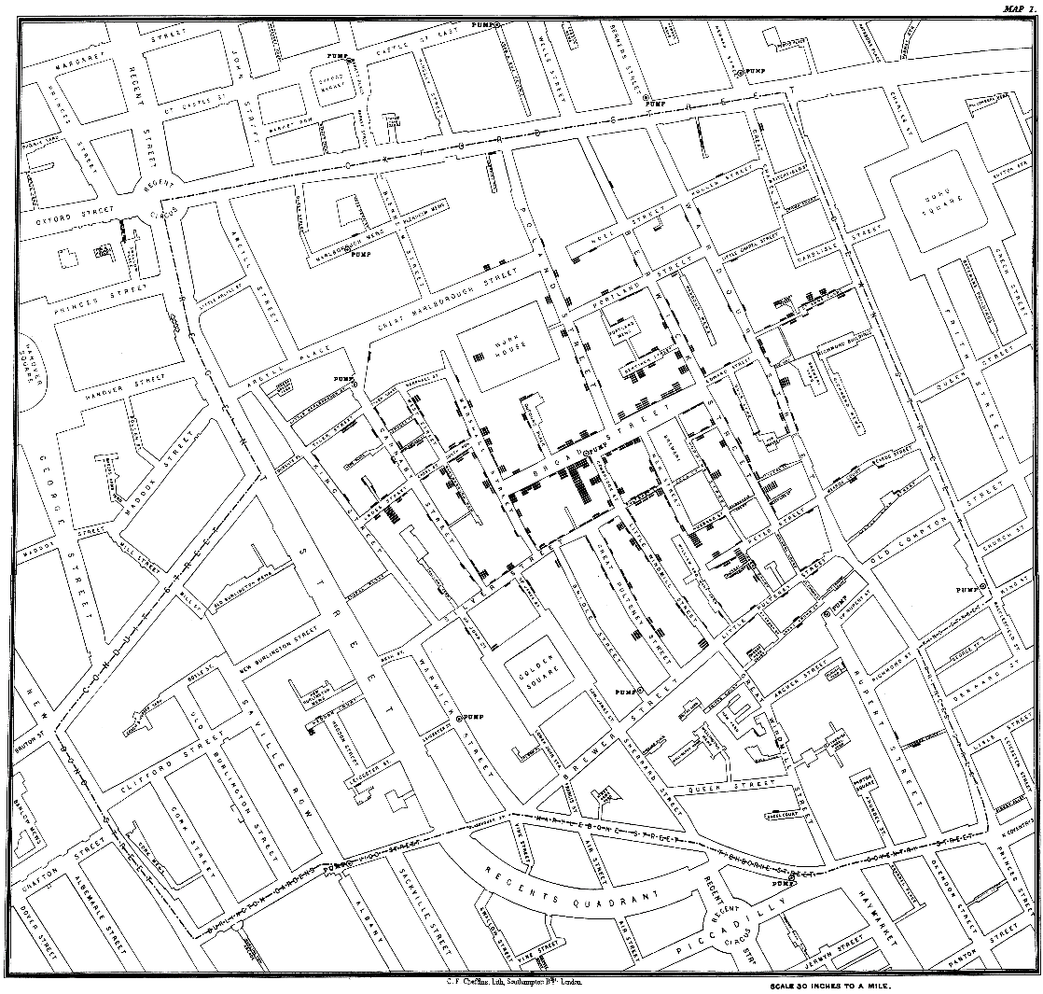
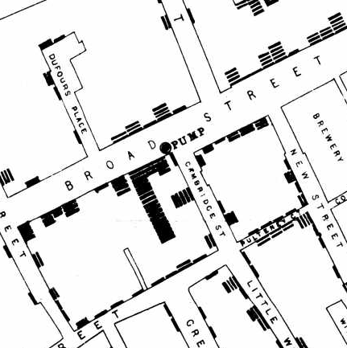
See data in context
Notes:
http://www.udel.edu/johnmack/frec682/cholera/
Dr. John Snow

Slide 19
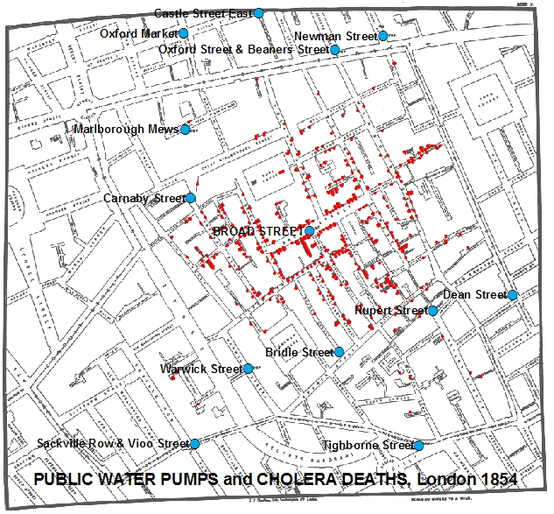
See data in context
[http://www.udel.edu/johnmack/frec682/cholera/]

Slide 20
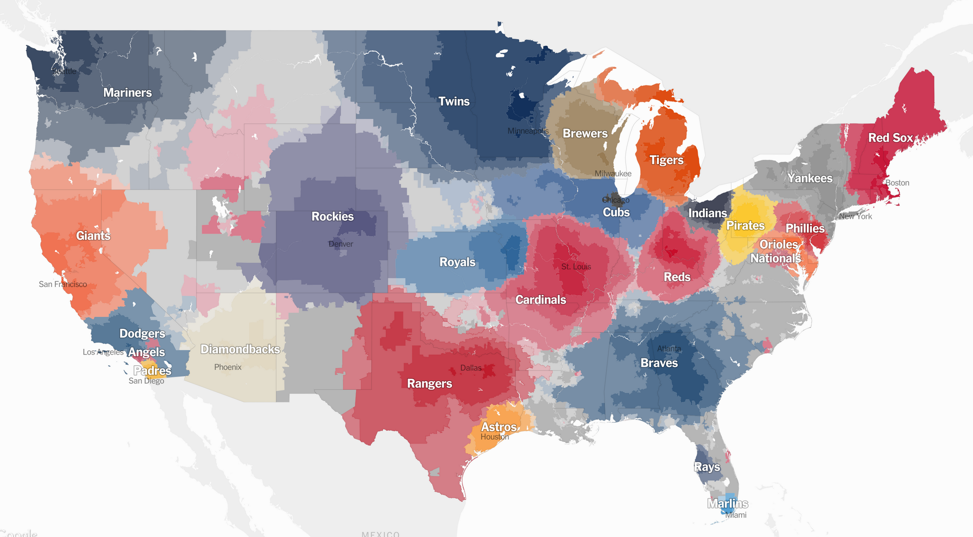
See data in context
[New York Times]

Slide 21
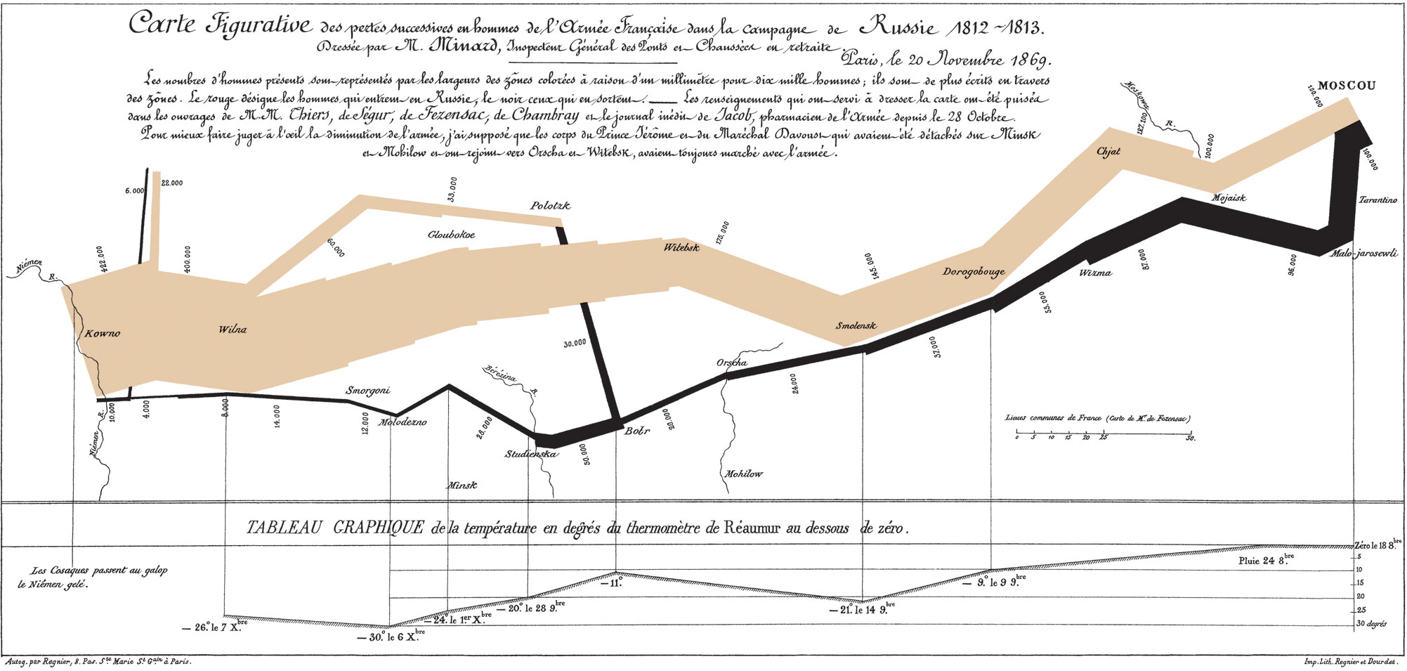
Tell a story
[Minard 1869, Tufte]
Notes:
Edward Tufte, Professor at Yale. He wrote lots of book on information design and visualizations.
He has been called “The da Vinci of data,” “Chart Master,” and “The Data Artist.”
Edward Tufte, in his praise of Minard's map, identified six separate variables that were captured within it.
First, the line width continuously marked the size of the army.
Second and third, the line itself showed the latitude and longitude of the army as it moved.
Fourth, the lines themselves showed the direction that the army was traveling, both in advance and retreat.
Fifth, the location of the army with respect to certain dates was marked.
Finally, the temperature along the path of retreat was displayed.
Few, if any, maps before or since have been able to coherently and so compellingly weave so many variables into a captivating whole.

Slide 22
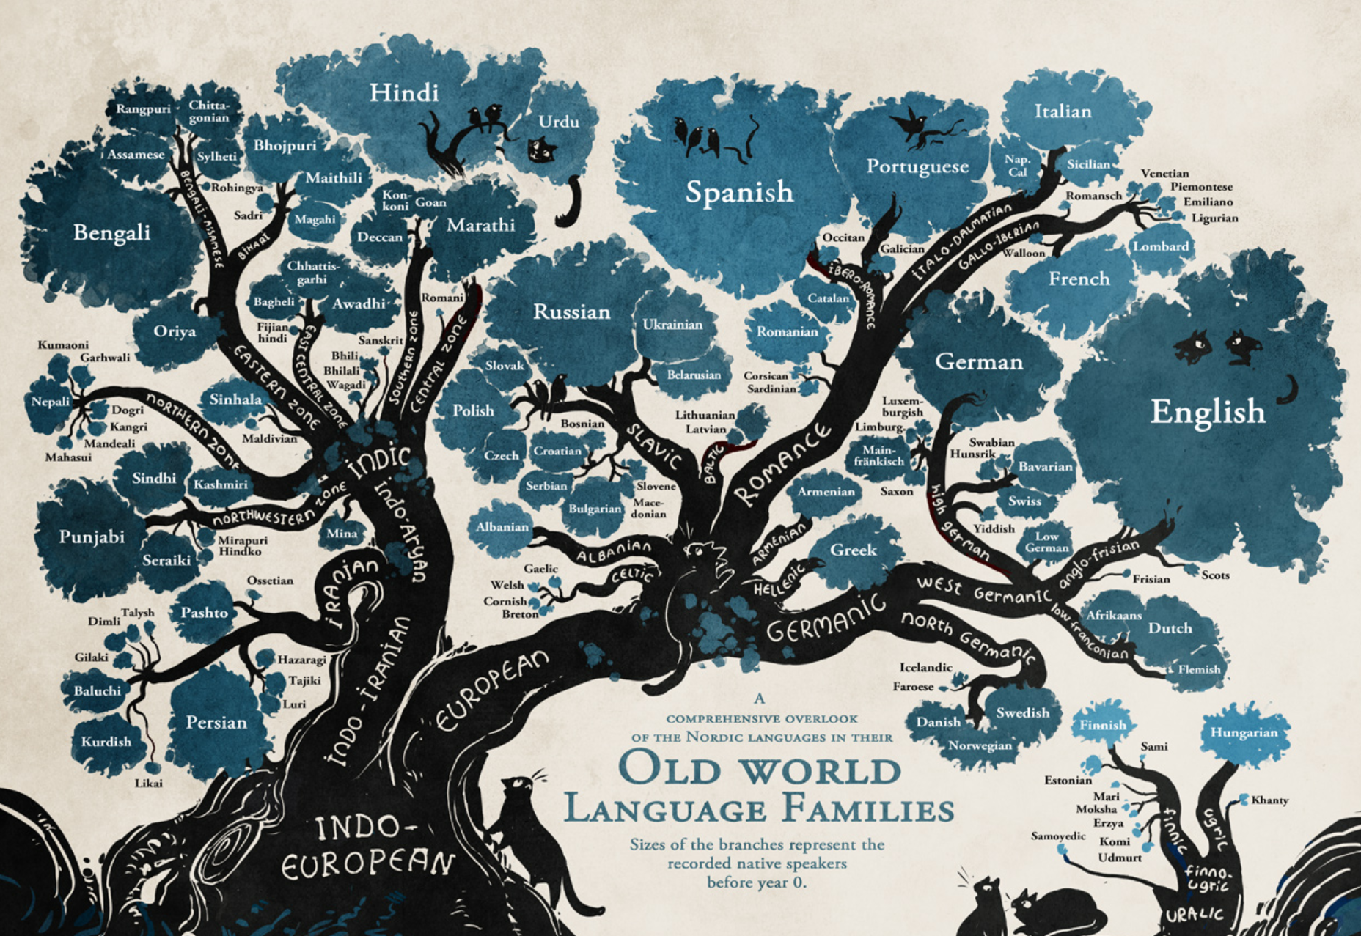
Tell a story
[Minna Sundberg]

Slide 23
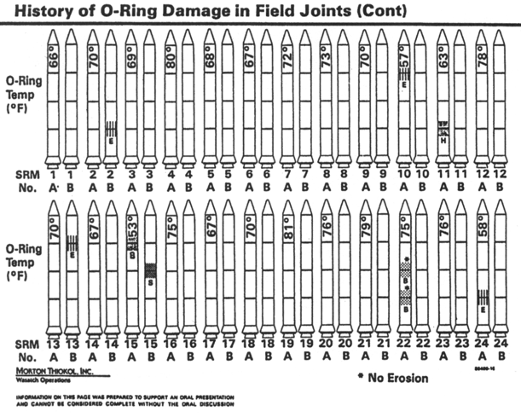
Notes:
https://alumni.stanford.edu/get/page/magazine/article/?article_id=32181
O-Ring, rubber ring that is used to seal off joints.
They loose flexibility when they are cold.
Before the 1986 Challenger launch, NASA engineers had collected data indicating that rubber O-rings failed to seal correctly in cold weather. But Tufte says the charts that made their way up NASA’s chain of command failed to convey fully the dangers of a frigid-morning liftoff. The typography was sloppy. Cutesy icons of rockets obscured key numbers.

Slide 24
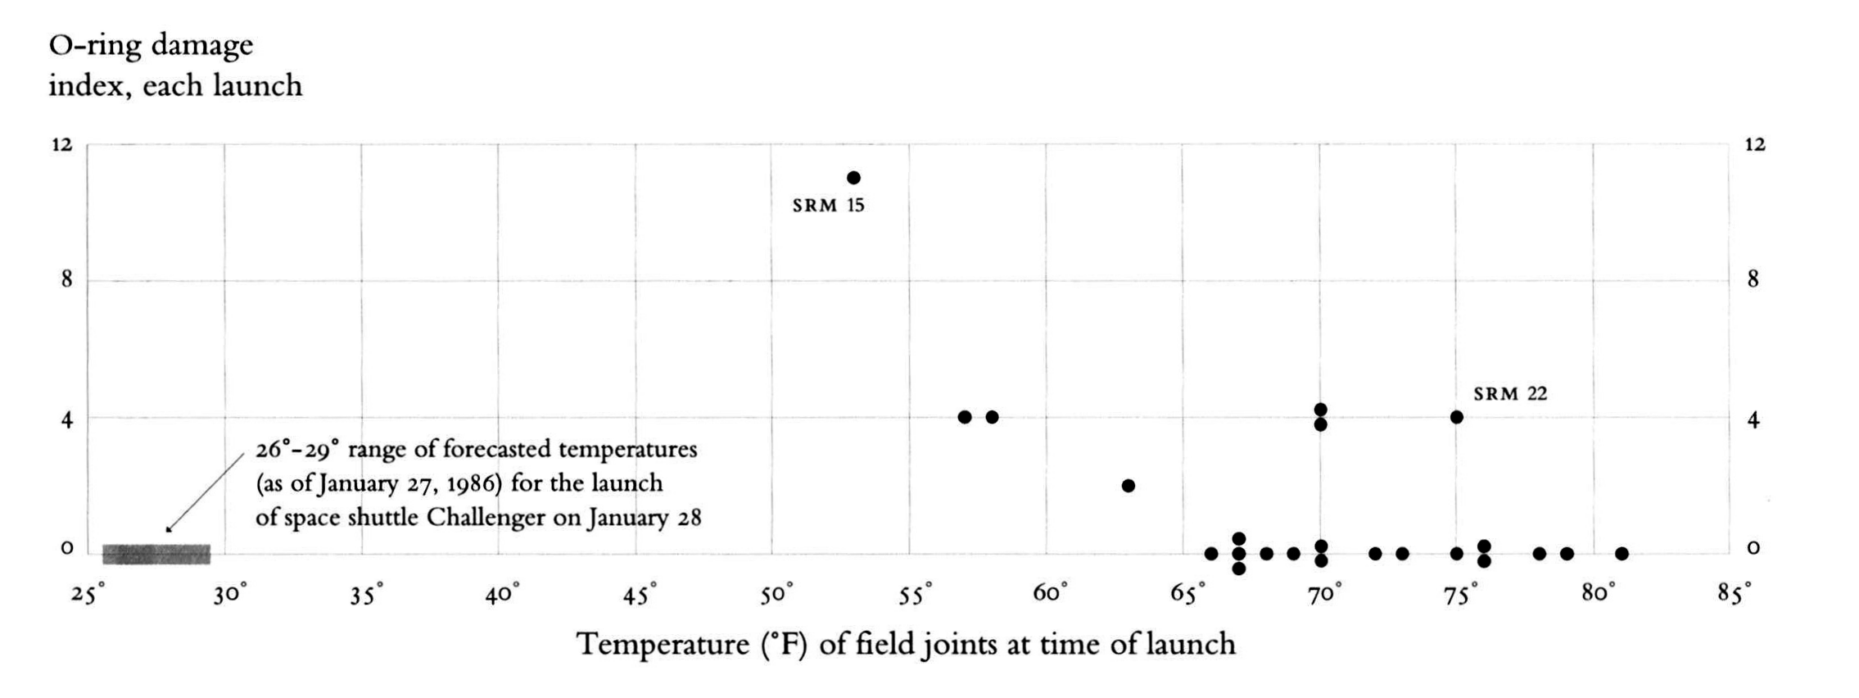

Slide 25
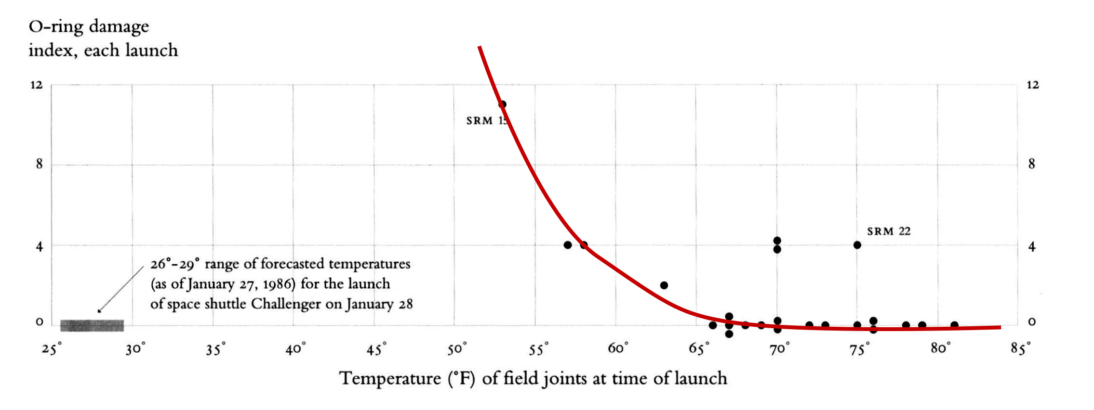
Make a decision

Slide 26
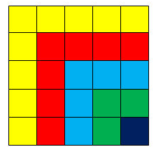
Support graphical calculations
Sum of odd numbers:
1 + 3 + 5 + 7 + 9 = 5
2
Notes:
Multiplication mental vs. pen and paper. Between 5 – 10 times faster just by the fact we can offload something onto paper.

Slide 27
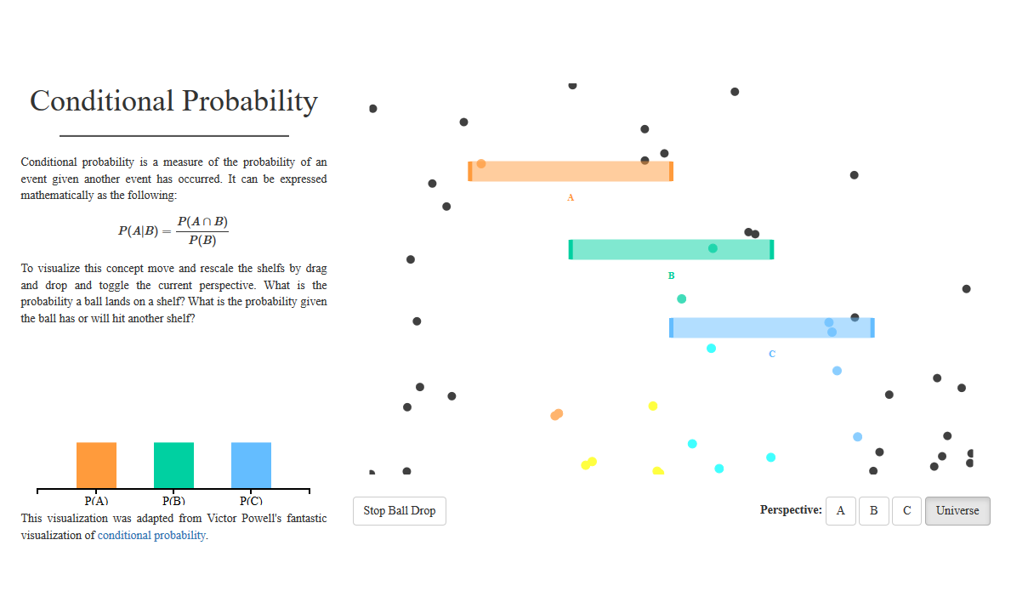
Teach
[students.brown.edu/seeing-theory/, Daniel Kunin]

Slide 28
Why create visualizations?
Answer questions (or discover them)
Make decisions
See data in context
Expand memory
Support graphical calculation
Find patterns
Present argument or tell a story
Teach

Slide 29
How do we create visualizations?

Slide 30
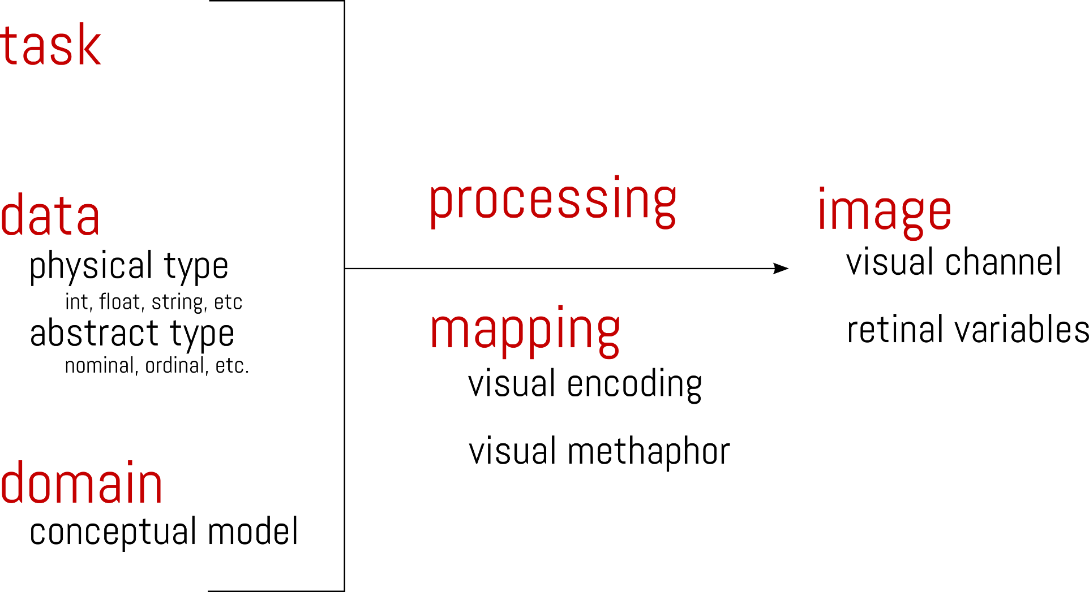

Slide 32

Data & Domain

Slide 33
Data Model
How the data is organized
How are data elements related
Conceptual Model
Mental constructions
Include semantics and support reasoning
Data vs. Conceptual
1D list of floats vs. Temperature
3D list of floats vs. Space
Notes:
Data Model tells you how the data is organized

Slide 34
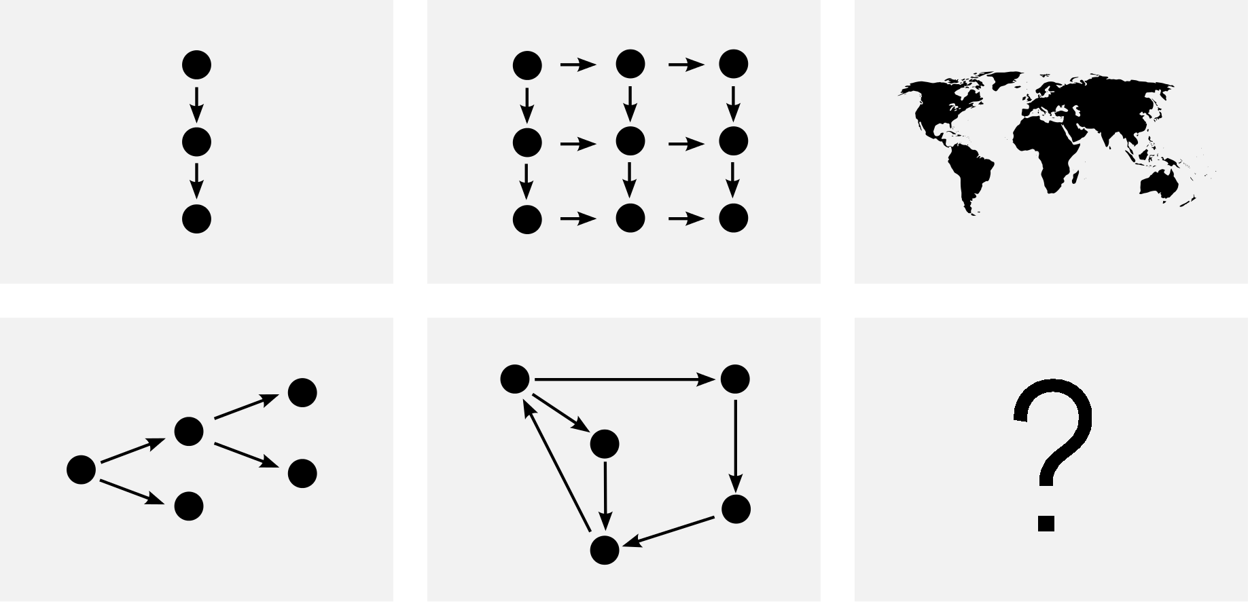
Data Model Taxonomy
Notes:
Others might be temporal. Widely enough used to create an on category
SQL is a way to describe data models

Slide 35
Variables
Physical types
  Characterized by storage format
  Characterized by machine operations
  Example:
    bool, short, int32, float, double, string, …
Level of measurement
  Describes the relationship among values
    Nominal
    Ordinal
    Quantitative
Notes:
A Data model is made out of variables. Think columns in SQL.
They have physical types and have a level of measurement.
Helps you how to interpret the values of a variable.

Slide 36
Nominal, Ordinal and Quantitative
N – Nominal (labels):
  Fruits: Apples, Oranges, …
O – Ordinal
  Quality of meat: Grade A, AA, AAA
Q – Interval (Location of zero is arbitrary)
  Dates: Mar. 14, 1933
  Lat: 26.1, Long: -110.0
  Only differences (i.e. Intervals) can be compared
Q – Ratio (zero fixed)
  Physical measurements: Length, Mass, Temp
  Counts and amounts
[S. S. Stevens, On the theory of scales of measurements, 1946]
Notes:
http://en.wikipedia.org/wiki/Level_of_measurement

Slide 37
Nominal, Ordinal and Quantitative
N - Nominal (labels):
  Operations: =, ≠
O - Ordinal
  Operations: =, ≠, <, >, ≤, ≥
Q - Interval (Location of zero arbitrary)
  Operations: =, ≠, <, >, ≤, ≥, -
  Can measure distances or spans
Q - Ratio (zero fixed)
  Operations: =, ≠, <, >, ≤, ≥, -, ÷
  Can measure ratios or proportions
[S. S. Stevens, On the theory of scales of measurements, 1946]
Notes:
http://en.wikipedia.org/wiki/Level_of_measurement
Interval: arbitrarily-defined zero point. Can not perform ratios.
9am is twice as long as 11am?
Can only compare intervals: from 9am to 11am is twice as long as from 9am to 10am.
Ratios are not meaningful since 20 °C cannot be said to be "twice as hot" as 10 °C, nor can
Meters, 10m is twice as long as 5m

Slide 38
Example
Data Model
  32.50, 54.0, 17.30, …
  1D, floats
Conceptual Model
  Temperature
N,O,Q Type
  Burned vs. Not burned (N)
  Hot, warm, cold (O)
  Continuous range of values (Q)
Notes:
http://en.wikipedia.org/wiki/Level_of_measurement

Slide 39
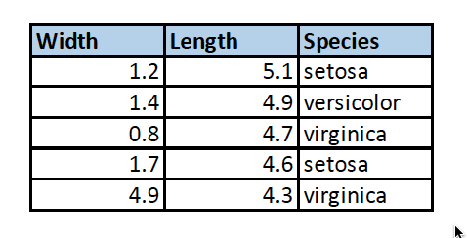
A: O, O, O
B: Q, Q, N
C: O, O, N
D: Q, Q, Q https://clicker.csail.mit.edu/6.S080
Nominal (N), Ordinal (O), Quantitative (Q)
Notes:
Correct is B

Slide 40
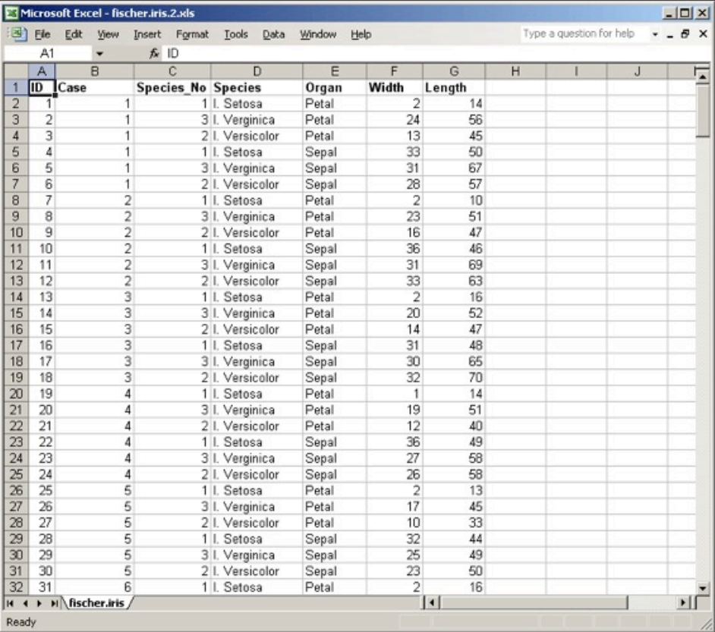
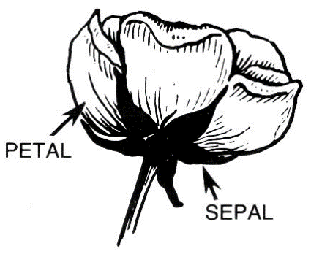
[Fisher, 1936] http://en.wikipedia.org/wiki/Iris_flower_data_set

Slide 41
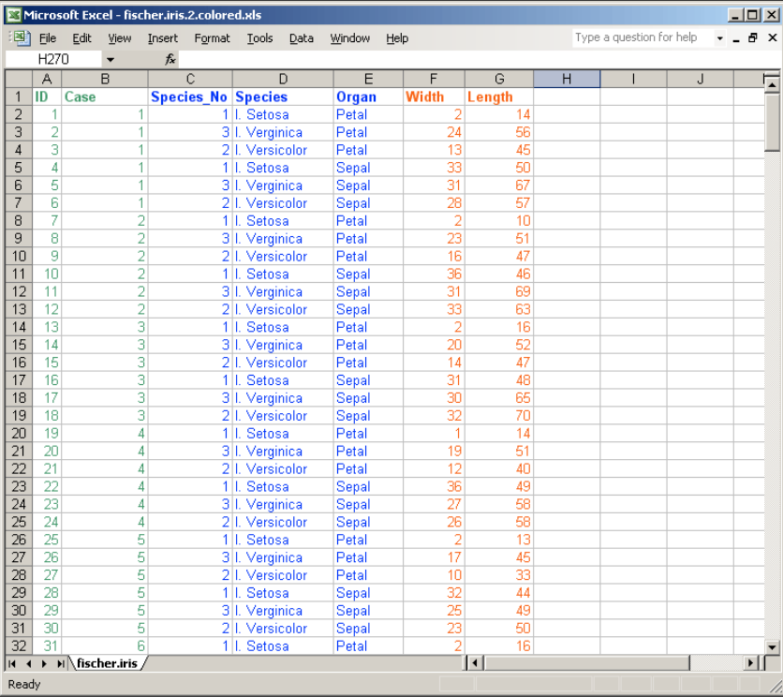
O
N
Q
[Fisher, 1936] http://en.wikipedia.org/wiki/Iris_flower_data_set

Slide 42
Image

Slide 43
Pre-attentive
unconscious, parallel, fast
Attentive
conscious, serial, slow
Notes:
The rods and cones that populate the retina are tuned to detect a limited set of visual
attributes, such as shape and color.
When we perceive an object, that perception is
constructed from a combination of these simple visual attributes. Even though an object as a
whole might take some conscious effort to identify, the basic visual attributes that combine to
make up that object are perceived without any conscious effort. Perception of these basic
visual attributes is called "preattentive" processing, in contrast to the conscious part of
perception, which is called "attentive" processing. Preattentive processing is extremely fast
and broadband in that we can simultaneously perceive a large number of these basic visual
attributes, called "preattentive attributes." Preattentive perception is done in parallel, but
attentive processing is done serially and is, therefore, much slower. Here's an exercise that
illustrates the difference between these two types of visual perception. Take a few seconds to
count how many times the number "5" appears in Figure 3.

Slide 44
[Tor Nørretranders]
Notes:
Small white box in the corner which is 0.7% is what we are aware of (the conscious part) when all this processing is happening

Slide 45
How many 3’s?
1281768756138976546984506985604982826762
9809858458224509856458945098450980943585
9091030209905959595772564675050678904567
8845789809821677654876364908560912949686
Notes:
Shapes like 3 and 5 are too complex to process preanttively.

Slide 46
How many 3’s?
1281768756138976546984506985604982826762
9809858458224509856458945098450980943585
9091030209905959595772564675050678904567
8845789809821677654876364908560912949686
Notes:
This time perception was easy and immediate, because the 5's were encoded with a different
preattentive visual attribute from the other numbers—in this case, a different color.
Why ist his important to note? Because if you want to visually encode information in a manner that
can be perceived instantly and easily by your readers, you now know that you should visually
encode the data using preattentive attributes, and if you want some of the data to stand out
from the rest, you should encode it using different preattentive attributes.

Slide 47
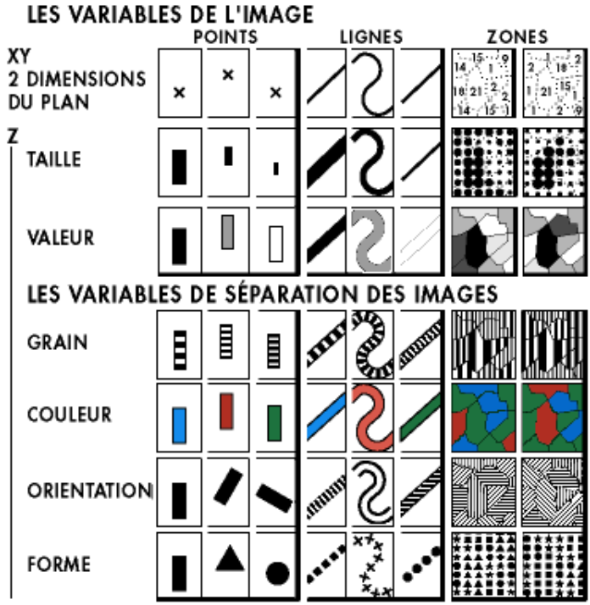
[Bertin, Simonolgy of Graphics, 1983]
Notes:
Crucial to this decision is an understanding of the different visual dimensions. Jacques
Bertin developed a theory of visual variables that is particularly useful here (Bertin,
Graphics and Graphics Information Processing, 1989). Jacques Bertin was a French cartographer and theorist.
The seven visual variables
identified by Bertin are shown above. Bertin called these dimensions retinal variables, in
fact, because they can be compared effortlessly without additional cognitive processing, as
if the retina were doing all the work. In terms of the model human processor abstraction,
differences along these dimensions can be detected by the Perceptual Processor. Comparing
numbers, on the other hand, would require the participation of the Cognitive Processor.

Slide 48
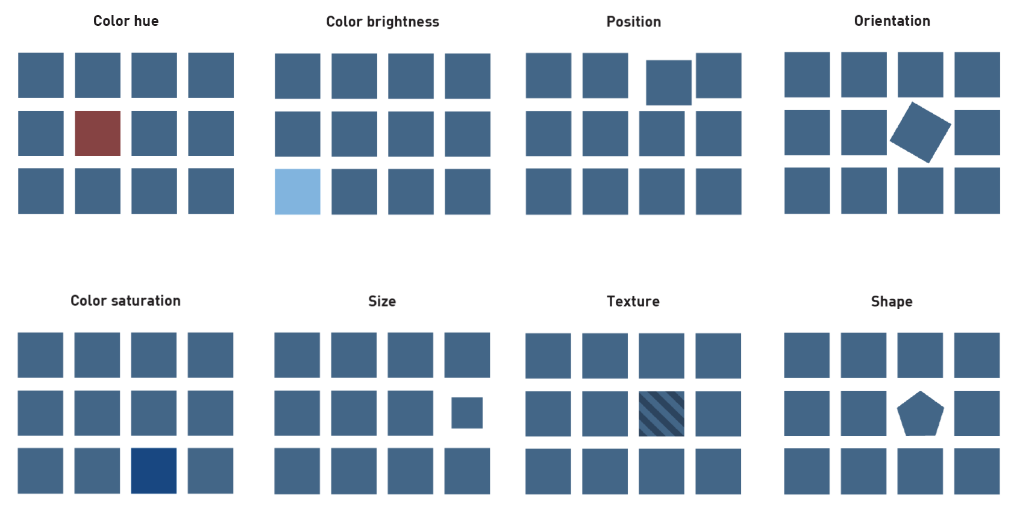

Slide 49





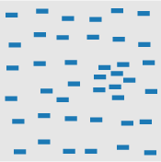

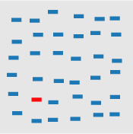
Line orientation
Length, width
closure
size
curvature
density
number, estimation
hue

Slide 50

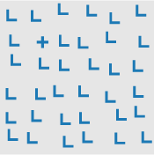
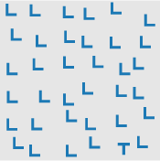
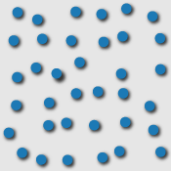
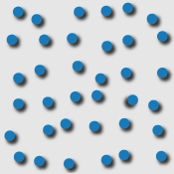
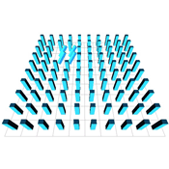
intensity
intersection
terminators
3D depth cues,
stereoscopic depth
Lighting direction
3D orientation

Slide 51
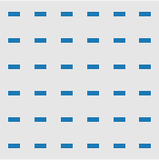
Flicker

Slide 52
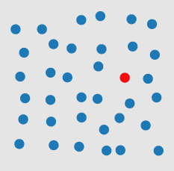

[http://www.csc.ncsu.edu/faculty/healey/PP/index.html]
Notes:
They are not all equal. Here again an example with Color. The red circle can be detected super fast.
These visual attributes aren't perceptually equal. Some are perceptually stronger than others.
Some can be perceived quantitatively and can therefore be used to encode numeric values,
and others can't.

Slide 53
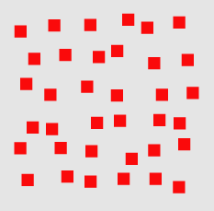
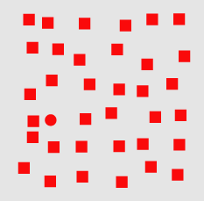
[http://www.csc.ncsu.edu/faculty/healey/PP/index.html]
Notes:
A unique visual property in the target (e.g., a red hue in Fig. 1, or a curved form in Fig. 2) allows it to "pop out" of a display.

Slide 54
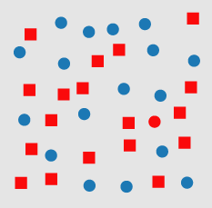
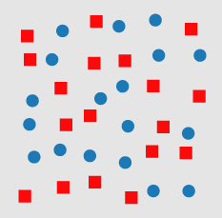
[http://www.csc.ncsu.edu/faculty/healey/PP/index.html]
Notes:
shows an example of conjunction search. The red circle target is made up of two features: red and circular. One of these features is present in each of the distractor objects (red squares and blue circles). This means the visual system has no unique visual property to search for when trying to locate the target. If a viewer searches for red items, the visual system always returns true because there are red squares in each display. Similarly, a search for circular items always sees blue circles. Numerous studies have shown that this target cannot be detected preattentively. Viewers must perform a time-consuming serial search through the displays to confirm its presence or absence.

Slide 55
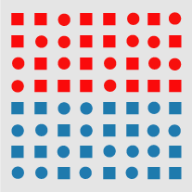
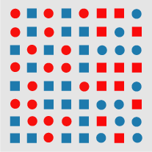
[http://www.csc.ncsu.edu/faculty/healey/PP/index.html]
Notes:
Fig. 4: An example of a boundary detection from Treisman's experiments: (a) a boundary defined by a unique feature hue (red circles and red squares on the top, blue circles and blue squares on the bottom) is preattentively classified as horizontal; (b) a boundary defined by a conjunction of features (red circles and blue squares on the left, blue circles and red squares on the right) cannot be preattentively classified as vertical

Slide 56
Mapping
Notes:
So we have a number of preattentive variables that we can play with.
We want to map our data to visual signals that stand out and direct a viewers attention.

Slide 57
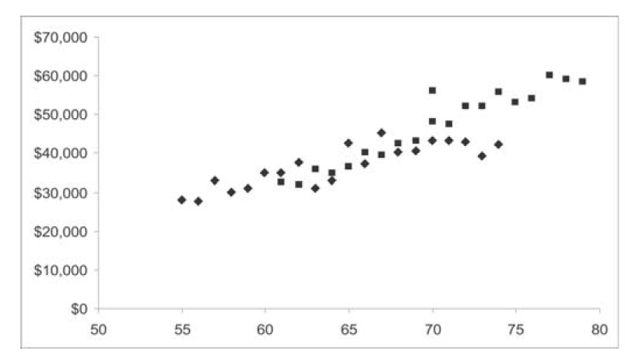
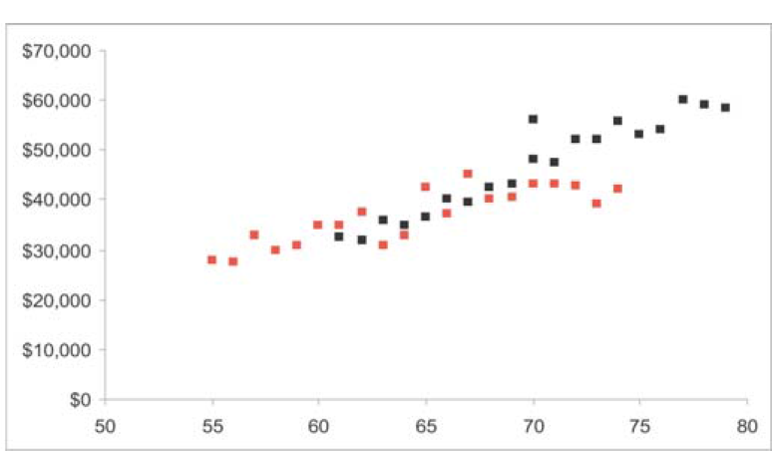
Notes:
Alternatively, it is important to know that we can’t just mix a lot of preattentive variables together because they loose their effect.

Slide 58
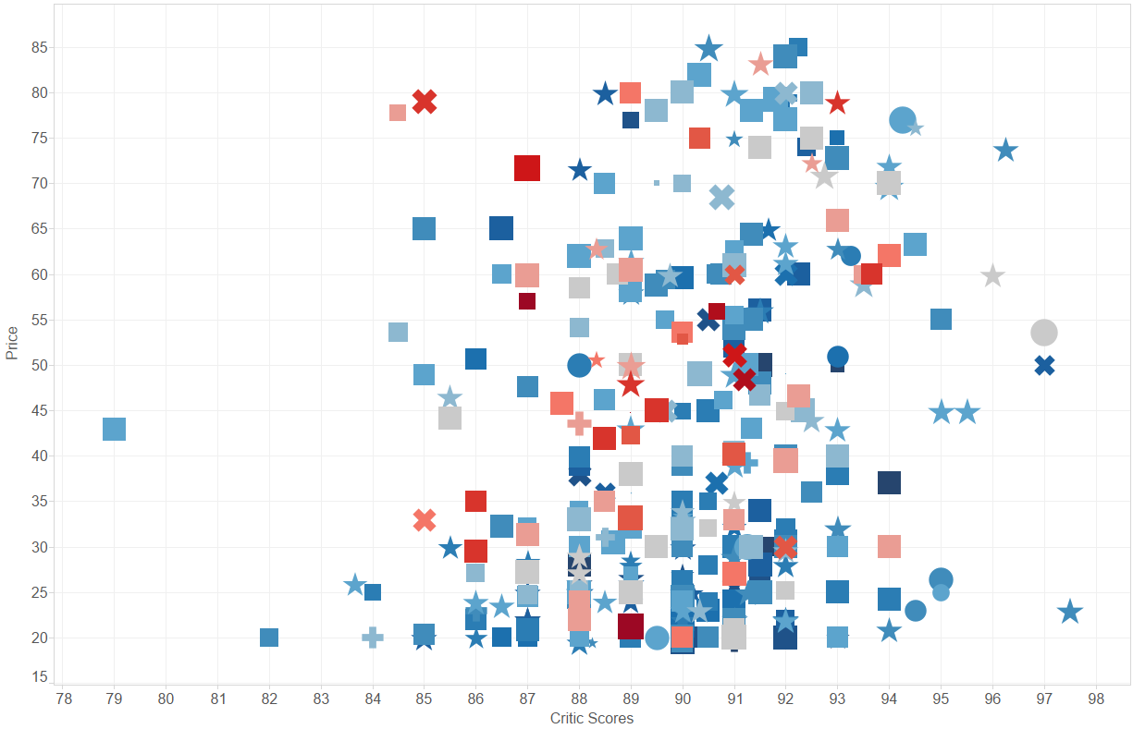
X: Critic Scores, Y: Price, Size: User Rating, Color: Vintage, Shape: Type
Notes:
It basically gives us an upper bound of how much variables we can encode in an image.
5 data variables mapped to 5 distinct preattentive variables
Remember napoleons march?
The other thing that is important to know when mapping data to visual signals. Is to consider how well they represent relationships among values of a variable.

Slide 59
Can you order these?
(low -> high)
Notes:
Length, width preatentive variable

Slide 61
Can you order these?
(low -> high)
Notes:
Size preattentive variable.

Slide 63
Can you order these?
(low -> high)
Notes:
Color variable

Slide 64
Notes:
Color variable

Slide 65
Can you order these?
(low -> high)
Notes:
Color variable

Slide 66
?

Slide 67
Nominal, Ordinal and Quantitative
Position
N | O | Q
Size
N | O | Q
N | O | Q
Nominal
Ordered
Quantitative
Value
Texture
N | o
N
N
N
Color
Orientation
Shape
Notes:
Value: Intensity, Brightness of color

Slide 68
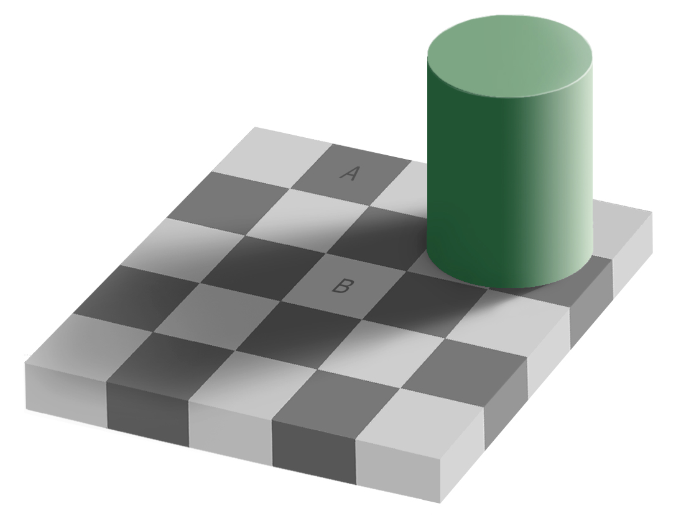
[Edward Adelson, 1995]
Notes:
Be carful with colors. I visual system plays tricks on us.

Slide 69
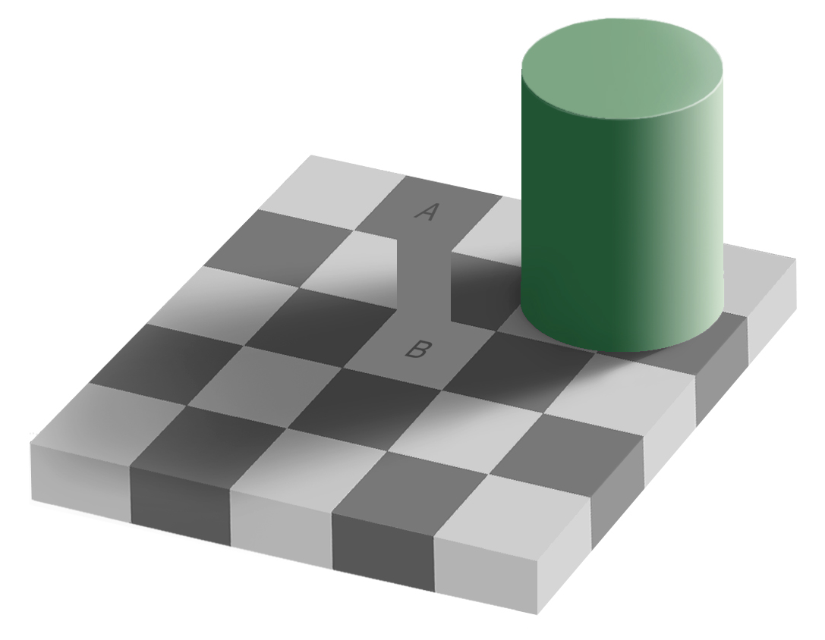
[Edward Adelson, 1995]

Slide 70
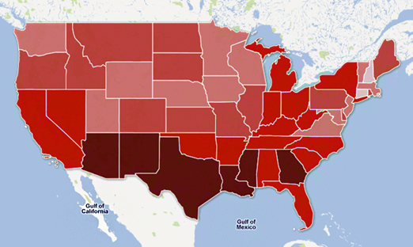
http://vis4.net/blog/posts/choropleth-maps/
Notes:
Poverty along states in the US.
You might think, poverty is highest in south central of the United States, especially near Mexican border

Slide 71
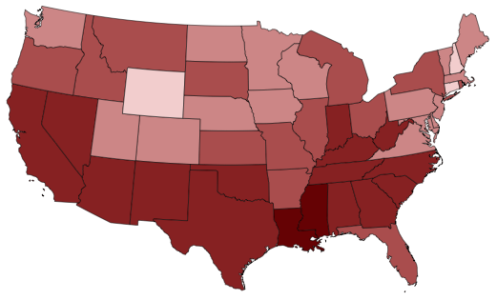




http://vis4.net/blog/posts/choropleth-maps/
Notes:
Bad mapping form data to visual feature.
Color is tricky.

Slide 72
Some Principles & Guidelines

Slide 73

http://homes.cs.washington.edu/~jheer/files/zoo/
Notes:
Make use of well-known pattern. Depends on your data type.
Find other visualizations you like and adapt.
Good article on the “visualization zoo”

Slide 74
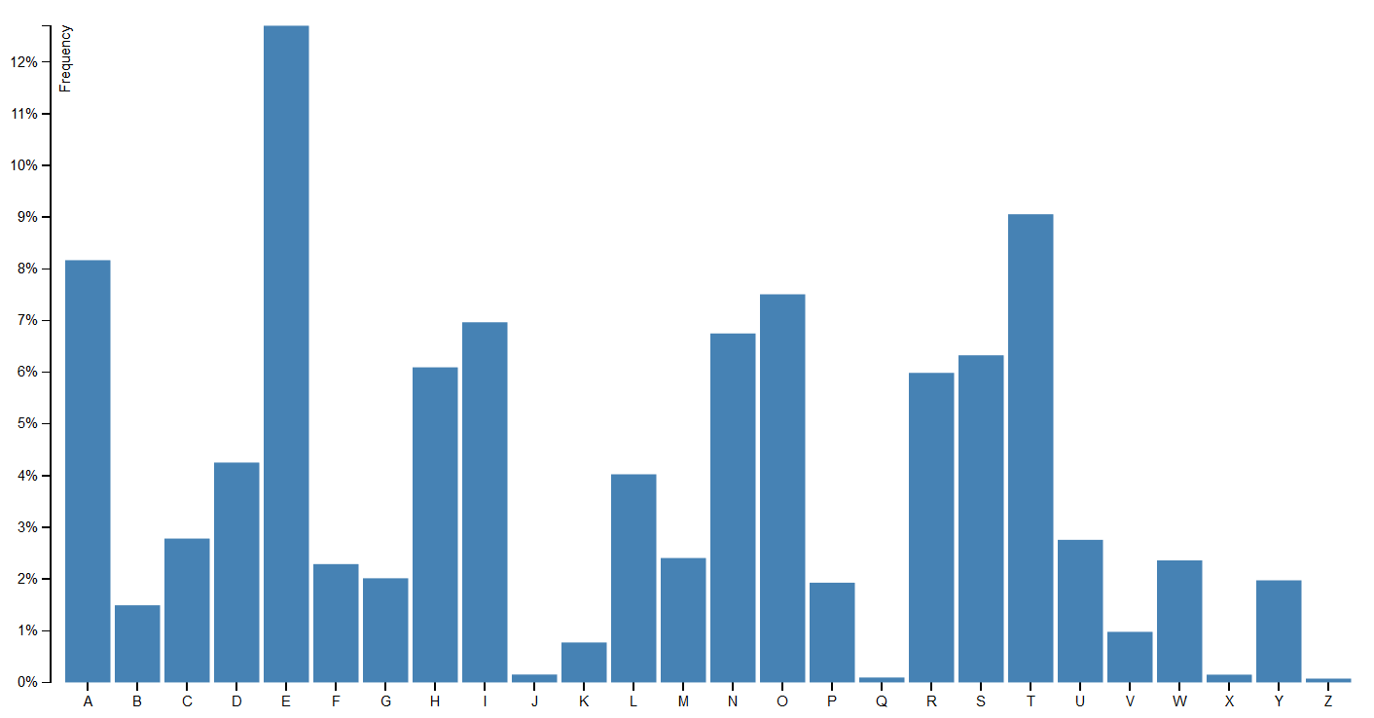
Bar chart
Display different quantities of single-variable data
https://github.com/mbostock/d3/wiki/Gallery
Notes:
Occurrence of letters in the English language
Also called historgram.

Slide 75
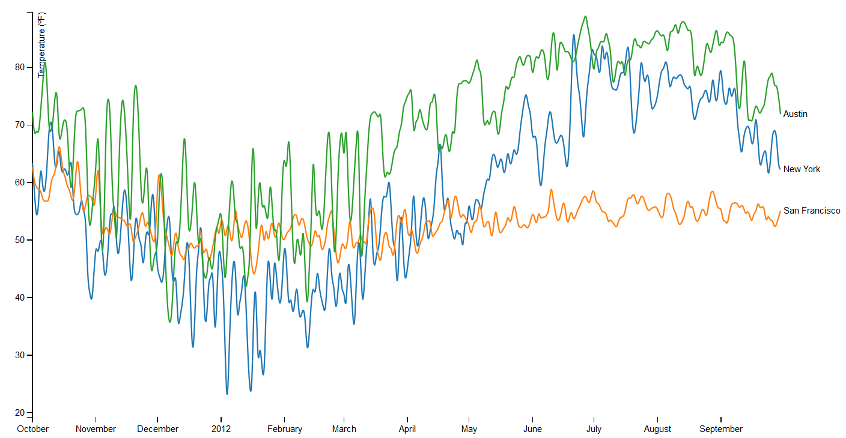
Line chart
Display how a variable develops over time
https://github.com/mbostock/d3/wiki/Gallery
Notes:
Average temperatures of cities

Slide 76
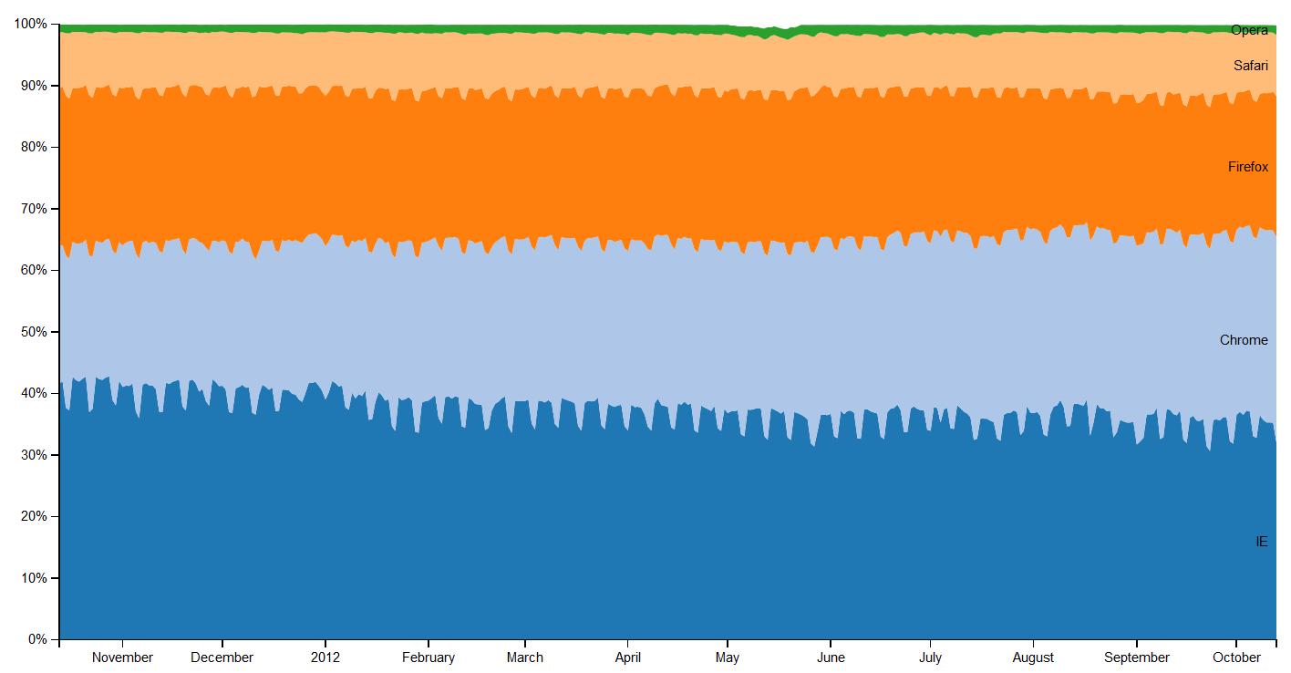
Stacked area chart
Display total of a variable over time
https://github.com/mbostock/d3/wiki/Gallery
Notes:
market share of several popular web browsers over the [2013]

Slide 77

Pie chart
Display distribution of a variable
https://github.com/mbostock/d3/wiki/Gallery
Notes:
Distribution among age groups
Kind of like a barchart, but when the totality is really important.

Slide 78

Scatterplot
Display relationship between two variables
https://github.com/mbostock/d3/wiki/Gallery

Slide 79

Scatterplot matrix
Display relationship between multiple variables
https://github.com/mbostock/d3/wiki/Gallery

Slide 80

Parallel coordinate plot
Display relationship between multiple variables
https://github.com/mbostock/d3/wiki/Gallery

Slide 81

Tree
Display hierarchical data
https://github.com/mbostock/d3/wiki/Gallery

Slide 82

Radial tree
Display hierarchical data
https://github.com/mbostock/d3/wiki/Gallery

Slide 83

Tree map
Display hierarchical data
https://github.com/mbostock/d3/wiki/Gallery

Slide 84

Force-directed graph
Display graphs, networks, relationships
https://github.com/mbostock/d3/wiki/Gallery

Slide 85

Radial graph
Display graphs, networks, relationships
https://github.com/mbostock/d3/wiki/Gallery

Slide 86

Radial graph
Display graphs, networks, relationships
https://github.com/mbostock/d3/wiki/Gallery

Slide 87

Co-occurrence matrix
Display graphs, networks, relationships
https://github.com/mbostock/d3/wiki/Gallery

Slide 88

Sankey diagram
Display flow amongst entities
https://github.com/mbostock/d3/wiki/Gallery
Notes:
Energy and how it gets used

Slide 89

Maps
Display a spatial variable
https://github.com/mbostock/d3/wiki/Gallery
Notes:
Unemployment rates

Slide 90


Maps
Display a spatial variable
Kendrick Perkins
James Harden
[New York Times]

Slide 91
A: Map
B: Scatterplot
C: Tree map
D: Pie chart https://clicker.csail.mit.edu/6.S080
Display relationship between two variables (Q, Q)?
Notes:
Correct scatterplot

Slide 93
Expressiveness
A set of facts is expressible in a visual language if the sentences (i.e. the visualizations) in the language express all the facts in the set of data, and only the facts in the data.
Effectiveness
A visualization is more effective than another visualization if the information conveyed by one visualization is more readily perceived than the information in the other visualization.
[Mackinlay, APT, 1986]
Notes:
Express all the facts, and only the facts.
Prefer the one that is easier to perceive.

Slide 94
[Fisher, 1936]
Notes:
Expressiveness example

Slide 95


Example 1: Cannot express the facts
A one-to-many (1->N) relation cannot be expressed in a single horizontal dot plot because multiple tuples are mapped to the same position.
Notes:
Expressiveness example

Slide 96

Example 2: Express facts not in the data
A length is interpreted as a quantitative value;
Length of bar says something untrue about Nominal data

Slide 97


Slide 98
Example 4: Effectiveness
Notes:
Expressiveness example

Slide 99

Notes:
Expressiveness example

Slide 100
Example 3: Effectiveness
Notes:
Effectiveness, choose the one that is more effective.

Slide 101

[Mackinlay]
Notes:
The visual preattentive variables have some ordering among them in terms of effectiveness for the different scales.

Slide 102
Tufte’s Rules
[http://www.sealthreinhold.com/tuftes-rules/rule_three.php]
Notes:
Edward Tufte (Tuff-tee) was born on 1942 in Kansas City, Missouri. He has been called “The da Vinci of data,” “Chart Master,” and “The Data Artist.”
Tufte grew up in California, with his father and mother. His father was an engineer and his mother, a teacher. Together, they taught him the importance of a purposeful life and the value of contribution.
Upon graduating Beverly Hills High School in 1960, Tufte went on to Stanford University to earn his BA and MA in Statistics and then Yale University to earn his PhD in Political Science.
Tufte’s education was the foundation for all of his later achievements and contributions, which includes becoming a highly respected professor.
Soon after Edward Tufte earned his PhD in Political Science from Yale University, he spent the next ten years teaching at Princeton University.
While teaching, he also did consulting work for various companies, including IBM, The New York Times, New Jersey Transit, NASA and NBC.
Overall, Tufte consulted for 20 years and taught at Princeton and Yale University for 32 years.
During his early years of consulting and teaching, Tufte began writing his first book on data design.
Many of the innovations and much of the clarity that has driven the field of information design are the result of Tufte’s award-winning books.
Tufte has gone on the road for many years now, lecturing to hundreds of people on his theories and principles of data design.

Slide 103


Avoid Chartjunk
Notes:
Chartjunk is what happens when your data design focuses too much on the design aspect.
As the example above demonstrates, the chart does not need the addition of perspective. If anything, it makes it harder to interpret the data.
Distracting patterns, overbearing colors and even unnecessary grids and outlines are just some of the elements of chartjunk.

Slide 104
Maximize Data-Ink Ratio
Data-Ink
Data-Ink Ratio =
Total Ink used
Notes:
proportion of graphic’s ink devoted to the non-redundant display of data-information

Slide 105


Notes:
As the example above demonstrates, there are many ways to utilize your data-ink.
However, be careful when deciding what to remove and what to keep. If you remove important info for the sake of simplicity, think again.
Above all else, your data is the priority, so only include design elements that will help your data be understood more effectively.

Slide 106


Notes:
As the example above demonstrates, there are many ways to utilize your data-ink.
However, be careful when deciding what to remove and what to keep. If you remove important info for the sake of simplicity, think again.
Above all else, your data is the priority, so only include design elements that will help your data be understood more effectively.

Slide 107
Interaction

Slide 108

http://dc-js.github.io/dc.js/
Notes:
Linking and Brushing

Slide 109

http://vis.stanford.edu/projects/immens/demo/brightkite/

Slide 110

850 wines
Multidimensional data
  Name
  Price
  Vintage
  User & critic scores
  Country
  Region
  etc.

Slide 111

http://cs.brown.edu/~ez/

Slide 112
Animation

Slide 113
Why Use Animation?
Visual variable to encode data
Direct attention
Understand system dynamics
Understand state transition (maintain context)
Increase engagement

Slide 114

http://hint.fm/wind/

Slide 115

http://bost.ocks.org/mike/miserables/

Slide 116

http://www.visualsedimentation.org/examples/

Slide 117
Courses
  Arvind Satyanarayan
    https://www.eecs.mit.edu/academics-admissions/academic-information/subject-updates-spring-2019/6894
  Maneesh Agrawala
    http://vis.berkeley.edu/courses/cs294-10-fa14/wiki/index.php/Main_Page
  Jeff Heer
    http://courses.cs.washington.edu/courses/cse512/14wi/
  John Stasko
  http://www.cc.gatech.edu/~stasko/7450/

Slide 118
press “A” to let us know you are here https://clicker.csail.mit.edu/6.S080

Slide 119
Blogs & Websites
https://www.reddit.com/r/dataisbeautiful/
http://fivethirtyeight.com/
http://flowingdata.com/
http://www.informationisbeautiful.net/
http://infosthetics.com/
http://junkcharts.typepad.com/
http://datavisualization.ch/
http://eagereyes.org/
http://blog.okcupid.com/
https://twitter.com/nytgraphics

Slide 120
Articles & Others
Tufte: The Visual Display of Quantitative Information
  http://www.edwardtufte.com/tufte/
http://www.csc.ncsu.edu/faculty/healey/PP/index.html
http://www.sealthreinhold.com/tuftes-rules/rule_three.php
Ted Talk: Beauty of Data Visualization
  https://www.youtube.com/watch?v=pLqjQ55tz-U
http://piksels.com/wp-content/uploads/2009/01/visualizingdata.pdf
http://homes.cs.washington.edu/~jheer/files/zoo/
http://www.targetprocess.com/articles/visual-encoding.html
http://en.wikipedia.org/wiki/Misleading_graph

