Slide 1

6.S080 Software Systems For Data Science

Slide 2
Administrivia
Lecturers:
Tim Kraska
Sam Madden
TAs:
Joana M.F. da Trindade
Matt Perron
Website: http://dsg.csail.mit.edu/6.S080/
Piazza: http://piazza.com/mit/fall2019/6s080
First Lab Due Wednesday

Slide 3
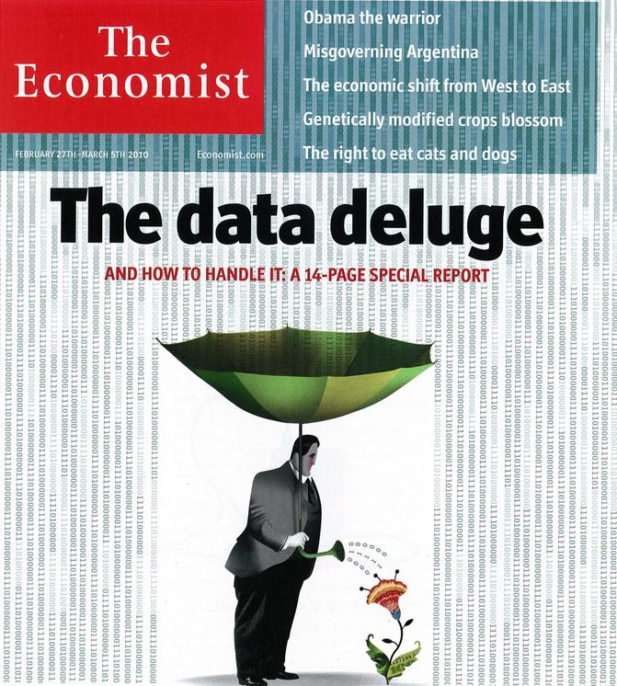
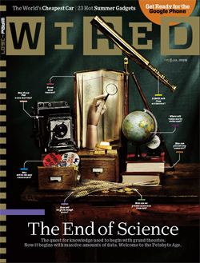

Slide 4

Examples

Slide 5


Slide 6
The Unreasonable Effectiveness of Data
Alon Halevy, Peter Norvig, and Fernando Pereira, Google

Slide 7
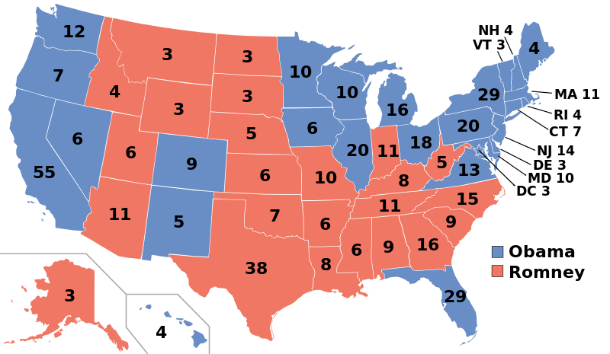
Nate Silver
“Silver, who made his name by using cold hard math to call
49 out of 50 states in the 2008 general election and all 50 in 2012”
http://commons.wikimedia.org/wiki/File:ElectoralCollege2012.svg
(public domain)

Slide 8
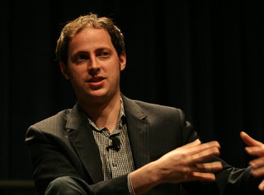
“The intuition behind this ought to be very simple: Mr. Obama is maintaining leads in the polls in Ohio and other states that are sufficient for him to win 270 electoral votes.”
Nate Silver
Nate Silver, Oct. 26, 2012
fivethirtyeight.com
source: randy stewart
“…the argument we’re making is exceedingly simple. Here it is: Obama’s ahead in Ohio.”
Nate Silver, Nov. 2, 2012
fivethirtyeight.com
“The bar set by the competition was invitingly low. Someone could look like a genius simply by doing some fairly basic research into what really has predictive power in a political campaign.”
Nate Silver, Nov. 10, 2012
DailyBeast
Notes:
State polls are the best predictor
But he put a lot of effort in convincing the result and visualization. Getting the result can be simple
Simple methods and a lot of data often trumps complicated techniques

Slide 9
Related: Obama campaign’s data-driven ground game
"In the 21st century, the candidate with [the] best data, merged with the best messages dictated by that data, wins.”
Andrew Rasiej, Personal Democracy Forum
“…the biggest win came from good old SQL on a Vertica data warehouse and from providing access to data to dozens of analytics staffers who could follow their own curiosity and distill and analyze data as they needed.”
Dan Woods
Jan 13 2013, CITO Research
“The decision was made to have Hadoop do the aggregate generations and anything not real-time, but then have Vertica to answer sort of ‘speed-of-thought’ queries about all the data.”
Josh Hendler, CTO of H & K Strategies
Also a good read: http://fivethirtyeight.com/features/a-history-of-data-in-american-politics-part-2-obama-2008-to-the-present/
Notes:
Who tweeted about bio products on twitter
Registered at some point on Obamas web-site, but have never donated
Get e-mail from Michelle Obama about Obamos enviritonment plans
Ad-hoc Hypothesis testing
System for used for it

Slide 10
Election 2016

Slide 11
Election 2016
“Why Donald Trump Isn’t A Real Candidate, In One Chart” (June 2015)
http://fivethirtyeight.com/datalab/why-donald-trump-isnt-a-real-candidate-in-one-chart/
Notes:
GOP, short for Grand Old Party, is a nickname for the Republican Party of the United States.
Taking into account name recognition, Trump’s net favorability rating (favorable minus unfavorable) of -32 percentage points stands out for its pure terribleness at this point in the campaign. Like his unfavorable rating, it is by far the worst of the 106 presidential candidates since 1980 who are in our database.

Slide 12
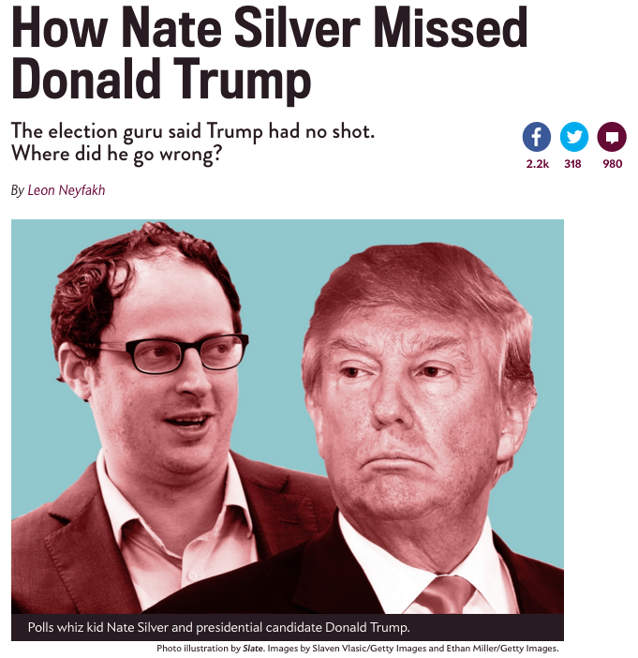

Slide 13

In June 2015 on Twitter: “Basically Trump is the Nickelback of presidential candidates. Disliked by most, super popular with a few.”

Slide 14
In September, he told CNN’s Anderson Cooper that Trump had a roughly 5-percent chance of beating his GOP rivals.

Slide 15
In November, he explained that Trump’s national following was about as negligible as the share of Americans who believe the Apollo moon landing was faked

Slide 16
https://fivethirtyeight.com/features/how-i-acted-like-a-pundit-and-screwed-up-on-donald-trump/
Notes:
Black swans were presumed not to exist
However, in 1697, Dutch explorers led by Willem de Vlamingh became the first Europeans to see black swans, in Western Australia.^{[5]} The term subsequently metamorphosed to connote the idea that a perceived impossibility might later be disproven.
The theory was developed by Nassim Nicholas Taleb to explain:
- The disproportionate role of high-profile, hard-to-predict, and rare events that are beyond the realm of normal expectations in history, science, finance, and technology.-
- The non-computability of the probability of the consequential rare events using scientific methods (owing to the very nature of small probabilities).
- The psychological biases that blind people, both individually and collectively, to uncertainty and to a rare event's massive role in historical affairs.

Slide 17
Our early forecasts of Trump’s nomination chances weren’t based on a statistical model, which may have been most of the problem.
Trump’s nomination is just one event, and that makes it hard to judge the accuracy of a probabilistic forecast.
The historical evidence clearly suggested that Trump was an underdog, but the sample size probably wasn’t large enough to assign him quite so low a probability of winning.
Trump’s nomination is potentially a point in favor of “polls-only” as opposed to “fundamentals” models.
There’s a danger in hindsight bias, and in overcorrecting after an unexpected event such as Trump’s nomination.
https://fivethirtyeight.com/features/how-i-acted-like-a-pundit-and-screwed-up-on-donald-trump/

Slide 18
Does it MEAN that DATA was
Useless in the 2016 Election?
Notes:
Reaction Facebook stops access to it all together.

Slide 19
Does it MEAN that DATA was
Useless in the 2016 Election?
Data was acquired via 3rd party app “thisisyourdigitallife”
Nearly 300K people downloaded it and offered their data
Notes:
Reaction Facebook stops access to it all together.

Slide 20
Does it MEAN that DATA was
Useless in the 2016 Election?
Data was acquired via 3rd party app “thisisyourdigitallife”
Nearly 300K people downloaded it and offered their data
Problem: Access was also granted access to their friends data
Estimated size: 87M users (nobody knows though)
Notes:
Reaction Facebook stops access to it all together.

Slide 21
Does it MEAN that DATA was
Useless in the 2016 Election?
Data was acquired via 3rd party app “thisisyourdigitallife”
Nearly 300K people downloaded it and offered their data
Problem: Access was also granted access to their friends data
Estimated size: 87M users (nobody knows though)
Trump campaign used the data for heavily targeted ads
Notes:
Reaction Facebook stops access to it all together.

Slide 22
Music

Slide 23
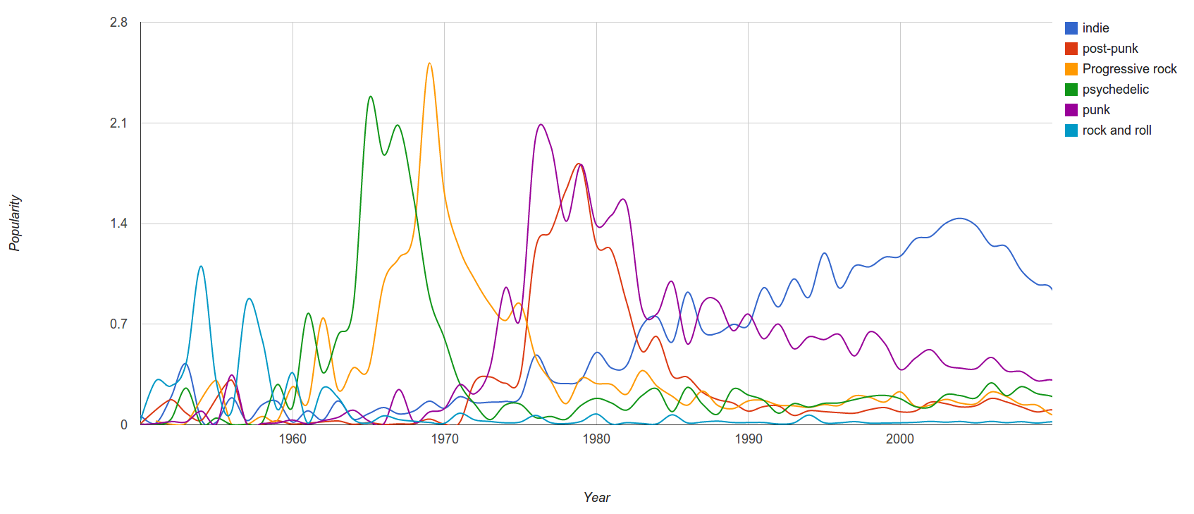
last.fm
“Since we have a massive amount of user tag data available we can easily correlate tags and years and measure “popularity” of a genre by counting the number of artists formed in a specific year.”
Janni Kovacs, Last.FM

Slide 24
How would you estimate the expression of Emotions over the 20th century?
(read: before Twitter)

Slide 25


Expression of Emotions over the 20th Century
1) Convert all the digitized books in the 20th century into n-grams (Thanks, Google!)
(http://books.google.com/ngrams/)
A 1-gram: “yesterday”
A 5-gram: “analysis is often described as”
2) Label each 1-gram (word) with a mood score.
(Thanks, WordNet Affect)
3) Count the occurrences of each mood word
Acerbi A, Lampos V, Garnett P, Bentley RA (2013) The Expression of Emotions in 20th Century Books. PLoS ONE 8(3): e59030. doi:10.1371/journal.pone.0059030
Notes:
How did the use word change over time
Method used are very simple
Take all books and digitize them (google did it for us)
2) Affect cores from WordNet
3) Count the number of occurrences and normalize them using the word the (Ci => count of some mood word) Normalize by something to encount for writing more books
Why not normalize by the total nb of words. We preferred to normalize by the word ‘‘the’’, rather than by the total number of words, to avoid the effect of the influx of data, special characters, etc. that may have come into books recently.
Encount for real sentences
Afterwards normalize to a normal distribution to make sets comparable
Researchers were able to chart historical periods of positive and negative moods through literature. Values above zero indicate generally "happy" periods, and values below the zero indicate generally "sad" periods.

Slide 26
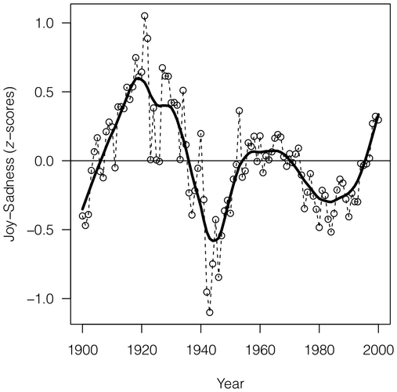
Acerbi A, Lampos V, Garnett P, Bentley RA (2013) The Expression of Emotions in 20th Century Books. PLoS ONE 8(3): e59030. doi:10.1371/journal.pone.0059030
Notes:
Researchers were able to chart historical periods of positive and negative moods through literature. Values above zero indicate generally "happy" periods, and values below the zero indicate generally "sad" periods.
Deep dip after world war 2

Slide 27
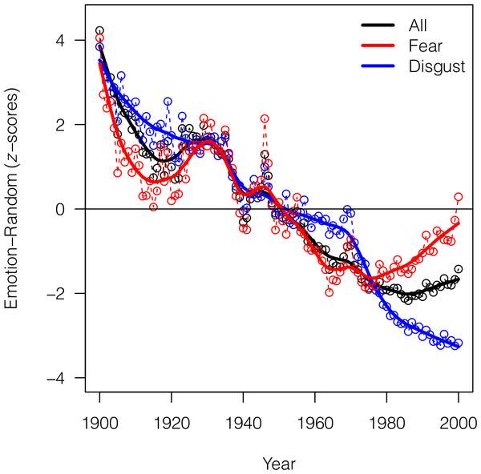
Acerbi A, Lampos V, Garnett P, Bentley RA (2013) The Expression of Emotions in 20th Century Books. PLoS ONE 8(3): e59030. doi:10.1371/journal.pone.0059030
Notes:
Emotion words total minus – random words total
We use fewer emotion words over time
Up-trend of fear words

Slide 28
Papers cited by them
…
2. Michel J-P, Shen YK, Aiden AP, Veres A, Gray MK, et al. (2011) Quantitative analysis of culture using millions of digitized books. Science 331: 176–182. doi: 10.1126/science.1199644. Find this article online
3. Lieberman E, Michel J-P, Jackson J, Tang T, Nowak MA (2007) Quantifying the evolutionary dynamics of language. Nature 449: 713–716. doi: 10.1038/nature06137. Find this article online
4. Pagel M, Atkinson QD, Meade A (2007) Frequency of word-use predicts rates of lexical evolution throughout Indo-European history. Nature 449: 717–720. doi: 10.1038/nature06176. Find this article online
…
6. DeWall CN, Pond RS Jr, Campbell WK, Twenge JM (2011) Tuning in to Psychological Change: Linguistic Markers of Psychological Traits and Emotions Over Time in Popular U.S. Song Lyrics. Psychology of Aesthetics, Creativity and the Arts 5: 200–207. doi: 10.1037/a0023195. Find this article online
…

Slide 29
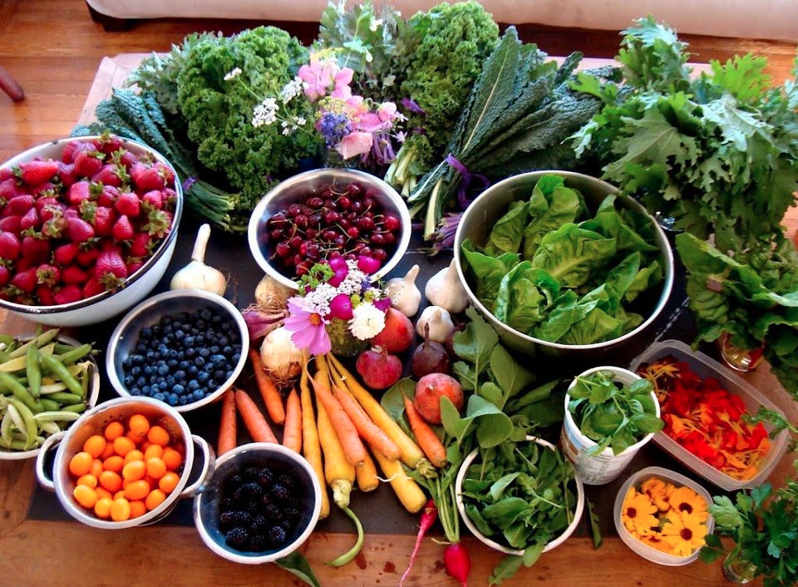
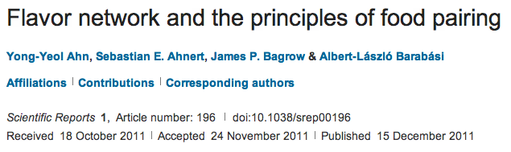
Idea: Analyze the co-occurrence graph of ingredients in recipes to analyze the underlying principles of food pairing.

Slide 30

A Class Experiment
Hypothesis:
Parents believe more often that their sons are gifted than their daughters
Parents care more about the appearance of their daughters than sons

Slide 31
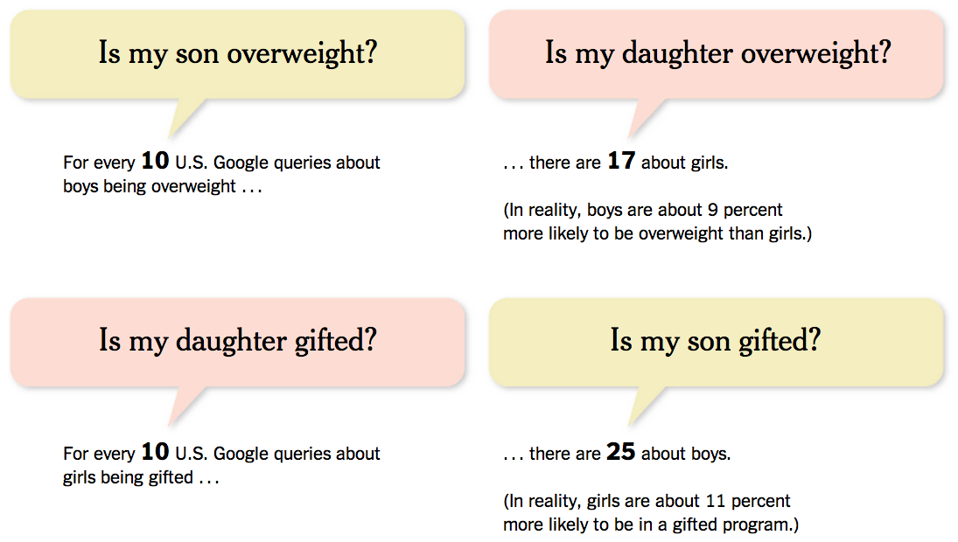
Results
http://www.nytimes.com/2014/01/19/opinion/sunday/google-tell-me-is-my-son-a-genius.html?smid=fb-share&_r=1

Slide 32
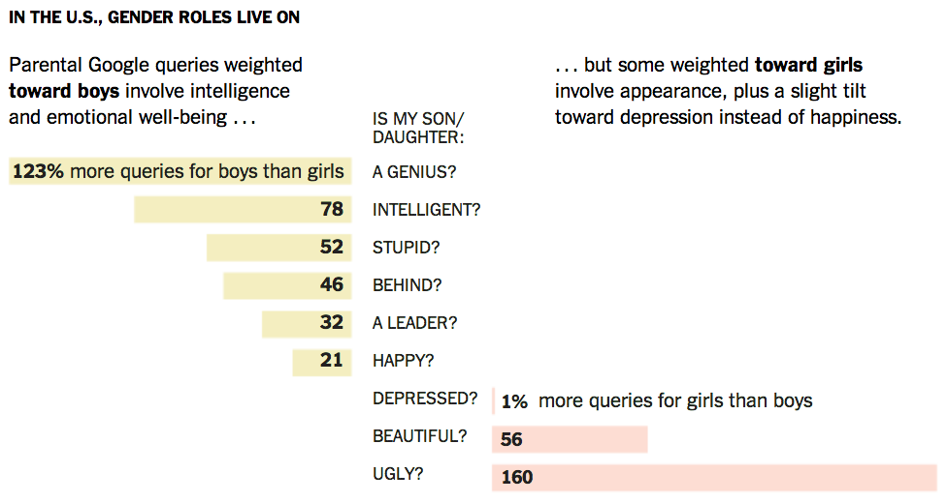
Results ctd
http://www.nytimes.com/2014/01/19/opinion/sunday/google-tell-me-is-my-son-a-genius.html?smid=fb-share&_r=1

Slide 33
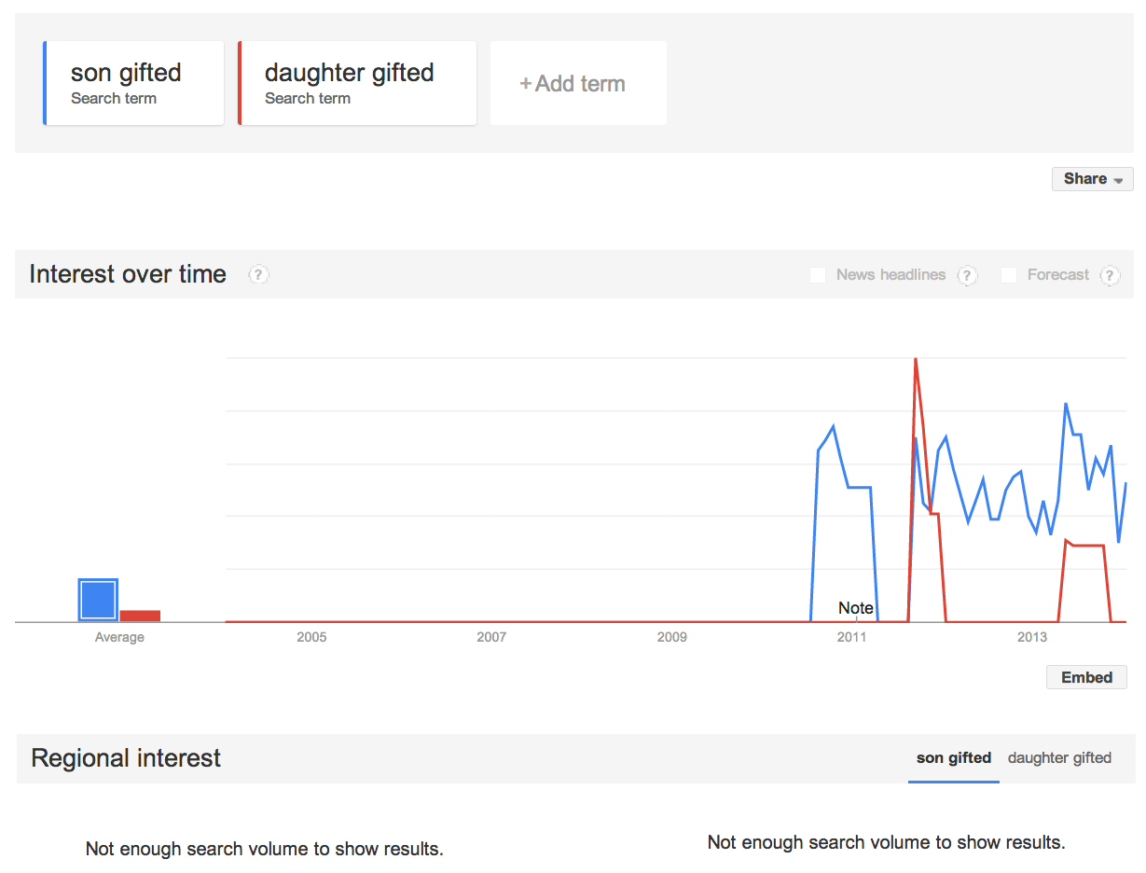
not enough data to draw conclusions

Slide 34
How would you build a flu prediction model?

Slide 35
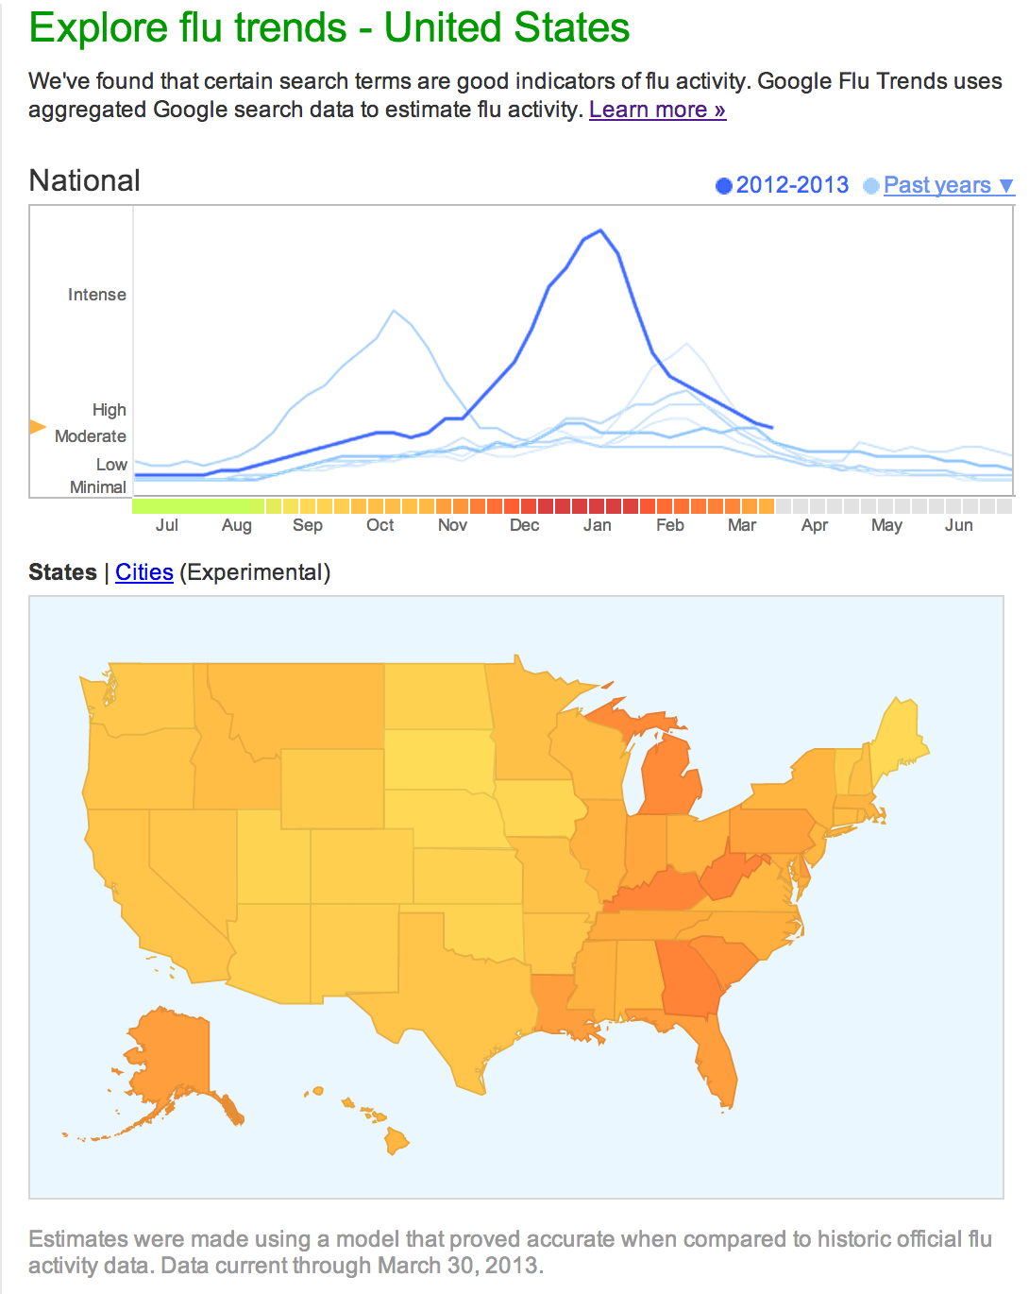
flu risk
“Scientific hindsight shows that Google Flu Trends far overstated this year's flu season….”
“Lots of media attention to this year's flu season skewed Google's search engine traffic.”
David Wagner, Atlantic Wire, Feb 13 2013
source:
http://www.google.org/flutrends/us/#US
Notes:
Google

Slide 36
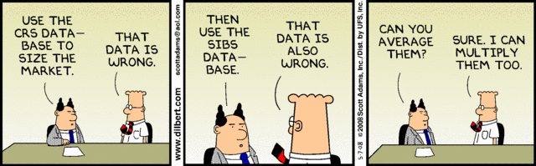

Slide 37
Simple Truths
„Power of data“
  the more data the merrier (GB -> TB)
  data comes from everywhere in all shapes
  value of data often discovered later
Services turn data into $
  the more services the merrier
  need to adapt quickly
E.g.: Google, Amadeus, Disney, Walmart, BMW, ...
Tools: Oracle/Vertica/PostgreSQL, Tableau, Python, Spark, SciKitLearn,....

Slide 38
Big Data Question: Yes or No?
Cure for cancer?
Find a spouse?
How to treat a cough?
Should I give Tim a loan?
Premium for fire insurance?
Which book should I read next?
Translate from English to German.
Notes:
Quizz – to see whether you have learned something ;-)

Slide 39
Some recurring themes
simple methods
repurposing data
communication matters
Other themes
  “Data products” – not just answers
  “Speed of thought” analysis
Notes:
Building “data products” to support “speed of thought” analysis

Slide 40
What is Data Science?
“Data Scientists:
The Definition of Sexy”
Forbes, 2012
“Data Scientist: The Sexiest
Job of the 21st Century”
Harvard Business Review, 2012

Slide 41
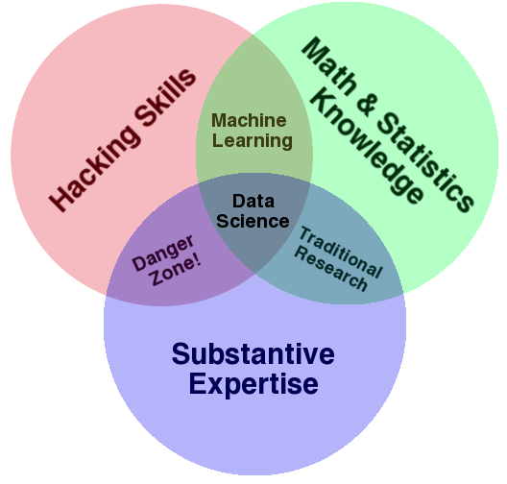
Drew Conway’s Data Science Venn Diagram

Slide 42
Mike Driscoll’s three sexy skills of data geeks
“data wrangling”
“data jujitsu”
“data munging”
Data Wrangling
  parsing, scraping, and formatting data
Statistics
  traditional analysis
Visualization
  graphs, tools, etc.

Slide 43
Doing Data Science
Peter Huber:
Inspection
Error checking
Modiﬁcation
Comparison
Modeling and model ﬁtting
Simulation
What-if analyses
Interpretation
Presentation of conclusions
[http://berkeleydatascience.files.wordpress.com/2012/01/20120117berkeley1.pdf]
Notes:
Peter Huber, statistician at UC Berkeley

Slide 44
Doing Data Science
Ben Fry:
Colin Mallows:
Acquire
Parse
Filter
Mine
Represent
Reﬁne
Interact
Identify data to collect and its relevance to your problem
Statistical speciﬁcation of the problem
Method selection
Analysis of method
Interpret results for non-statisticians
[http://berkeleydatascience.files.wordpress.com/2012/01/20120117berkeley1.pdf]
Notes:
Ben fry https://fathom.info/

Slide 45
A Practical Definition
Data Science is about the whole processing pipeline to extract information out of data
Data Scientist understand and care about the whole data pipeline and produce data products
A data pipeline consists of 3 steps:
1) Preparing to run a model
2) Running the model
3) Communicating the results / Create data products
Gathering, cleaning, integrating, restructuring, transforming, loading, filtering, deleting, combining, merging, verifying, extracting, shaping

Slide 46
Data Science is about Data Products
“Data-driven apps”
  Spellchecker
  Machine Translator
Interactive visualizations
  Google flu application
  Global Burden of Disease
Online Databases
  Enterprise data warehouse
  Sloan Digital Sky Survey
Data science is about building data products, not just answering questions
Data products empower others to use the data.
May help communicate your results (e.g., Nate Silver’s maps)
May empower others to do their own analysis
(e.g., Global Burden of Disease)
Notes:
Colin L. Mallows, Abaya Labs, Bell Labs, ….

Slide 47
Course Structure
2 lectures per week; ~1/3 will be a “hands on” exercise
Weekly readings
No exams
Grading Rubric:
  40% labs
  50% final project
  10% participation (we will also use clicker)

Slide 48
Labs
- Working with data in pandas / SQL
- Data wrangling
- Data cleaning and integration
- End to end data modeling and prediction
- Data visualization
- Scalable data processing tools (spark)
- Stats and statistical errors

Slide 49
Project
Two options:
Build a system for working with data
Choose a data set and do some end to end modeling on it

Slide 50
Example “Systems”
Given a twitter keyword, analyze the distribution of sentiment in tweets about it
Build a tool to extract structured data from a particular type of document, i.e., go from scanned PDF ➔ tabular data
Build a high performance visualization system for some data set

Slide 51
Interactive
Large-Scale Visualization using a GPU Database

Slide 52
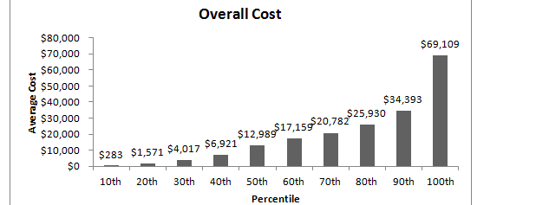
The Need for Interactive Analytics
Idea: often need to browse massive data sets
Browsing is best supported through visualization
➔ ad-hoc analytics, with millisecond response times

Slide 53
MapD: GPU Accelerated SQL Database
Key insight: GPUs have enough memory that a cluster of them can store substantial amounts of data
Not an accelerator, but a full blown query processor!
Massive parallelism enables interactive browsing interfaces
  4x GPUs can provide > 1 TB/sec of bandwidth
  12 Tflops compute
  Order of magnitude speedups over CPUs, when data is on GPU
“Shared nothing” arrangement
Notes:
----- Meeting Notes (8/27/13 11:58) -----
improvements -> speedups

Slide 54
Demo

Slide 55
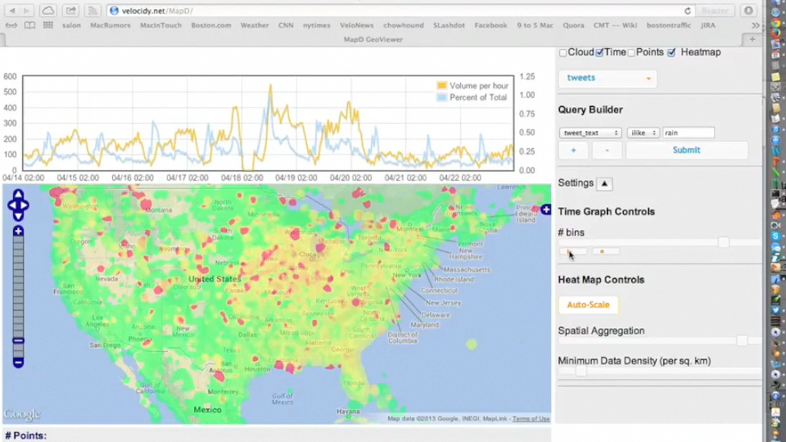

Slide 58
Example Data Sets
- Election data (donations, fundrasing)
- Sports data, at fine granularity (e.g., individual shots / passes)
- Education data (admissions, jobs, costs, loans)
- Medical data (medicare, billing, etc.)
- Federal funding (defense, nsf, etc)
- Real estate (transactions, property prices, restaurants, etc)

Slide 59
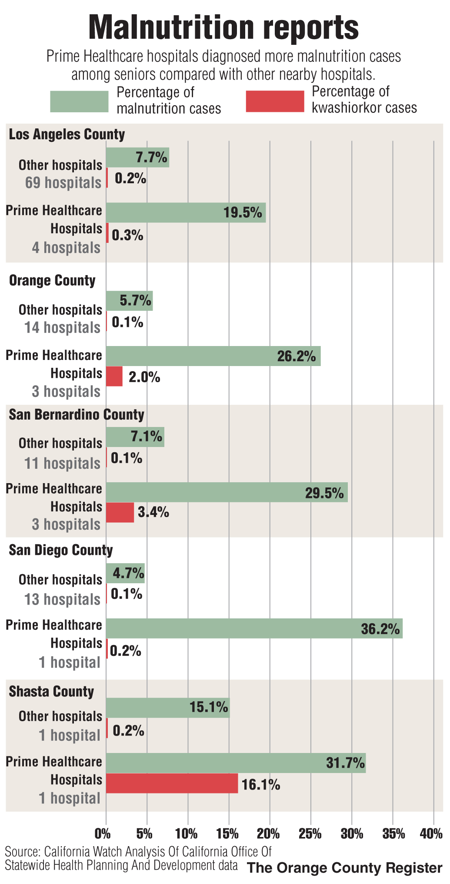
Kwashiorkor
Malnutrition from insufficient protein
Extremely rare in the US
16.1% of patients at Shasta county hospital reported to have it
Not one of 217 claims for the treatment of the condition in Medicare patients was proven legitimate in recent audits of two U.S. hospitals.

