Slide 1
6.5830 Lecture 5
Database Internals Continued
September 20, 2023

Slide 2
What is GoDB?
A basic database system
SQL Front-end (Provided for later labs)
Heap files (Lab 1)
Buffer Pool (Labs 1)
Basic Operators (Labs 1 & 2)
Scan, Filter, JOIN, Aggregate
Transactions (Lab 3)
Recovery (Lab 3)
Query optimizer
B-Tree Indexes

Slide 3
Start Early: It looks trivial until you get into it
Before Starting Lab 1
Finishing Lab 1

Slide 4
Example
Client
pageCache
hf:HeapFile
bp:BufferPool

Slide 5
Example
Client
Iterator()
Project(hf)
f()
pageCache
hf:HeapFile
bp:BufferPool

Slide 6
Example
Client
Iterator()
Project(hf)
f()
pageCache
Iterator()
hf:HeapFile
bp:BufferPool
f2()

Slide 7
Example
Client
Iterator()
Project(hf)
f()
pageCache
Iterator()
hf:HeapFile
readPage()
bp:BufferPool
p
p
GetPage()
f2()
p
&p

Slide 8
Example
Client
Iterator()
Project(hf)
t’
f()
pageCache
Iterator()
hf:HeapFile
readPage()
bp:BufferPool
p
t
p
GetPage()
f2()
p
Iterator()
&p
t
f3()

Slide 9
Deleting Records and Rids
Consider a query like: DELETE FROM x WHERE f > 10 This is translated into a plan like
Delete
Q: How does the delete operator know which records to delete?
Filter
A: Each record from the HeapFile is annotated with a record id that is used to identify the position of the record in the heap file to be deleted
Heap File

Slide 10
Deleting Records and Rids
// Remove the provided tuple from the HeapFile. This method should use the
// [Tuple.Rid] field of t to determine which tuple to remove.
// This method is only called with tuples that are read from storage via the
// [Iterator] method, so you can so you can supply the value of the Rid
// for tuples as they are read via [Iterator]. Note that Rid is an empty interface,
// so you can supply any object you wish. You will likely want to identify the
// heap page and slot within the page that the tuple came from.
func (f *HeapFile) deleteTuple(t *Tuple, tid TransactionID) error {
deleteTuple will be called by the delete operator
Using the t.Rid object, you can clear out the position in the heap file containing the record
Your heapfile implementation supplies the Rid in the iterator, and so you can identify this position however you like
A standard Rid implementation is a page number and a slot within the page
Recall that all pages have the same number of slots

Slide 11
func computeFieldSum(fileName string, td TupleDesc, sumField string
) (int, error) {
//Create buffer pool
bp := NewBufferPool(10)
hf, err := NewHeapFile("myfile.dat", &td, bp)
…
err = hf.LoadFromCSV(CSVfile, true, ",", false)
//find the column
fieldNo, err := findFieldInTd(FieldType{sumField, "", IntType}, &td)
//Start a transaction -> we will do the implementation in another lab
tid := NewTID()
bp.BeginTransaction(tid)
iter, err := hf.Iterator(tid)
//Iterate through the tuples and sum them up.
sum := 0
for {
tup, err := iter()
f := tup.Fields[fieldNo].(IntField)
sum += int(f.Value)
}
bp.CommitTransaction() //commit transaction
return sum, nil //return the value
}

Slide 12
Plan for Next Few Lectures
Admission Control
Connection Management
Query System
Parser
Today
Rewriter
Planner
Optimizer
(Lec 9)
Today+Lec 5
Lec 7 – Join Algos
Executor
Storage System
Access Methods
Buffer Manager
Lock Manager
Log Manager
Lec 6

Slide 13
Query Processing Steps
Admission Control
Query Rewriting
Plan Formulation (SQL → Tree)
Optimization

Slide 14
Connecting Operators: Iterator Model
Each operator implements a simple iterator interface:
open(params)
getNext() → record
close() → cleanup
Any iterator can compose with any other iterator
Π_{movieTitle}
⨝
starName = name
𝛔_{birthday…}
starsIn
Data flows from bottom to top
it1 = Scan.open(“movieStar”, …)
it2 = Filter.open(it1, bday=x, …)
it3 = Scan.open(“starsIn”, …)
it4 = Join.open(it2, it3,
starName=name)
it5 = Proj.open(it4, movieTitle)
movieStar

Slide 15
Iterator Model
it1 = Scan.open(“movieStar”, …)
it2 = Filter.open(it1, bday=x, …)
it3 = Scan.open(“starsIn”, …)
it4 = Join.open(it2, it3,
starName=name)
it5 = Proj.open(it4, movieTitle)
getNext
(”Brad Pitt”)
it5
(”Brad Pitt”, “Ad Astra”)
getNext
it4
“Brad Pitt”
getNext
”Ad Astra”
getNext
it2
it3
starsIn
“Brad Pitt”
getNext
it1
movieStar

Slide 16
GoDB Iterator
Π_{movieTitle}
⨝
starName = name
𝛔_{birthday…}
starsIn
Data flows from bottom to top
movieStar
hf1, _ := NewHeapFile(MovieStarsFile,…)
filt, _ := NewIntFilter(&ConstExpr{IntField{..}, IntType}, OpGt, &fieldExp, hf1)
hf2, _ := NewHeapFile(StarsInFile, …)
join, _ := NewStringEqJoin (filt, &leftField, hf2, &rightField, 100)
proj, _ := NewProjectOp([]Expr{&fieldExpr}, outNames, false, join)
iter, _ := proj.Iterator(tid)
for {
tup, err := iter()
if err != nil { t.Errorf(err.Error())}
if tup == nil {
break
}
///do something with tup
}

Slide 17
This Lecture
What makes a good query plan?
Cost Estimation
Buffer Management
Postgres Examples

Slide 18
Cost Estimation
Π_{ename,count}
Query optimization goal: find plan that has lowest cost?
What is cost?
𝛔_{count > 7}
𝛂_{agg:count(*), group by ename}
⨝
eno=eno
Order?
Disk I/O (Pages Read)
Memory Accesses
CPU Cycles
Comparisons
Records Processed
⨝
dno=dno
kids
𝛔_{name=‘eecs’}
𝛔_{sal>50k}
dept
emp

Slide 19
Memory Hierarchy
Core1
Core2
Core1
Core2
4 cycles
L1 Cache
L1 Cache
L1 Cache
L1 Cache
32 KB
12 cycles
L2 Cache
L2 Cache
256 KB
36 cycles
L3 Cache
8 MB
Memory Bus
50-100ns
(~ 150-300 cycles)
System Memory
64 GB
SSD (Flash) Disk
4 TB
Notes:
(F

Slide 20
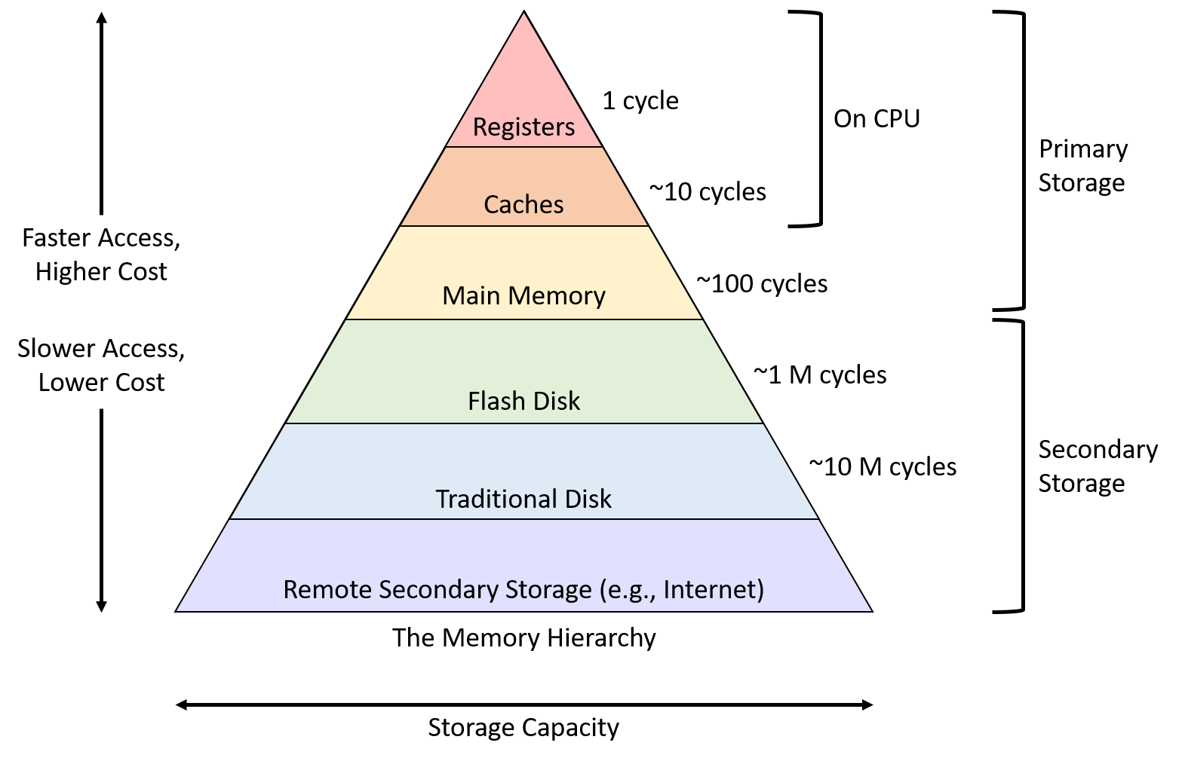

Slide 21
Bandwidth vs Latency
1st access latency often high relative to the rate device can stream data sequentially (bandwidth)
RAM: 50 ns per 16 B cache line
random access bandwidth of 16 * 1/5x10⁻⁸ = 320 MB / sec
If streaming sequentially, bandwidth 20-40 GB/sec
Flash disk: 250 us per 4K page
Random access bandwidth of 4K * 1/2.5x10⁻⁴= 16 MB / sec
If streaming sequentially, bandwidth 2+ GB/sec
(100x difference)
(125x difference)

Slide 22
Bandwidth v Latency (cont.)
(250x difference)
Spinning disk: 10 ms latency vs 100 MB seq bandwidth
Random access BW per 4KB page = 400 KB/sec
Local network: 100 us latency vs 10 GB seq bandwidth
Random access BW per byte = 10K / sec
Wide area net: 10 ms latency vs 1 GB seq bandwidth
Random access BW per byte = 100 B / sec
(1Mx difference)
(100Mx difference)

Slide 23
Important Numbers
CPU Cycles / Sec | 2+ Billion (.5 nsec latency)
L1 latency | 2 nsec (4 cycles)
L2 latency | 6 nsec (12 cycles)
L3 latency | 18 nsec (36 cycles)
Main memory latency | 50 – 100 ns (150-300 cycles)
Sequential Mem Bandwidth | 20-40+ GB/sec
SSD Latency | 250+ usec
SSD Seq Bandwidth | 2-4 + GB/sec
HD (spinning disk) latency | 10 msec
HD Seq Bandwidth | 100+ MB
Local Net Latency | 10 – 100 usec
Local Net Bandwidth | 1 – 40 Gbit /sec
Wide Area Net Latency | 10 – 100 msec
Wide Area Net Bandwidth | 100 – 1 Gbit / sec

Slide 24
Speed Analogy
Disk
10s
100m
10 msec / access
Flash
10s
…
10km
100 usec / access
Main Memory
10s
…
100,000 km
10 nsec/access
Notes:
2x around the world

Slide 25
Database Cost Models
Typically try to account for both CPU and I/O
I/O = ”input / output”, i.e., data access costs from disk
Database algorithms try to optimize for sequential access (to avoid massive random access penalties)
Simplified cost model for 6.5830:
# seeks (random I/Os) x random I/O time +
sequential bytes read x sequential B/W
Notes:
Which do you think dominates in most database systems? CPU or IO?
(Depends. Not always disk I/O. Typically vendors try to configure machines so they are 'balanced'. Can vary from query to query. Because of sequential access methods, buffer pool, we can often end up CPU bound.)
For example, fastest TPC-H benchmark result (data warehousing benchmark), on 10 TB of data, uses 1296 74 GB disks, which is 100 TB of storage. Add'l storage is partly for indices, but partly just because they needed add'l disk arms. 72 processors, 144 cores -- ~10 disks / processor!

Slide 26
Example
SELECT * FROM emp, dept, kids
WHERE sal > 10k
AND emp.dno = dept.dno
AND emp.eid = kids.eid
100 tuples/page
10 pages RAM
10 KB/page
3000
|dept| = 100 records = 1 page = 10 KB
|emp| = 10K = 100 pages = 1 MB
|kids| = 30K = 300 pages = 3 MB
⨝ eno=eno
1000
30000
kids
Spinning Disk:
10 ms / random access page
100 MB/sec sequential B/W
Assume nested loops joins, no indexes
⨝ dno=dno
1000
100
𝛔_{sal>10k}
10%
10K
dept
emp

Slide 27
Example w/ Simple Cost Model
WHAT IF…..
We use an index to random-seek to the 10% selection of emp?
Instead of 1 seek + 1MB/ 100MB/sec = 20ms,
it’s 10 seeks for 10 pages (which is very lucky)?
10 seeks + 100k / 100MB/sec = 100ms + 1ms
# seeks (random disk I/Os) x random I/O time + sequential bytes read / sequential disk B/W
100 tuples/page
10 pages RAM
10 KB/page
|dept| = 100 records = 1 page = 10 KB
|emp| = 10K = 100 pages = 1 MB
|kids| = 30K = 300 pages = 3 MB
Spinning Disk:
10 ms / random access page
100 MB/sec sequential B/W
Dept is outer in NL Join:
1 scan of dept
100 scans of emp (can we cache?)
1 scan of dept:
1 seek + 10KB / 100 MB/sec
10 ms + .1ms = 10.1 ms
1 scan of emp:
1 seek + 1 MB / 100 MB/sec
10 ms + 10 ms = 20 ms
100 x 20 ms + 10.1 ms = 2.1001 s
⨝ eno=eno
⨝ dno=dno
kids
𝛔_{sal>10k}
dept
emp
Notes:
WE CANNOT CACHE. 10 PAGES OF RAM BUT 100 PAGES OF emp

Slide 28
Example w/ Simple Cost Model
# seeks (random disk I/Os) x random I/O time + sequential bytes read / sequential disk B/W
100 tuples/page
10 pages RAM
10 KB/page
|dept| = 100 records = 1 page = 10 KB
|emp| = 10K = 100 pages = 1 MB
|kids| = 30K = 300 pages = 3 MB
Spinning Disk:
10 ms / random access page
100 MB/sec sequential B/W
Dept is inner in NL Join:
Let’s take a break and try to do this individually
⨝ eno=eno
⨝ dno=dno
kids
1000
𝛔_{sal>10k}
(Caching has huge benefit!)
dept
emp

Slide 29
Example w/ Simple Cost Model
Actually…
remember we have 10 pages of RAM!
What’s wrong here?
# seeks (random disk I/Os) x random I/O time + sequential bytes read / sequential disk B/W
100 tuples/page
10 pages RAM
10 KB/page
|dept| = 100 records = 1 page = 10 KB
|emp| = 10K = 100 pages = 1 MB
|kids| = 30K = 300 pages = 3 MB
Spinning Disk:
10 ms / random access page
100 MB/sec sequential B/W
Dept is inner in NL Join:
1 scan of emp
1K scans of dept (can we cache?)
Load dept (and 1k cached reads)
1 seek + 10KB / 100 MB/sec
10 ms + .1ms = 10.1 ms
1 scan of emp:
1 seek + 1 MB / 100 MB/sec
10 ms + 10 ms = 20 ms
20ms + 10.1 ms = 30.1 ms
(vs 2.1001s previously; ~70x faster!)
⨝ eno=eno
⨝ dno=dno
kids
1000
𝛔_{sal>10k}
(Caching has huge benefit!)
dept
emp

Slide 30
Example w/ Simple Cost Model
# seeks (random disk I/Os) x random I/O time + sequential bytes read / sequential disk B/W
100 tuples/page
10 pages RAM
10 KB/page
|dept| = 100 records = 1 page = 10 KB
|emp| = 10K = 100 pages = 1 MB
|kids| = 30K = 300 pages = 3 MB
Spinning Disk:
10 ms / random access page
100 MB/sec sequential B/W
2nd join – kids is inner
How much time does 2nd join take?
Again, take a moment to do it out
⨝ eno=eno
1000
⨝ dno=dno
kids
𝛔_{sal>10k}
dept
emp

Slide 31
Example w/ Simple Cost Model
# seeks (random disk I/Os) x random I/O time + sequential bytes read / sequential disk B/W
100 tuples/page
10 pages RAM
10 KB/page
|dept| = 100 records = 1 page = 10 KB
|emp| = 10K = 100 pages = 1 MB
|kids| = 30K = 300 pages = 3 MB
Spinning Disk:
10 ms / random access page
100 MB/sec sequential B/W
2nd join – kids is inner
1000 scans x
1 seek + 3 MB / 100 MB / sec
1000 x (0.01 + 0.03) = 40 sec
⨝ eno=eno
1000
⨝ dno=dno
kids
Many query planners will not consider plans where “inner” (e.g., kids) is not a base relation – so called “left deep” plans
𝛔_{sal>10k}
dept
emp

Slide 32
Example w/ Simple Cost Model
# seeks (random disk I/Os) x random I/O time + sequential bytes read / sequential disk B/W
100 tuples/page
10 pages RAM
10 KB/page
|dept| = 100 records = 1 page = 10 KB
|emp| = 10K = 100 pages = 1 MB
|kids| = 30K = 300 pages = 3 MB
Spinning Disk:
10 ms / random access page
100 MB/sec sequential B/W
What if dept were stored on a local network machine?
Local network: 100 us latency, 10 GB seq bandwidth (assume data loading costs on remote machine are negligible)
⨝ eno=eno
1000
⨝ dno=dno
kids
𝛔_{sal>10k}
dept
emp

Slide 33
Example w/ Simple Cost Model
# seeks (random disk I/Os) x random I/O time + sequential bytes read / sequential disk B/W
100 tuples/page
10 pages RAM
10 KB/page
|dept| = 100 records = 1 page = 10 KB
|emp| = 10K = 100 pages = 1 MB
|kids| = 30K = 300 pages = 3 MB
Spinning Disk:
10 ms / random access page
100 MB/sec sequential B/W
Dept is inner in NL Join:
1 scan of emp
1K scans of dept (cached)
Load dept:
1 request + 10KB / 10 GB/sec
0.01 ms + .001ms = 0.011 ms
1 scan of emp:
1 seek + 1 MB / 100 MB/sec
10 ms + 10 ms = 20 ms
0.011 ms + 20 ms = 20.011 ms
(vs 30.1ms when dept is on disk)
⨝ eno=eno
⨝ dno=dno
kids
1000
𝛔_{sal>10k}
dept
emp

Slide 34
Are we oversimplifying?

Slide 35
Buffer Pool
Buffer pool is a cache for memory access. Caches pages of files / indices.
When page is in buffer pool, don't need to read from disk
Updates can also be cached
Discuss more w/ transactions

Slide 36
Buffer Pool
Memory region organized as an array of fixed size pages. An array entry is called a frame.
Dirty pages are kept and not written to disk immediately (transaction processing).
Page1
Page6
Page9
frame4
frame5
frame6
Page1
Page2
Page3
Page4
Page5
Page6
Page7
Page8
Page9
Page10
…
PageN

Slide 37
Buffer Pool
The page table keeps track of what pages are in memory and maintains additional meta-data per page:
Dirty Flag
Pin/Reference Counter
Latches
In OpsDB also responsible for read/write locks (normally separate component lock manager)
Page1
frame1
Page6
frame2
Page9
frame3
Page5
frame4
frame5
frame6
Page1
Page2
Page3
Page4
Page5
Page6
Page7
Page8
Page9
Page10
…
PageN

Slide 38
LOCKS VS. LATCHES
Locks:
Protects the database's logical contents from other transactions.
Held for transaction duration
Need to be able to rollback changes.
Latches (Mutex)
Protects the critical sections of internal data structure from other threads.
Held for operation duration.
Do not need to be able to rollback changes

Slide 39
Eviction Policy
Least Recently Used (LRU)
Evict oldest page accessed
Intuitively, makes sense because recently accessed data is likely to be accessed again
Is LRU always optimal?
Notes:
What is optimal buffer pool caching strategy? Always LRU?
No.
What if some relation doesn't fit into memory? (MRU preferred)
2 pages RAM, 3 pages of a relation R -- a, b c, accessed sequentially in a loop

Slide 40
Is LRU Always Optimal?
No! What if some relation doesn't fit into memory?
Consider: 2 pages RAM, 3 pages of a relation R -- a, b c, accessed sequentially in a loop
 | Access
RAM Page | 1 | 2 | 3 | 4
1 | a | a | c | c
2 |  | b | b | a
LRU Always misses!
Databases do not comply with some traditional OS assumptions

Slide 41
Consider MRU
Consider: 2 pages RAM, 3 pages of a relation R -- a, b c, accessed sequentially in a loop
 | Access
RAM Page | 1 (a) | 2 (b) | 3 (c) | 4 (a) | 5 (b) | 6 (c) | 7 (a) | 8 (b)
1 | a | a | a | A - hit | b | b | b | B - hit
2 |  | b | c | c | c | C – hit | a | a
MRU hits on 1 out of 2!

Slide 42
Better Policies
What other policies can you think of?

Slide 43
Better Policies
LRU-K: Keep the last k accesses. Estimate when the next one will happen
Query-local-policies: Queries often know better what the access pattern is. Leverage it (e.g., Postgres maintains a small ring buffer that is private to the query.
Priority hints: For example, set a priority hint for the top index pages rather data pages

Slide 44
Buffer Pool Optimization
What other optimizations can you think of?

Slide 45
Buffer Pool Optimizations
Multiple Buffer Pools
Pre-Fetching
Scan Sharing
Buffer Pool Bypass
Notes:
The sequential scan operator will not store fetched
pages in the buffer pool to avoid overhead. → Memory is local to running query. → Works well if operator needs to read a large sequence of
pages that are contiguous on disk. → Can also be used for temporary data (sorting, joins).
Called "Light Scans" in Informix.

Slide 46
Scan Sharing
How does Scan Sharing work?
PostgreSQL: synchronize_seqscans (boolean) This allows sequential scans of large tables to synchronize with each other, so that concurrent scans read the same block at about the same time and hence share the I/O workload. …. This can result in unpredictable changes in the row ordering returned by queries that have no ORDER BY clause.

Slide 47
Postgres Query Plans
create table dept (dno int primary key, bldg int);
insert into dept (dno, bldg) select x.id, (random() * 10)::int FROM generate_series(0,100000) AS x(id);
create table emp (eno int primary key, dno int references dept(dno), sal int, ename varchar);
insert into emp (eno, dno, sal, ename) select x.id, (random() * 100000)::int, (random() * 55000)::int, 'emp' || x.id from generate_series(0,10000000) AS x(id);
create table kids (kno int primary key, eno int references emp(eno), kname varchar);
insert into kids (kno,eno,kname) select x.id, (random() * 1000000)::int, 'kid' || x.id from generate_series(0,3000000) AS x(id);
Notes:
explain select ename, count(*)
from emp, dept, kids
where emp.dno=dept.dno
and kids.eno=emp.eno
and emp.sal > 50000
and dept.bldg = 1
group by ename
having count(*) > 7
;

Slide 48
Postgres Costs
explain select * from emp;
QUERY PLAN
----------------------------------------------------------------
Seq Scan on emp (cost=0.00..163696.15 rows=10000115 width=22)
(1 row)
test=# select relpages from pg_class where relname = 'emp';
relpages
----------
63695
(1 row)
test=# show cpu_tuple_cost;
cpu_tuple_cost
----------------
0.01
(1 row)
Cost =
cpu_tuple_cost * rows + pages =
.01 * 10000115 + 63695 = 163696.15

Slide 49
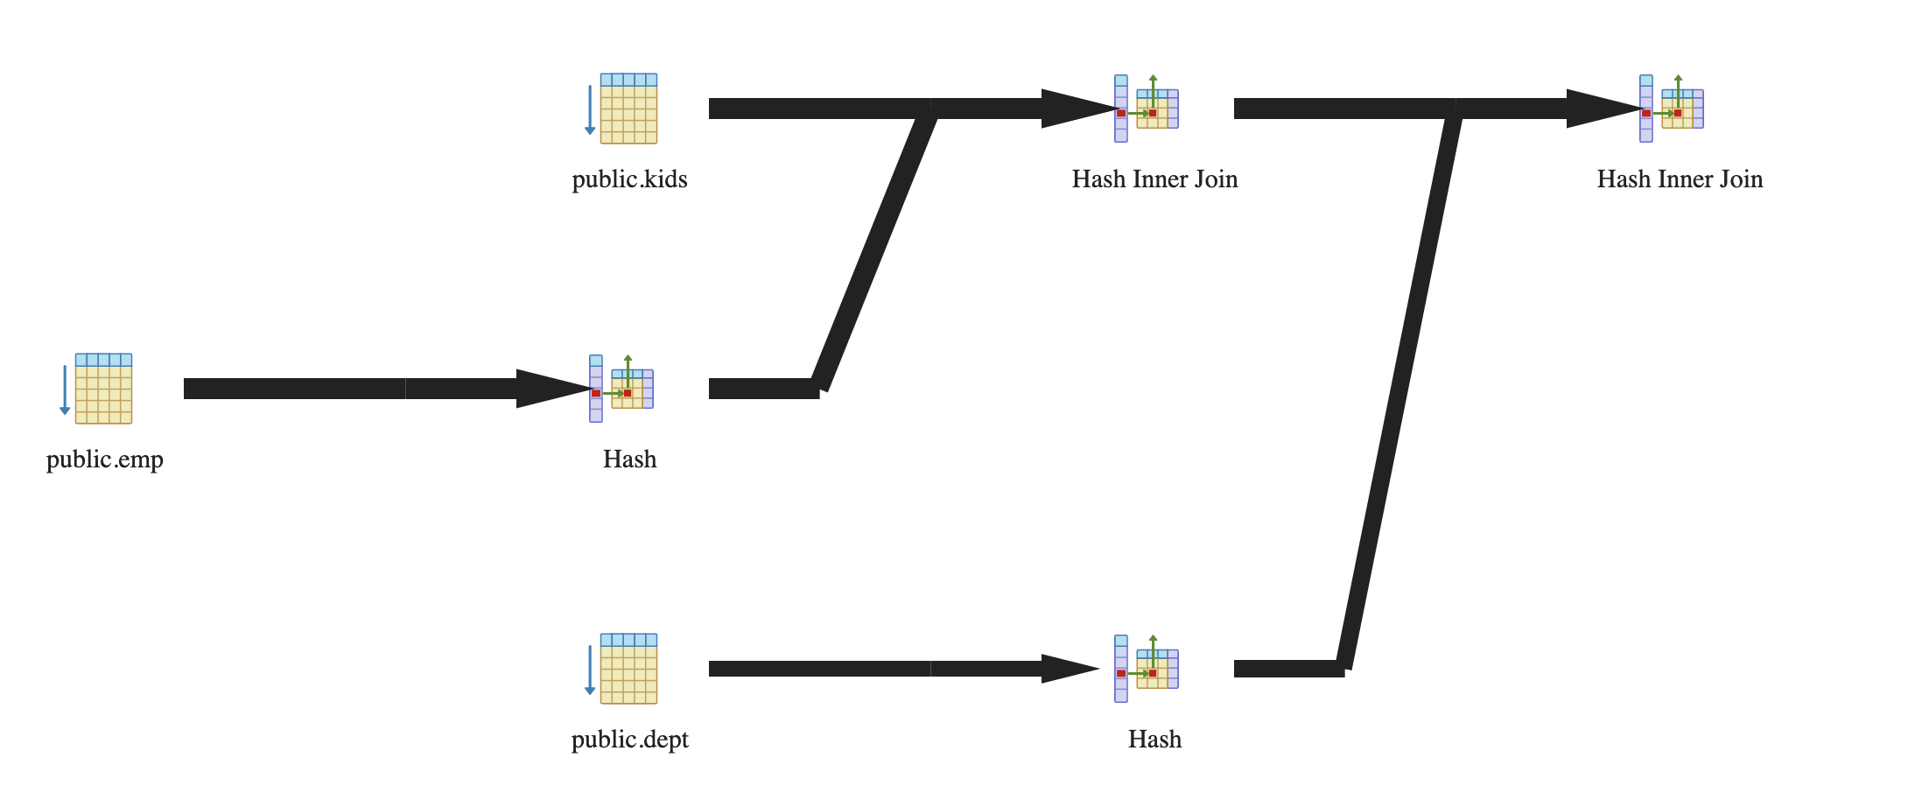
Postgres Plans
SELECT * FROM emp, dept, kids
WHERE sal > 10000
AND emp.dno = dept.dno
AND emp.eno = kids.eno
QUERY PLAN
---------------------------------------------------------------------------------
Hash Join (cost=342160.30..527523.82 rows=2457233 width=48)
Hash Cond: (emp.dno = dept.dno)
-> Hash Join (cost=339076.28..479202.29 rows=2457233 width=40)
Hash Cond: (kids.eno = emp.eno)
-> Seq Scan on kids (cost=0.00..49099.01 rows=3000001 width=18)
-> Hash (cost=188696.44..188696.44 rows=8190867 width=22)
-> Seq Scan on emp (cost=0.00..188696.44 rows=8190867 width=22)
Filter: (sal > 10000)
-> Hash (cost=1443.01..1443.01 rows=100001 width=8)
-> Seq Scan on dept (cost=0.00..1443.01 rows=100001 width=8)
(10 rows)

Slide 50
Study Break
Assuming disk can do 100 MB/sec I/O, and 10ms / seek
And the following schema:
grades (cid int, g_sid int, grade char(2))
students (s_int, name char(100))
Estimate time to sequentially scan grades, assuming it contains 1M records (Consider: field sizes, headers)
Estimate time to join these two tables, using nested loops, assuming students fits in memory but grades does not, and students contains 10K records.

Slide 51
Seq Scan Grades
grades (cid int, g_sid int, grade char(2))
8 bytes (cid) + 8 bytes (g_sid) + 2 bytes (grade) + 4 bytes (header) = 22 bytes
22 x 1M = 22 MB / 100 MB/sec = .22 sec + 10ms seek
➔ .23 sec

Slide 52
NL Join Grades and Students
grades (cid int, g_sid int, grade char(2))
students (s_int, name char(100))
10 K students x (100 + 8 + 4 bytes) = 1.1 MB
Students Inner (Preferred)
Cache students in buffer pool in memory: 1.1/100 s = .011 s
One pass over students (cached) for each grade (no additional cost beside caching)
Time to scan grades (previous slide) = .23 s
.244 s
Grades Inner
One pass over grades for each student, at .22 sec / pass, plus one seek at 10 ms (.01 sec) ➔ .23 sec / pass
2300 seconds overall
(Time to scan students is .011 s, so negligible)

Slide 53
Today: Access Methods
Access method: way to access the records of the database
3 main types:
Heap file / heap scan
Hash index / index lookup
B+Tree index / index lookup / scan ← next time
Many alternatives: e.g., R-trees ← next time
Each has different performance tradeoffs

Slide 54
Design Considerations for Indexes
What attributes to index?
Why not index everything?
Index structure:
Leaves as data
Only one index?
“Primary Index”
Leaves as pointers to heap file
“Secondary Index”
Clustered vs unclustered
Primary Index
Data
R1 R2
R3 R4
…
Secondary Index
Pointers
…
In 6.5830 we will use secondary indexes, and distinguish between clustered and unclustered
Heap File
R1 R2
R3 R4
…
Notes:
Each index is usually a copy of at least one column, so there’s a space penalty
BUT ALSO, updates get more expensive!
THERE ARE tradeoffs between different storage representations
scan vs. search vs. insert vs. delete

Slide 55
Tree Index
<3 | ≥3, <5 | ≥5, <7 | ≥8, 9
Index File
0 | 1 | 2 | 2 | 2
3 | 4
5 | 6
8 | 9 | 9
Hdr | R1 | R2 | R3 | R4
 | 3 | 2 | 9 | 4
Hdr | R4 | R5 | R6 | R7
 | 6 | 1 | 0 | 2
Hdr | R8 | R9 | R10 | R11
 | 9 | 8 | 2 | 5
Heap File
Attr1
…
Attrn

Slide 56
Index Scan
Traverse the records in Attr1 order, or lookup a range
<3 | ≥3, <5 | ≥5, <7 | ≥8, 9
0 | 1 | 2 | 2 | 2
3 | 4
5 | 6
8 | 9 | 9
Attr1 >= 6 &
Attr1 < 9
Hdr | R1 | R2 | R3 | R4
 | 3 | 2 | 9 | 4
Hdr | R4 | R5 | R6 | R7
 | 6 | 1 | 0 | 2
Hdr | R8 | R9 | R10 | R11
 | 9 | 8 | 2 | 5
Heap File
Attr1
Note random access! – this is an “unclustered” index

Slide 57
Costs of Random Access
Portion Read
(B bytes)
Entire Table
T bytes
Consider an SSD with 100 usec latency, 1 GB/sec BW
Query accesses B bytes, R bytes per record, whole table is T bytes
Seq scan time S = T / 1GB/sec
Rand access via index time = 100 usec * B/R + B / 1GB/sec
Suppose R is 100 bytes, T is 10 GB
When is it cheaper to scan than do random lookups via index?
100x10⁻⁶ * B / 100 + B/1x10⁹ > 10x10⁹ / 1x10⁹
1x10⁻⁶B + 1x10⁻⁹B > 10
B > 9.99x10⁶
For scans of larger than 10 MB, cheaper to scan entire 10 GB table than to use index

Slide 58
Clustered Index
Order pages on disk in index order
<3 | ≥3, <5 | ≥5, <7 | ≥8, 9
Index File
0 | 1 | 2 | 2 | 2
3 | 4
5 | 6
8 | 9 | 9
Hdr | R1 | R2 | R3 | R4
 | 3 | 2 | 9 | 4
Hdr | R4 | R5 | R6 | R7
 | 6 | 1 | 0 | 2
Hdr | R8 | R9 | R10 | R11
 | 9 | 8 | 2 | 5
Heap File
Attr1
…
Attrn

Slide 59
Clustered Index
Order pages on disk in index order
<3 | ≥3, <5 | ≥5, <7 | ≥8, 9
Index File
0 | 1 | 2 | 2 | 2
3 | 4
5 | 6
8 | 9 | 9
Per record random I/O → per page random I/O for index scans on Attr1 (but only Attr1!)
Hdr | R6 | R8 | R2 | R7
 | 0 | 1 | 2 | 2
Hdr | R10 | R1 | R4 | R11
 | 2 | 3 | 4 | 5
Hdr | R4 | R9 | R3 | R8
 | 6 | 8 | 9 | 9
Heap File
Attr1
…
Attrn

Slide 60
Benefit of Clustering
Consider an SSD with 100 usec latency, 1 GB/sec BW
Query accesses B bytes, R bytes per record, whole table is T bytes
Pages are P bytes
Seq scan time S = T / 1GB/sec
Clustered index access time = 100 usec * B/PR + B / 1GB/sec
Suppose R is 100 bytes, T is 10 GB, P is 1 MB
When is it cheaper to scan than do random lookups via clustered index?
100x10⁻⁶ * B / 1x10⁶ + B/1x10⁹ > 10x10⁹ / 1x10⁹
1x10⁻¹²B + 1x10⁻⁹B > 10
B > 9.99x10⁹
For scans of larger than 9.9 GB, cheaper to scan entire 10 GB table than to use ^{clustered index}

