Slide 1

6.5830 Lecture 2
Please use Piazza:
https://piazza.com/class/llmf39nuxcs5us
http://dsg.csail.mit.edu/6.5830/
Sam Madden
Key ideas:
Relational vs Other Data Models
Advanced SQL
PS1 Out (SQL, due next Weds)
Lab 0 Due This Wednesday
“Those who cannot remember the past are doomed to repeat it”

Slide 2
Today
Data models + history
  Hierarchical (IMS/DL1) – 1960’s
  Network (CODASYL) – 1970’s
  Relational – 1970’s and beyond
Key ideas
  Data redundancy (and how to avoid it)
  Physical and logical data independence
  Relational algebra and axioms

Slide 3
Recap: Zoo Data Model
Entity Relationship Diagram
1
Animal
n
contains
1
Cage
1
entity
relationship
entity
name
n
feedTime
1
1
Name
Time
keeps
1
age
Building
1
bldg
Age
n
species
Keeper
1
name
1
entity
Species
1
Name
Animals have names, ages, species
Keepers have names
Cages have cleaning times, buildings
Animals are in 1 cage; cages have multiple animals
Keepers keep multiple cages, cages kept by multiple keepers

Slide 4
Zoo Tables
Animals
id | name | age | species | cageno
1 | Sam | 3 | Salamander | 1
2 | Mike | 12 | Giraffe | 1
3 | Sally | 1 | Student | 2
Cages
no | feedtime | building
1 | 12:30 | 1
2 | 1:30 | 2
Keepers
Keeps
id | name
1 | Jane
2 | Joe
kid | cageno
1 | 1
1 | 2
2 | 1

Slide 5
Cages in Building 32
NESTED LOOPS
Imperative
    for each row a in animals
    for each row c in cages
    if a.cageno = c.no and c.bldg = 32
    output a
Declarative
    SELECT a.name FROM animals AS a, cages AS c WHERE a.cageno = c.no AND c.bldg = 32
JOIN
Equivalently
    SELECT a.name
    FROM animals AS a, cages AS c ON a.cageno = c.no WHERE c.bldg = 32

Slide 6
Average Age of Bears
Declarative
    SELECT AVG(age) FROM animals
    WHERE species = ‘bear’

Slide 7
Complex Queries
  Find pairs of animals of the same species and different genders older than 1 year:
  SELECT a1.name,a2.name
  FROM animals as a1, animals as a2
  WHERE a1.gender = M and a2.gender = F
  AND a1.species = a2.species
  AND a1.age > 1 and a2.age > 1
“self join”
Find cages with salamanders fed later than the average feedtime of any cage:
  SELECT cages.cageid FROM cages, animals
  WHERE animals.species = ’salamander'
  AND animals.cageid = cages.cageid
  AND cages.feedtime >
  (SELECT AVG(feedtime) FROM cages )
“nested queries”

Slide 8
Modified Zoo Data Model
Slightly different than last time:
Each animal in 1 cage, multiple animals share a cage
Each animal cared for by 1 keeper, keepers care for multiple animals

Slide 9
IMS (Hierarchical Model)
Data organized as segments
  Collection of records, each with same segment type
  Arranged in a tree of segment types, e.g.:
    Keepers Keepers
      Animals Cages
        Cages Animals
Segments have different physical representations
  Unordered
  Indexed
    Sorted
    Hashed

Slide 10
Example Hierarchy
Jane (keeper) (HSK 1)
Sam, salamander, … (2)
1, 100sq ft, … (3)
Tim, giraffe, … (4)
2, 1000sq ft, … (5)
Sally, student, … (6)
1, 100sq ft, … (7)
Joe (keeper) (8)
Repeated information!
IMS Physical Represenation
Keepers segment
A1 Segment A2 Segment A3 Segment
C1 Segment C2 Segment C3 Segment

Slide 11
Segment Structure
Each segment has a particular physical representation
  Chosen by database administrator
  E.g., ordered, hashed, unordered…
Choice of segment structure affects which operations can be applied on it

Slide 12
IMS / DL/1 Operations
GetUnique (seg type, pred)
  Get first record satisfying pred
  Only supported by hash / sorted segments
GetNext (seg type, pred)
  Get first or next key in hierarchical order
  Starts from last GetNext/GetUnique call
GetNextParent (seg type, pred)
  Same as GetNext, but will not move up hierarchy to next parent
Delete, Insert

Slide 13
Example PL/I Program #1
Find the cages that Jane keeps
GetUnique(Keepers, name = "Jane")
Until done:
cageid = GetNextParent (cages).no
print cageid
Jane (keeper) (HSK 1)
Sam, salamander, … (2)
1, 100sq ft, … (3)
Tim, giraffe, … (4)
2, 1000sq ft, … (5)
Sally, student, … (6)
1, 100sq ft, … (7)
Joe (keeper) (8)
This iterates through data underneath Jane
Implicitly, now navigating from the Jane record in keepers

Slide 14
Example PL/I Program #2
Find the keepers that keep cage 6
keep = GetUnique(keepers)
Until done:
cage = GetNextParent(cages, id = 6)
if (cage is not null):
print keep
keep = GetNext(keepers)

Slide 15
What’s Bad About IMS & PL/I?
Duplication of data w/ non-hierarchical data
Painful low level programming interface – have to program the search algorithm
Limited physical data independence
  Change root from indexed to hash --- programs that do GetNext on the root segment will fail
  Change root from keepers to animals? Also fails.
  Cannot do inserts into sequential root structure
Limited logical data independence
  Schemas change, do programs have to?

Slide 16
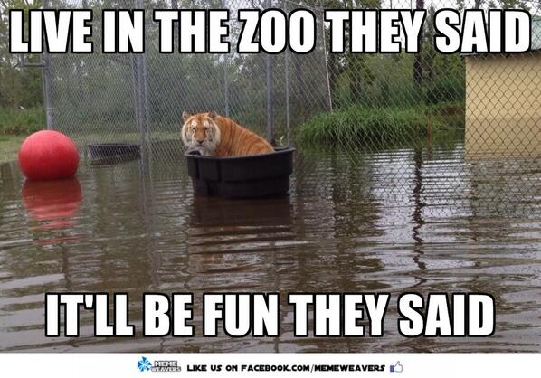
Logical Data Independence
Suppose as a cost cutting measure, Zoo management decides a keeper will be responsible for a cage – and all the animals in that cage.
Programs have to change, because the position in the database after a GN/GNP call may not be the same anymore!
Will see how SQL addresses this

Slide 17
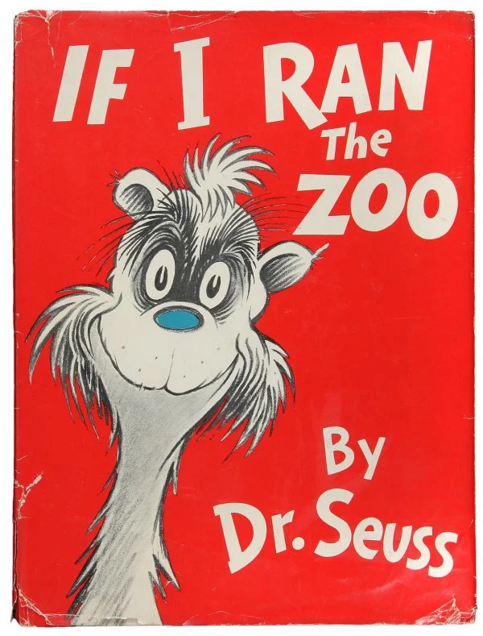
Schemas Change for Many Reasons
Management decides to have “patrons” who buy cages
  Need to add a patronid column
Feds change the rules (OSHA)
  Keepers can keep at most 2 cages
Tax rules change (IRS)
Merge with another zoo

Slide 18
Study break #2
Consider a course schema with students, classes, rooms (each has a number of attributes)
Classes in exactly one room
Students in zero or more classes
Classes taken by zero or more students
Rooms host zero or more classes
Classes
isin
takenby
Students
Rooms

Slide 19
Questions
Describe one possible hierarchical schema for this data
Is there a hierarchical representation that is free of redundancy?
Classes
isin
takenby
Students
Rooms

Slide 20
Solution
Many are possible; one example:
  Classes
    Students
      Rooms
Duplicates data about students,
  Students take multiple classes, rooms host multiple classes
Any other arrangement also duplicates data

Slide 21
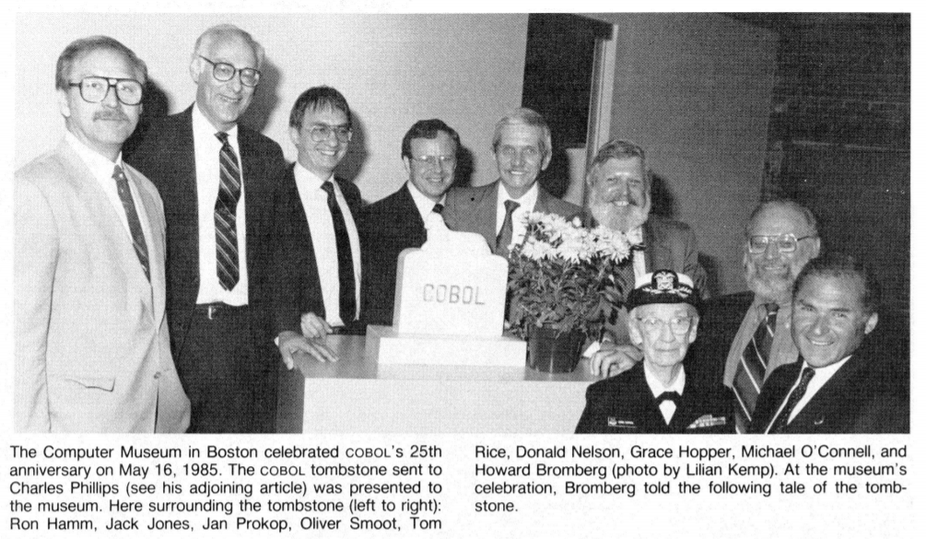
CODASYL
Conference/Committee on Data Systems Languages
  Responsible for COBOL
CODASYL data model developed by consortium of large companies in the 70’s
Designed to address limitations of IMS and PL/I
Graph or network-based data model

Slide 22
Example CODASYL Network
Records can either be hashes (allowing equality lookup) or sorted ("clustered") according to some key (allowing a range lookup).

Slide 23
Example: Find Cages Joe Keeps
caredforby
Find keepers (name = 'Joe')
  Until done:
    Find next animal in caredforby
      Find cage in livesin
Programming is finding an entry point and navigating around in multidimensional space
  Each line of code is implicitly at some location in this structure
  Have to remember where you are
livesin

Slide 24

CODASYL Problems
Incredibly complex —
“Navigational Programming”
Programs lack physical or logical data independence
  Can't change schema w/out changing programs;
  Can't change physical representation either b/c different index types might or might not support different operations
Some of this could have been fixed by adding a high-level language to CODASYL
Relational model was a clean-slate approach designed to fix this

Slide 25
Example CODASYL Program
Find the cages that Joe keeps
Find keepers (name = 'Joe')
Until done:
Find next animal in caredforby
Find cage in livesin

Slide 26
Relational Principles
Simple representation
Set-oriented programming model that doesn't require "navigation"
No physical data model description required(!)
  E.g., no specification of sort orders, hashes, etc

Slide 27
Relational Data Model
All data is represented as tables of records (tuples)
Tables are unordered sets (no duplicates)
Database is one or more tables
Each relation has a schema that describes the types of the columns/fields
Each field is a primitive type -- not a set or relation
Physical representation/layout of data is not specified (no index types, nestings, etc)

Slide 28
Zoo Tables
Foreign Keys
Animals
id | name | age | species | cageno | keptby | feedtime
1 | Sam | 3 | Salamander | 1 | 1 | 10:00 am
2 | Tim | 12 | Giraffe | 1 | 2 | 11:00 am
3 | Sally | 1 | Student | 2 | 1 | 1:00 pm
Primary
Key
Cages
Schema: Animals
(id: int,
name: string,
age: int,
species: string,
cageno: int references cages.no,
keptby: int references keepers.id.
feedtime: time )
no | building
1 | 1
2 | 2
Primary
Key
Keepers
id | name
1 | Jane
2 | Joe
Primary
Key

Slide 29
Zoo Tables (original schema)
Animals
id | name | age | species | cageno
1 | Sam | 3 | Salamander | 1
2 | Tim | 12 | Giraffe | 1
3 | Sally | 1 | Student | 2
Primary
Key
Foreign Key
Cages
no | feedtime | building
1 | 12:30 | 1
2 | 1:30 | 2
Primary
Key
Keepers
Keeps
id | name
1 | Jane
2 | Joe
kid | cageno
1 | 1
1 | 2
2 | 1
Primary
Key
Foreign Key
Foreign Key

Slide 30
Relational Algebra
Projection (π(T,c1, …, cn))
  select a subset of columns c1 .. cn
Selection (σ(T, pred))
  select a subset of rows that satisfy pred
Cross Product (T1 x T2)
  combine two tables
Join (⨝(T1, T2, pred)) = σ(T1 x T2, pred)
  combine two tables with a predicate
Plus set operations (UNION, DIFFERENCE, etc)
“Algebra” – Closed under its own operations
  Every expression over relations produces a relation

Slide 31
Examples
id | name | age | species | cageno
1 | Sam | 3 | Salamander | 1
2 | Tim | 12 | Giraffe | 1
3 | Sally | 1 | Student | 2
name | age
Sam | 3
Tim | 12
Sally | 1
π(animals,name,age))
id | name | age | species | cageno
1 | Sam | 3 | Salamander | 1
2 | Tim | 12 | Giraffe | 1
σ(animals,age > 1))

Slide 32
Examples, Cont. : Join
Join as cross product
cageno | no | name | bldg
1 | 1 | Sam | 32
1 | 2 | Sam | 36
1 | 1 | Tim | 32
1 | 2 | Tim | 36
2 | 1 | Sally | 32
2 | 2 | Sally | 36
Animals
Cages
name | cageno
Sam | 1
Tim | 1
Sally | 2
no | bldg
1 | 32
2 | 36
Find animals in bldg. 32
Real implementations do not ever materialize the cross product
σ (
⨝(
    animals,
    cages,
    animals.cageno = cages.no
),
bldg = 32
)

Slide 33
Examples, Cont. : Join
cageno | no | name | bldg
1 | 1 | Sam | 32
1 | 2 | Sam | 36
1 | 1 | Tim | 32
1 | 2 | Tim | 36
2 | 1 | Sally | 32
2 | 2 | Sally | 36
Animals
Cages
name | cageno
Sam | 1
Tim | 1
Sally | 2
no | bldg
1 | 32
2 | 36
Find animals in bldg. 32
1. animals.cageno = cages.no
σ (
⨝(
    animals,
    cages,
    animals.cageno = cages.no
),
bldg = 32
)

Slide 34
Examples, Cont. : Join
cageno | no | name | bldg
1 | 1 | Sam | 32
1 | 2 | Sam | 36
1 | 1 | Tim | 32
1 | 2 | Tim | 36
2 | 1 | Sally | 32
2 | 2 | Sally | 36
Animals
Cages
name | cageno
Sam | 1
Tim | 1
Sally | 2
no | bldg
1 | 32
2 | 36
Find animals in bldg. 32
animals.cageno = cages.no
bldg = 32
σ (
⨝(
    animals,
    cages,
    animals.cageno = cages.no
),
bldg = 32
)
Do you think this is how databases actually execute joins?

Slide 35
Relational Identities
Join reordering
  A ⨝ B = B ⨝ A
  (A ⨝ B) join C = A ⨝ (B ⨝ C)
Selection reordering
  σ₁(σ₂(A)) = σ₂(σ₁(A))
Selection push down
  σ(A ⨝_{pred} B) = σ(A) ⨝_{pred} σ(b)
  σ may only apply to one table
Projection push down
  π(σ(A)) = σ(π(A))
  As long as π doesn’t remove fields used in σ
  Also applies to joins
Key identity for query optimization!

Slide 36
Push Down Example
σ (
⨝ (
    animals,
    cages,
    animals.cageno = cages.no
),
bldg = 32
)
⨝ (
    animals,
    σ (
      cages,
      bldg = 32
    )
    animals.cageno = cages.no
)

Slide 37
Join Ordering Example
SQL query executor free to choose either ordering!
Text of SQL query is not an ordering
Find buildings Joe keeps
SQL
  SELECT building
  FROM cages JOIN keeps ON no = cageno
  JOIN keepers on kid = id
  WHERE name = ‘Joe’
⨝ (
  ⨝ (
      cages,
      keeps,
      no = cageno
  ),
  σ (
        keepers,
        name = ‘Joe’
        ),
        kid = id
      )
⨝ (
  cages,
  ⨝ (
    σ (
          keepers,
          name = ‘Joe’
          ),
      keeps,
      kid=id
  ),
        no = cageno
        )
Best ordering depends on sizes of tables
Filtered keepers may be much smaller

Slide 38
Study Break # 2
Schema:
classes: (cid, c_name, c_rid, …)
rooms: (rid, bldg, …)
students: (sid, s_name, …)
takes: (t_sid, t_cid)
SELECT s_name FROM student,takes,classes
WHERE t_sid=sid AND t_cid=cid
AND c_name=‘6.830’

Slide 39
Questions
Write an equivalent relational algebra expression for this query
Are there other possible expressions?
Do you think one would be more “efficient” to execute? Why?
SELECT s_name FROM student,takes,classes
WHERE t_sid=sid AND t_cid=cid
AND c_name=‘6.830’

Slide 40
Solution
SELECT s_name FROM student,takes,classes
WHERE t_sid=sid AND t_cid=cid
AND c_name=‘6.830’
⨝ (
  student,
  ⨝ (
    σ (
          classes,
          c_name = ‘6.830’
          ),
      takes,
      t_cid=cid
  ),
        t_sid=sid
        )
Filtering first is probably a good idea
Filtered table is small, so do join with it and classes first
Will formalize this intuition in a few classes

Slide 41
IMS v CODASYL v Relational
 | IMS | CODASYL | Relational
Many to many relationships without redundancy | ❌ | ✓ | ✓
Declarative, non “navigational” programming | ❌ | ❌ | ✓

Slide 42
IMS v CODASYL v Relational
 | IMS | CODASYL | Relational
Many to many relationships without redundancy | ❌ | ✓ | ✓
Declarative, non “navigational” programming | ❌ | ❌ | ✓
Physical data independence | ❌ | ❌ | ✓

Slide 43
Physical Independence
Can change representation of data without needing to change code
Example:
SELECT a.name FROM animals AS a, cages AS c WHERE a.cageno = c.no AND c.bldg = 32
Nothing about how animals or cages tables are represented is evident
  Could be sorted, stored in a hash table / tree, etc
  Changing physical representation will not change SQL
No specification of implementation
Both CODASYL and IMS expose representation-dependent operations in their query API

Slide 44
IMS v CODASYL v Relational
 | IMS | CODASYL | Relational
Many to many relationships without redundancy | ❌ | ✓ | ✓
Declarative, non “navigational” programming | ❌ | ❌ | ✓
Physical data independence | ❌ | ❌ | ✓
Logical data independence | ❌ | ❌ | ✓

Slide 45
Logical Data Independence
What if I want to change the schema without changing the code?
No problem if just adding a column or table
Views allow us to map old schema to new schema, so old programs work
  Even when changing existing fields

Slide 46
Key Idea: View
View is a logical definition of a table in terms of other tables
E.g., a view computing animals per cage
CREATE VIEW cage_count as
  (SELECT cageno, count(*)
  FROM animals JOIN cages ON cageno=no
  GROUP by cageno
  )
This view can be used just like a table in other queries

Slide 47
Views Example
Suppose I want to add multiple feedtimes?
How to support old programs?
  Rename existing animals table to animals2
  Create feedtimes table
  Copy feedtime data from animals2
  Remove feedtime column from animals2
  Create a view called animals that is a query over animals2 and feedtimes
CREATE VIEW animals as (
SELECT name, age, species, cageno,
( SELECT feedtime FROM feedtimes
WHERE animalid = id LIMIT 1
)
FROM animals2
)

Slide 48
Summary: IMS v CODASYL v Relational
 | IMS | CODASYL | Relational
Many to many relationships without redundancy | ❌ | ✓ | ✓
Declarative, non “navigational” programming | ❌ | ❌ | ✓
Physical data independence | ❌ | ❌ | ✓
Logical data independence | ❌ | ❌ | ✓

Slide 49
SQL
Now that we’ve seen the motivation for the relational model, let’s turn to SQL

Slide 50
Expanded Animal DB, as a Graph
Keepers
Cages
Cage6
Joe
Kid=2
Cage3
Anant
Kid=4
Cage1
4. Barry the Bear
Sam the Salamander
Tim the Giraffe
Yuan
Kid=3
Cage5
Jane
Kid=1
Cage2
5. Turdy the Turtle
6. Mork the Mink
7. Ollie the Otter
3. Sally the Student
Cage4

Slide 51
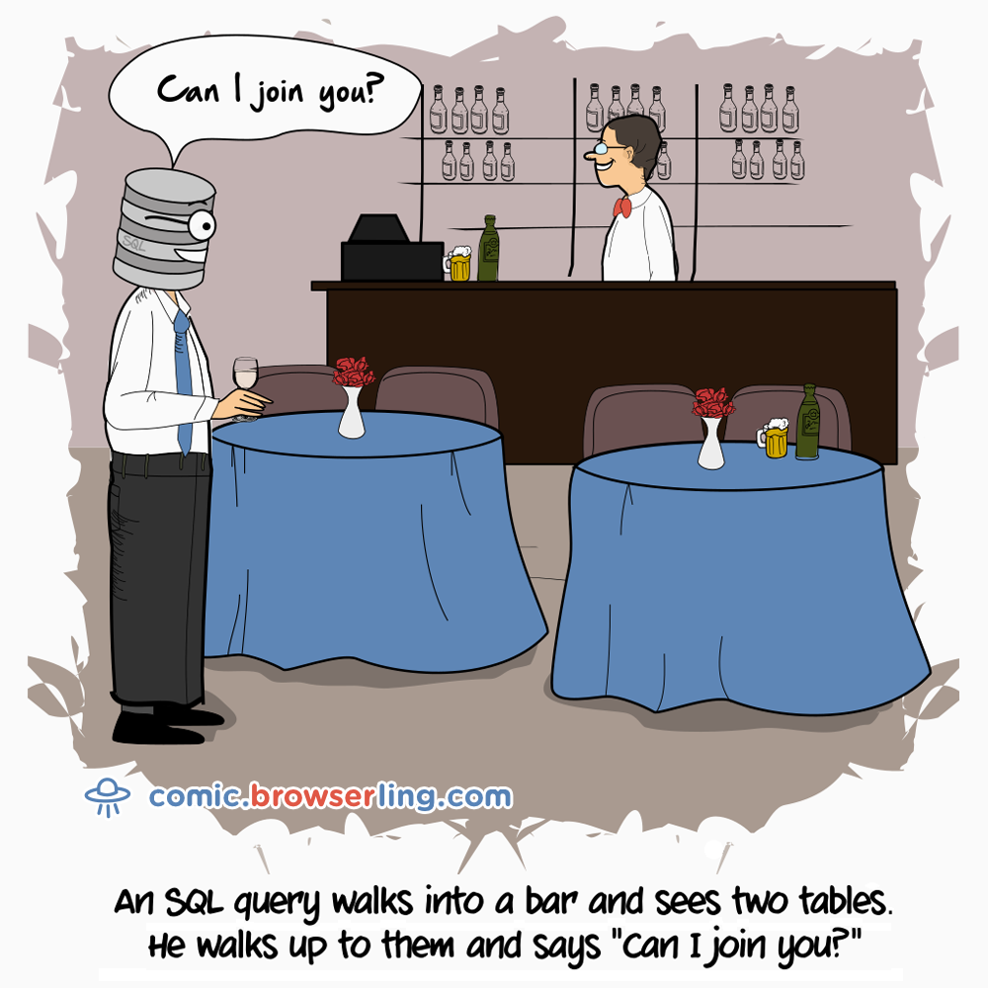
Cages in Building 32
Animals: (aid, name, age, species, acageno)
Cages: (no, feedtime, bldg)
Keepers: (id, name)
Keeps: (kid, cageno)
NESTED LOOPS
Imperative
    for each row a in animals
    for each row c in cages
    if a.acageno = c.no and c.bldg = 32
    output a
Declarative
    SELECT name
    FROM animals, cages
    WHERE acageno = no AND bldg = 32
JOIN
Alternate Syntax
    SELECT name
    FROM animals JOIN cages on acageno = no
    WHERE bldg = 32

Slide 52
Aliases and Ambiguity
Keepers who keep bears
SELECT name
FROM keepers JOIN keeps ON id = kid
JOIN cages on cageno = no
JOIN animals on acageno =no
WHERE species = 'bear'
This doesn’t work. Why?
Animals: (aid, name, age, species, acageno)
Cages: (no, feedtime, bldg)
Keepers: (id, name)
Keeps: (kid, cageno)
Unclear which “name” we are referring to
Keepers
⨝
⨝
Keeps
⨝
Cages
Animals
4 table join
((keepers ⨝ keeps) ⨝ cages) ⨝ animals

Slide 53
Aliases and Ambiguity
Keepers who keep bears
SELECT animals.name
FROM keepers JOIN keeps ON id = kid
JOIN cages on cageno = no
JOIN animals on acageno =no
WHERE species = ‘bear’
This doesn’t work. Why?
Animals: (aid, name, age, species, acageno)
Cages: (no, feedtime, bldg)
Keepers: (id, name)
Keeps: (kid, cageno)
Keepers
⨝
⨝
Keeps
⨝
Cages
Animals

Slide 54
Poll: SQL Comprehension
Fill in the blank to complete this query to “find cages kept by Jane”? SELECT no FROM ____________ WHERE name = 'jane'
  keepers, cages
  keepers JOIN cages ON keepers.id = cages.no
  keepers JOIN keeps ON id = kid JOIN cages ON cageno = no
  cages JOIN keepers on keepers.id = cages.no JOIN keeps ON cageno = no
Animals: (aid, name, age, species, acageno)
Cages: (no, feedtime, bldg)
Keepers: (id, name)
Keeps: (kid, cageno)
https://clicker.mit.edu/6.8530/

Slide 55
Aggregation
Find the number of keepers of each cage
SELECT no,count(*)
FROM cages JOIN keeps ON no=cageno
GROUP BY no
What about cages with 0 keepers?
Animals: (aid, name, age, species, acageno)
Cages: (no, feedtime, bldg)
Keepers: (id, name)
Keeps: (kid, cageno)

Slide 56
Left Join?
T1 LEFT JOIN T2 ON pred produces all rows in T1 x T2 that satisfy pred, plus all rows in T1 that don’t join with any row in T2
  For those rows, fields of T2 are NULL
Example:
SELECT no, MAX(kid)
FROM cages LEFT JOIN keeps
ON no=cageno
GROUP BY no
keeps
cages
kid | cageno
1 | 1
1 | 2
2 | 1
3 | 2
3 | 4
2 | 3
4 | 5
no | …
1
2
3
4
5
6
Can also use “RIGHT JOIN” and “OUTER JOIN” to get all rows of T2 or all rows of both T1 and T2
no | MAX
1 | 2
2 | 3
3 | 2
4 | 3
5 | 4
6 | NULL
What about COUNT?

Slide 57
Left Join?
T1 LEFT JOIN T2 ON pred produces all rows in T1 x T2 that satisfy pred, plus all rows in T1 that don’t join with any row in T2
  For those rows, fields of T2 are NULL
Example:
SELECT no, COUNT(*)
FROM cages LEFT JOIN keeps
ON no=cageno
GROUP BY no
keeps
cages
kid | cageno
1 | 1
1 | 2
2 | 1
3 | 2
3 | 4
2 | 3
4 | 5
no | …
1
2
3
4
5
6
no | COUNT
1 | 2
2 | 2
3 | 1
4 | 1
5 | 1
6 | 1
Not what we wanted!

Slide 58
Left Join?
T1 LEFT JOIN T2 ON pred produces all rows in T1 x T2 that satisfy pred, plus all rows in T1 that don’t join with any row in T2
  For those rows, fields of T2 are NULL
Example:
SELECT no, COUNT(cageno)
FROM cages LEFT JOIN keeps
ON no=cageno
GROUP BY no
keeps
cages
kid | cageno
1 | 1
1 | 2
2 | 1
3 | 2
3 | 4
2 | 3
4 | 5
no | …
1
2
3
4
5
6
no | COUNT
1 | 2
2 | 2
3 | 1
4 | 1
5 | 1
6 | 0
COUNT(*) counts all rows including NULLs, COUNT(col) only counts rows with non-null values in col

Slide 59
Self Joins
Keepers who keep bears and giraffes
SELECT keepers.name
FROM keepers JOIN keeps ON id = kid
JOIN cages ON cageno = no
JOIN animals ON acageno = cageno
WHERE species = 'Bear’ AND species = 'Giraffe'
Doesn’t work!
OR species = ‘Giraffe’?
Also doesn’t work!

Slide 60
Self Joins
Keepers who keep bears and giraffes
Need to build two tables, Bear keepers and Giraffe keepers, and intersect them
SELECT bear_keepers.name
FROM keepers AS bear_keepers
JOIN keeps AS bear_keeps ON bear_keepers.id = bear_keeps.kid
JOIN cages AS bear_cages ON bear_keeps.cageno = bear_cages.no
JOIN animals AS bear_animals ON bear_animals.acageno = bear_cages.no
JOIN keepers AS giraffe_keepers
JOIN keeps AS giraffe_keeps ON giraffe_keepers.id = giraffe_keeps.kid
JOIN cages AS giraffe_cages ON giraffe_keeps.cageno = giraffe_cages.no
JOIN animals AS giraffe_animals ON giraffe_animals.acageno = giraffe_cages.no
WHERE bear_animals.species = 'Bear'
AND giraffe_animals.species = 'Giraffe'
AND giraffe_keepers.id = bear_keepers.id

Slide 61
Self Joins
⨝
⨝
Keepers who keep bears and giraffes
Need to build two tables, Bear keepers and Giraffe keepers, and intersect them
⨝
𝛔_{(species=‘Bear’)}
Keepers
Keeps
Cages
SELECT bear_keepers.name
FROM keepers AS bear_keepers
JOIN keeps AS bear_keeps ON bear_keepers.id = bear_keeps.kid
JOIN cages AS bear_cages ON bear_keeps.cageno = bear_cages.no
JOIN animals AS bear_animals ON bear_animals.acageno = bear_cages.no
JOIN keepers AS giraffe_keepers
JOIN keeps AS giraffe_keeps ON giraffe_keepers.id = giraffe_keeps.kid
JOIN cages AS giraffe_cages ON giraffe_keeps.cageno = giraffe_cages.no
JOIN animals AS giraffe_animals ON giraffe_animals.acageno = giraffe_cages.no
WHERE bear_animals.species = 'Bear'
AND giraffe_animals.species = 'Giraffe'
AND giraffe_keepers.id = bear_keepers.id
Animals

Slide 62
Self Joins
Keepers who keep bears and giraffes
Need to build two tables, Bear keepers and Giraffe keepers, and intersect them
⨝
⨝
⨝
𝛔_{(species=‘Bear’)}
Keepers
Keeps
Cages
Animals
SELECT bear_keepers.name
FROM keepers AS bear_keepers
JOIN keeps AS bear_keeps ON bear_keepers.id = bear_keeps.kid
JOIN cages AS bear_cages ON bear_keeps.cageno = bear_cages.no
JOIN animals AS bear_animals ON bear_animals.acageno = bear_cages.no
JOIN keepers AS giraffe_keepers
JOIN keeps AS giraffe_keeps ON giraffe_keepers.id = giraffe_keeps.kid
JOIN cages AS giraffe_cages ON giraffe_keeps.cageno = giraffe_cages.no
JOIN animals AS giraffe_animals ON giraffe_animals.acageno = giraffe_cages.no
WHERE bear_animals.species = 'Bear'
AND giraffe_animals.species = 'Giraffe'
AND giraffe_keepers.id = bear_keepers.id
Bears

Slide 63
Self Joins
Keepers who keep bears and giraffes
Need to build two tables, Bear keepers and Giraffe keepers, and intersect them
⨝
⨝
⨝
⨝
⨝
⨝
𝛔_{(species=‘Bear’)}
𝛔_{(species=‘Giraffe’)}
Keepers
Keeps
Cages
Animals
Keepers
Keeps
Cages
Animals
SELECT bear_keepers.name
FROM keepers AS bear_keepers
JOIN keeps AS bear_keeps ON bear_keepers.id = bear_keeps.kid
JOIN cages AS bear_cages ON bear_keeps.cageno = bear_cages.no
JOIN animals AS bear_animals ON bear_animals.acageno = bear_cages.no
JOIN keepers AS giraffe_keepers
JOIN keeps AS giraffe_keeps ON giraffe_keepers.id = giraffe_keeps.kid
JOIN cages AS giraffe_cages ON giraffe_keeps.cageno = giraffe_cages.no
JOIN animals AS giraffe_animals ON giraffe_animals.acageno = giraffe_cages.no
WHERE bear_animals.species = 'Bear'
AND giraffe_animals.species = 'Giraffe'
AND giraffe_keepers.id = bear_keepers.id
Giraffes
Bears

Slide 64
Self Joins
Keepers who keep bears and giraffes
Need to build two tables, Bear keepers and Giraffe keepers, and intersect them
⨝
giraffe_keepers.id = bear_keepers.id
⨝
⨝
⨝
⨝
⨝
⨝
𝛔_{(species=‘Bear’)}
𝛔_{(species=‘Giraffe’)}
SELECT bear_keepers.name
FROM keepers AS bear_keepers
JOIN keeps AS bear_keeps ON bear_keepers.id = bear_keeps.kid
JOIN cages AS bear_cages ON bear_keeps.cageno = bear_cages.no
JOIN animals AS bear_animals ON bear_animals.acageno = bear_cages.no
JOIN keepers AS giraffe_keepers
JOIN keeps AS giraffe_keeps ON giraffe_keepers.id = giraffe_keeps.kid
JOIN cages AS giraffe_cages ON giraffe_keeps.cageno = giraffe_cages.no
JOIN animals AS giraffe_animals ON giraffe_animals.acageno = giraffe_cages.no
WHERE bear_animals.species = 'Bear'
AND giraffe_animals.species = 'Giraffe'
AND giraffe_keepers.id = bear_keepers.id
Keepers
Keeps
Cages
Animals
Keepers
Keeps
Cages
Animals
Bears
Giraffes
7-way join, for a fairly simple query!

Slide 65
Recap
Today:
  Hierarchical vs Network vs Relational Model
  Redundancy free relationships
  Non “navigational programming”
  Physical and Logical Data Indepence
  SQL:
    Aliases
    Joins – Self, Outer, Inner, Left, Right
Next Time: More SQL, DB Design

