Slide 1
6.5830/6.5831
Introduction to Databases
Please use Piazza:
https://piazza.com/class/llmf39nuxcs5us
http://dsg.csail.mit.edu/6.5830/
6.5830 Lecture 1- 9/6/2023
Sam Madden
madden@csail.mit.edu

Slide 2





Course Staff
Tim Kraska
Ferdi Kossmann
Darryl Ho
Sam Madden
Ziniu Wu

Slide 3
Administrivia
http://dsg.csail.mit.edu/6.5830
Email: 6.5830-staff@mit.edu
Ask questions on Piazza! Use sign up link on website.
Lecturers:
  Sam Madden (madden@csail.mit.edu)
  Tim Kraska (kraska@csail.mit.edu)
TAs:
Darryl Ho (darry140@mit.edu)
Ferdi Kossmann (kossmann@mit.edu)
Ziniu Wu (ziniuw@mit.edu)
Office hours: TBD (weekly)
Note generative AI policy
5 Late Days

Slide 4
Textbooks
Readings in Database Systems
  http://www.redbook.io
Rest of readings will be drawn from literature (research papers and web pages)

Slide 5
What is A Database?
Structured Data Collection
  Records
  Relationships
This class: Database Management Systems (DBMSs)
  Software systems for storing and querying databases

Slide 6
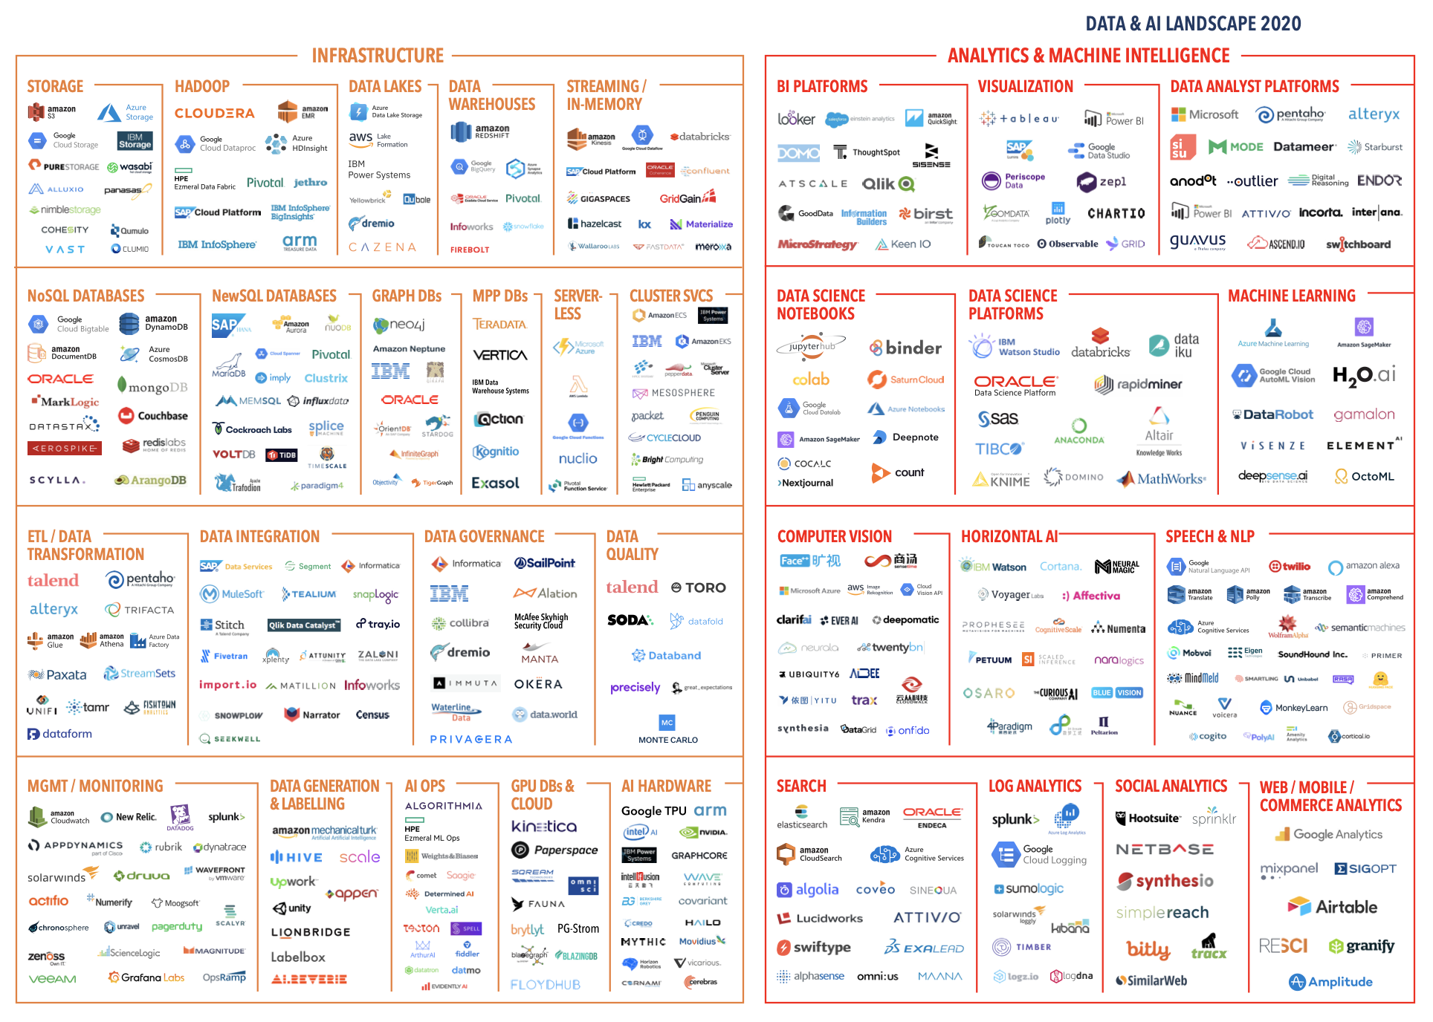
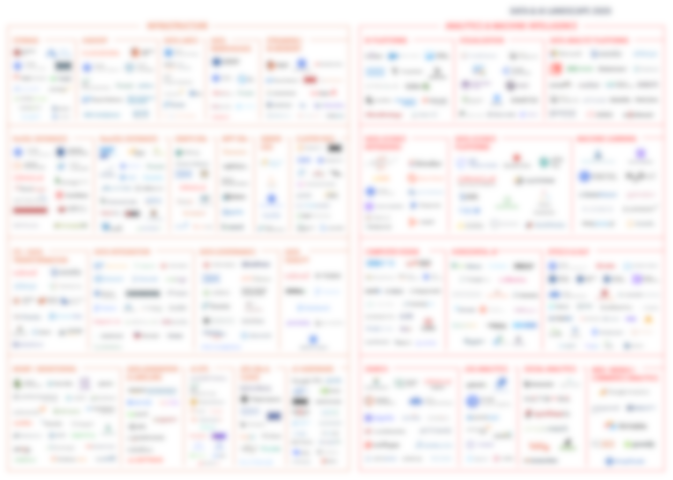
Source: mattturck.com

Slide 9
6.5830 Concepts
Data modeling / layout
Declarative querying
  Query processing
  Algorithms for accessing and manipulating data
Consistency / Transactions (“ACID”)
“Big Data” – scaling to massive volumes, many machines
Quiz 1
Quiz 2

Slide 10
6.5830/1 Assignments
4 Labs: GoDB
3 Problem Sets
  SQL
  Quiz Prep 1
  Quiz Prep 2
2 Quizzes
6.5830: Final Project – open ended research project of your choice
6.5831: Final Project: Extend GoDB OR open ended research
  6.5831 satisfies the CI/M requirement; final project will require both an oral midterm report as well as a written final report

Slide 11
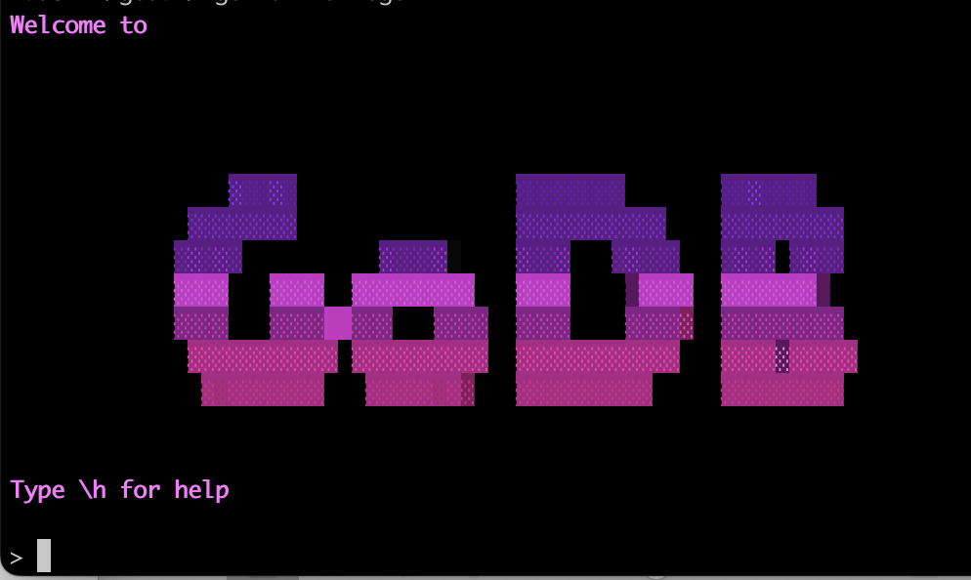
GoDB

Slide 12
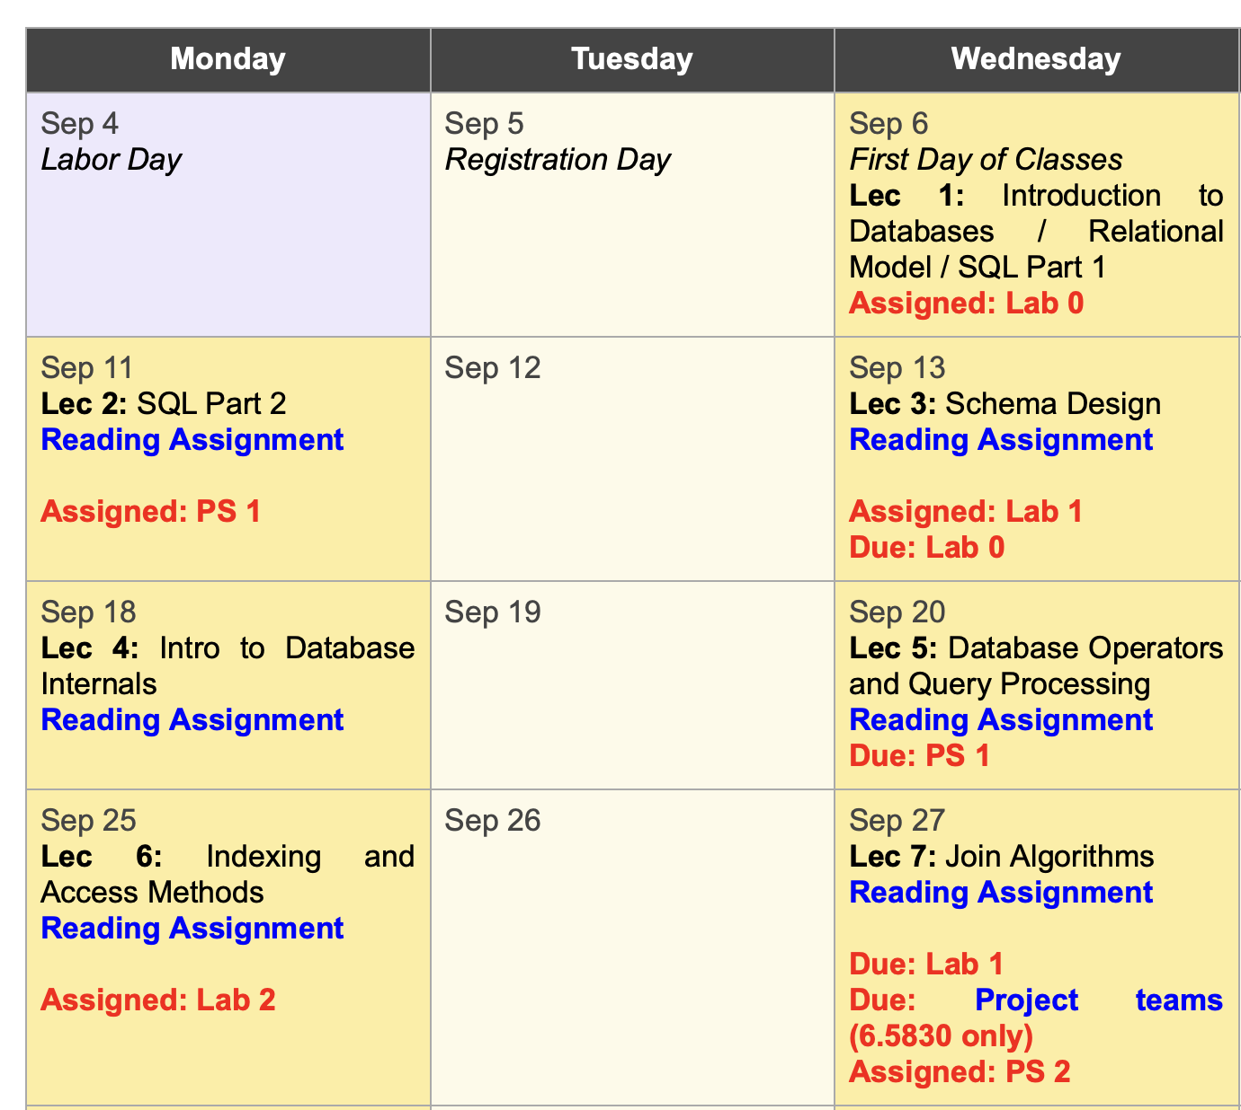

Lab 0 Out Today: Introductory lab designed to teach you Go
PS1 Out Next Monday: Designed to teach you SQL
Lab 1 Out Next Wednesday: First part of the GoDB system

Slide 13
Interactive
Large-Scale Visualization using a GPU Database

Slide 14
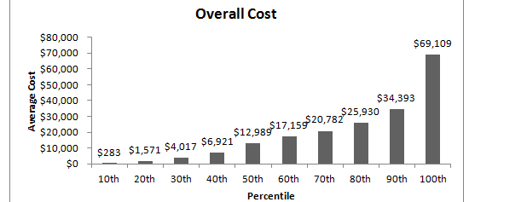
The Need for Interactive Analytics
Idea: often need to browse massive data sets
Browsing is best supported through visualization
➔ ad-hoc analytics, with millisecond response times

Slide 15
MapD: GPU Accelerated SQL Database
Key insight: GPUs have enough memory that a cluster of them can store substantial amounts of data
Not an accelerator, but a full blown query processor!
Massive parallelism enables interactive browsing interfaces
  4x GPUs can provide > 1 TB/sec of bandwidth
  12 Tflops compute
  Order of magnitude speedups over CPUs, when data is on GPU
“Shared nothing” arrangement
Notes:
----- Meeting Notes (8/27/13 11:58) -----
improvements -> speedups

Slide 16
Demo

Slide 17
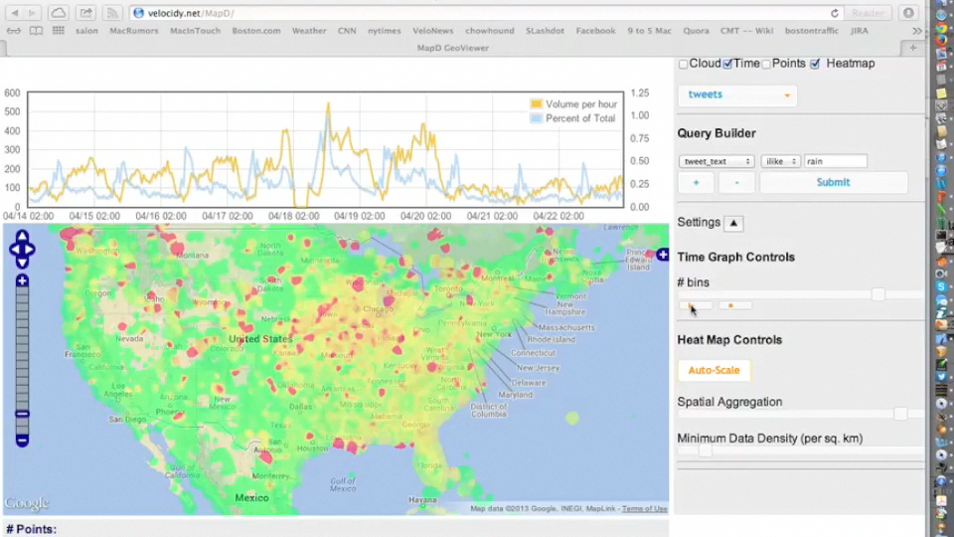

Slide 20
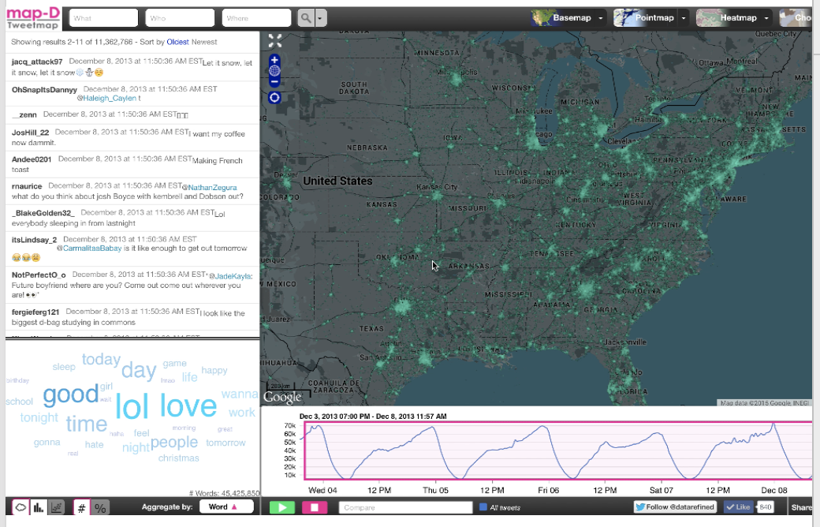

Slide 21

Today
Why database systems?
User’s perspective:
  Modeling data
  Querying data
Data Models

Slide 22
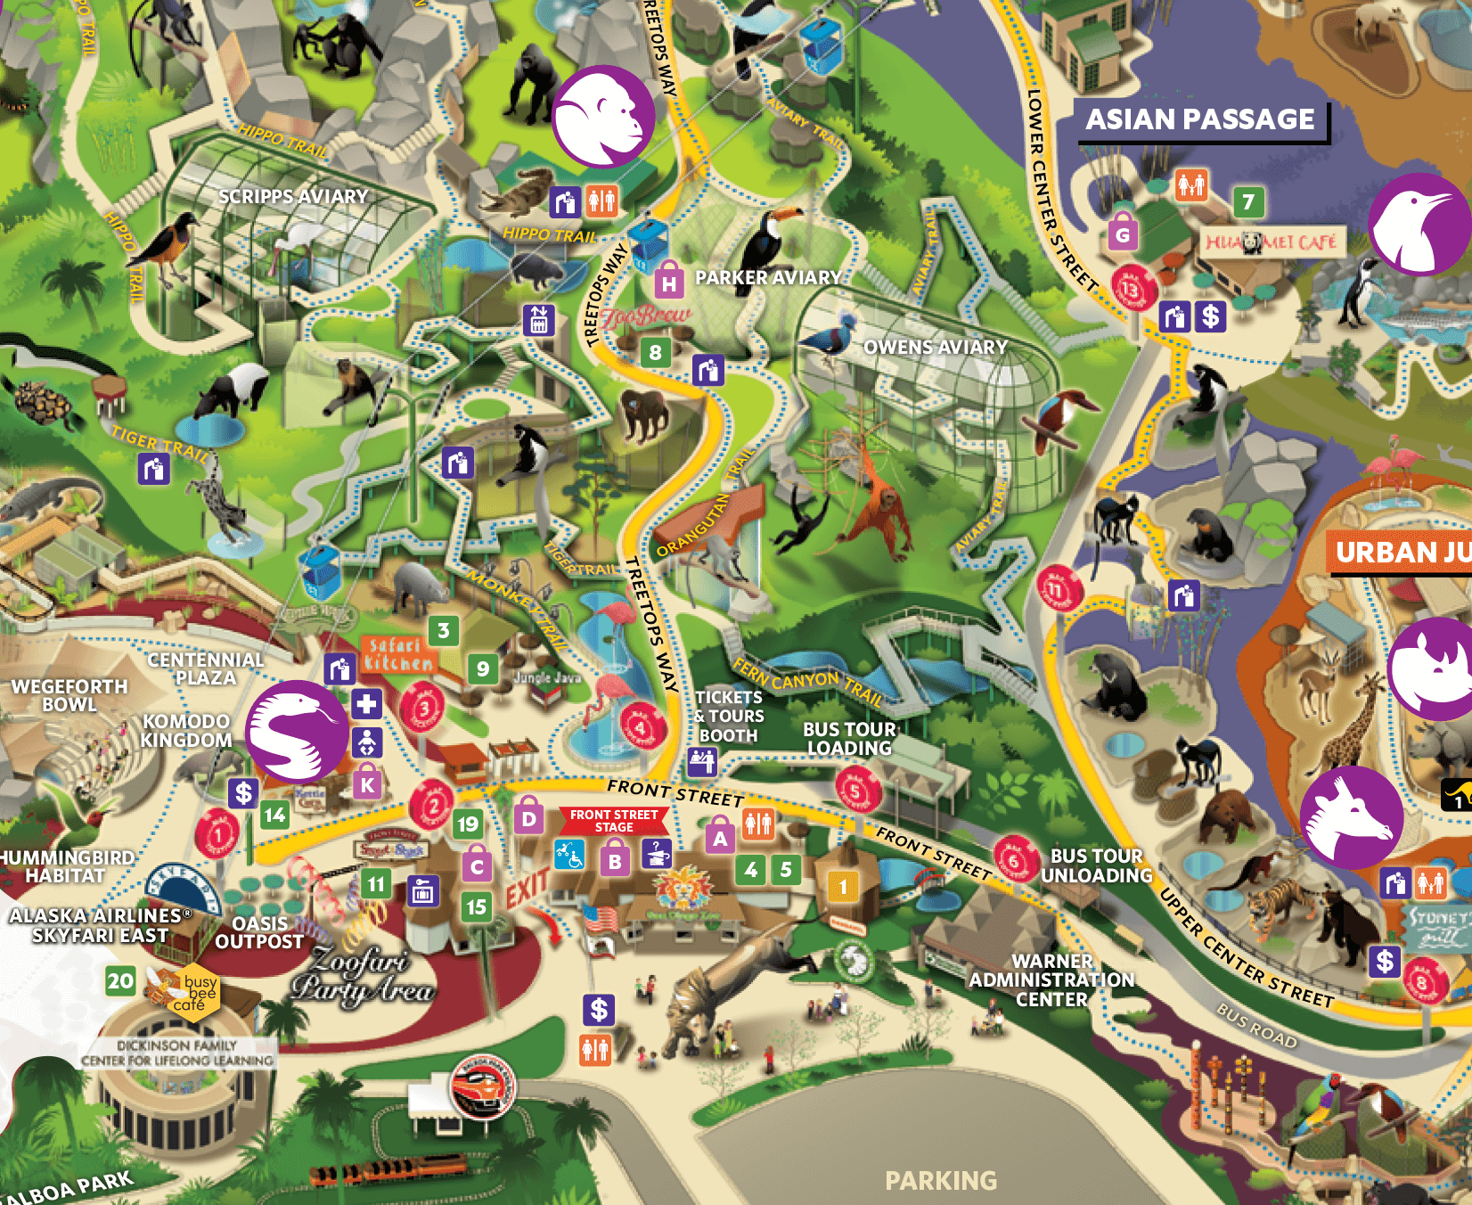

Zoo Website Features
Admin interface
  Edit
  Add an animal
Public
  Pictures & Maps
Zookeeper
  Feed times
1K animals, 5K URLs, 10 admins, 200 keepers

Slide 23
Zoo Data Model
Entity Relationship Diagram
1
Animal
n
contains
1
Cage
1
entity
relationship
entity
name
n
feedTime
1
1
Name
Time
keeps
1
age
Building
1
bldg
Age
n
species
Keeper
1
name
1
entity
Species
1
Name
Animals have names, ages, species
Keepers have names
Cages have cleaning times, buildings
Animals are in 1 cage; cages have multiple animals
Keepers keep multiple cages, cages kept by multiple keepers

Slide 24

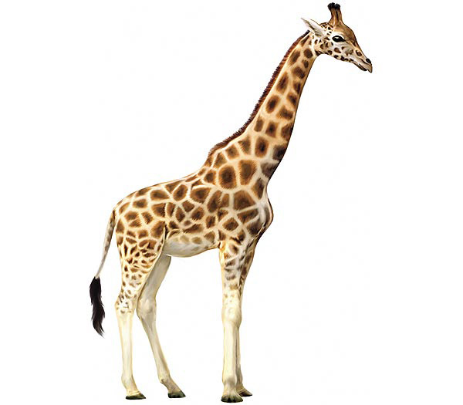
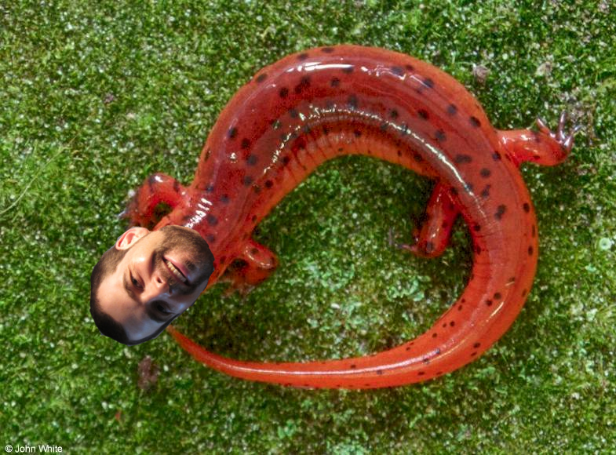
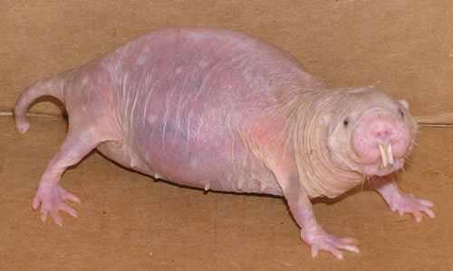
Our Zoo
Sam the Salamander
Tim the Giraffe
Sally the Student
Slimy
Lanky

Slide 25
Zoo Data Model
Entity Relationship Diagram
1
Animal
n
contains
1
Cage
1
entity
relationship
entity
feedTime
name
?
n
1
1
Name
?
Time
age
keeps
1
Building
1
Age
bldg
n
species
Keeper
1
name
Cageid | Feedtime | Bldg
1 | 1:30 | 1
2 | 2:30 | 2
1
Species
entity
1
Name
Id | Name | Age | Species | Cageno
1 | Tim | 13 | Giraffe | 1
2 | Sam | 3 | Salamander | 2
3 | Sally | 1 | Student | 1

Slide 26
Zoo Data Model
Entity Relationship Diagram
1
Animal
n
contains
1
Cage
1
entity
relationship
entity
feedTime
name
n
1
1
Name
?
Time
age
keeps
1
Building
1
Age
bldg
n
species
Keeper
1
name
Cageid | Feedtime | Bldg
1 | 1:30 | 1
2 | 2:30 | 2
1
Species
entity
1
Name
keeperid | cageid
1 | 1
1 | 2
2 | 1
keeperid | name
1 | jenny
2 | joe

Slide 27
Study Break #1
Questions
  Are there other ways to represent this zoo data than a collection of tables?
  What are tradeoffs in different representations?

Slide 28
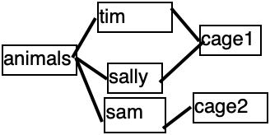
Alternatives to Relations
Hierarchy
Graph
cage 1
tim
giraffe
13 yrs
sally
student
1 yr
cage 2
sam
salamander
3 yrs

Slide 29
Multiple Tabular Representations Are Possible
name | age | species | cageno | feedtime | bldg
tim | 13 | giraffe | 1 | 1:30 | 1
sam | 3 | salamander | 2 | 2:30 | 2
sally | 1 | student | 1 | 1:30 | 1
Is this a good representation? Why or why not?
Not “Normalized” – repeats data. More in later lectures!

Slide 30
SQL – Structured Query Language
    SELECT field1, …, fieldM
    FROM table1, …
    WHERE condition1, …
    INSERT INTO table VALUES (field1, …)
    UPDATE table SET field1 = X, …
    WHERE condition1,…

Slide 31
Names of Giraffes
Imperative
  for each row r in animals
  if r.species = ‘giraffe’
  output r.name
Declarative
SELECT r.name FROM animals
WHERE r.species = ‘giraffe’

Slide 32
Cages in Building 32
NESTED LOOPS
Imperative
    for each row a in animals
    for each row c in cages
    if a.cageno = c.no and c.bldg = 32
    output a
Declarative
    SELECT a.name FROM animals AS a, cages AS c WHERE a.cageno = c.no AND c.bldg = 32
JOIN

Slide 33
Average Age of Bears
Declarative
    SELECT AVG(age) FROM animals
    WHERE species = ‘bear’

Slide 34
Complex Queries
  Find pairs of animals of the same species and different genders older than 1 year:
  SELECT a1.name,a2.name
  FROM animals as a1, animals as a2
  WHERE a1.gender = M and a2.gender = F
  AND a1.species = a2.species
  AND a1.age > 1 and a2.age > 1
“self join”
Find cages with salamanders fed later than the average feedtime of any cage:
  SELECT cages.cageid FROM cages, animals
  WHERE animals.species = ’salamander'
  AND animals.cageid = cages.cageid
  AND cages.feedtime >
  (SELECT AVG(feedtime) FROM cages )
“nested queries”

Slide 35
Complex Queries 2
  Find keepers who keep both students and salamanders:
  SELECT keeper.name
  FROM keeper, cages as c1, cages as c2,
  keeps as k1, keeps as k2, animals as a1, animals as a2
  WHERE c1.cageid = k1.cageid AND keeper.keeperid = k1.keeperid
  AND c2.cageid = k2.cageid AND keeper.keeperid = k2.keeperid
  AND a1.species = ’student' AND a2.species = ’salamander'
  AND c1.cageid = a1.cageid AND c2.cageid = a2.cageid
keeper.keeperid = k1.keeperid
a1
c1
k1
species = ‘salamander’
keeper
a2
c2
k2
keeper.keeperid = k2.keeperid
species = ‘student’

Slide 36
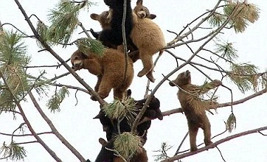
Declarative Queries: What not How!
Many possible procedural plans for a given SQL query
Besides looping through all records, what else could we do?
  Sort animals on type
    + good for “bears” query
    - Inserts are slower
  Store animals table in a hash table or tree (“index”)

Slide 37
SQL →Procedural Plan → Optimized Plan → Compiled Program
Select
Bldg == 2
Binary search?
Join
R1.cageno == R2.cageid
Animals
R1
Cages
R2

Slide 38
SQL →Procedural Plan → Optimized Plan → Compiled Program
Select
Bldg == 2
Join
R1.cageno == R2.cageid
SQL programmer just thinks in terms of table operations, not the order or implementation!
Animals
R1
“Predicate push down”
Cages
R2

Slide 39

Summary: Database Systems
Relational Model + Schema Design
Declarative Queries
Query Optimization
Efficient access and updates to data
  Recoverability
  Consistency

Slide 40
Relational Model
“Those who cannot remember the past are doomed to repeat it”

Slide 41
A Short History Lesson
Different Data Models
  Hierarchical (IMS/DL1) – 1960’s
  Network (CODASYL) – 1970’s
  Relational – 1970’s and beyond
Key ideas
  Data redundancy (and how to avoid it)
  Physical and logical data independence
  Relational algebra and axioms

Slide 42
Recap: Zoo Data Model
Entity Relationship Diagram
1
Animal
n
contains
1
Cage
1
entity
relationship
entity
name
n
feedTime
1
1
Name
Time
keeps
1
age
Building
1
bldg
Age
n
species
Keeper
1
name
1
entity
Species
1
Name
Animals have names, ages, species
Keepers have names
Cages have cleaning times, buildings
Animals are in 1 cage; cages have multiple animals
Keepers keep multiple cages, cages kept by multiple keepers

Slide 43
Zoo Tables (aka Relations)
Animals
“Schema”: Field names & types
id | name | age | species | cageno
1 | Sam | 3 | Salamander | 1
2 | Tim | 12 | Giraffe | 1
3 | Sally | 1 | Student | 2
Rows, records, or tuples
Cages
no | feedtime | building
1 | 12:30 | 1
2 | 1:30 | 2
Keepers
Keeps
id | name
1 | Jane
2 | Joe
kid | cageno
1 | 1
1 | 2
2 | 1

Slide 44
Cages in Building 32
NESTED LOOPS
Imperative
    for each row a in animals
    for each row c in cages
    if a.cageno = c.no and c.bldg = 32
    output a
Declarative
    SELECT a.name FROM animals AS a, cages AS c WHERE a.cageno = c.no AND c.bldg = 32
JOIN
Equivalently
    SELECT a.name
    FROM animals AS a JOIN cages AS c ON a.cageno = c.no WHERE c.bldg = 32

Slide 45
Average Age of Bears
Declarative
    SELECT AVG(age) FROM animals
    WHERE species = ‘bear’

Slide 46
Complex Queries
  Find pairs of animals of the same species and different genders older than 1 year:
  SELECT a1.name,a2.name
  FROM animals as a1, animals as a2
  WHERE a1.gender = M and a2.gender = F
  AND a1.species = a2.species
  AND a1.age > 1 and a2.age > 1
“self join”
Find cages with salamanders fed later than the average feedtime of any cage:
  SELECT cages.cageid FROM cages, animals
  WHERE animals.species = ’salamander'
  AND animals.cageid = cages.cageid
  AND cages.feedtime >
  (SELECT AVG(feedtime) FROM cages )
“nested queries”

Slide 47
Modified Zoo Data Model
Slightly different than last time:
Each animal in 1 cage, multiple animals share a cage
Each animal cared for by 1 keeper, keepers care for multiple animals

Slide 48
IMS (Hierarchical Model)
Data organized as segments
  Collection of records, each with same segment type
  Arranged in a tree of segment types, e.g.:
    Keepers Keepers
      Animals Cages
        Cages Animals
Segments have different physical representations
  Unordered
  Indexed
    Sorted
    Hashed

Slide 49
Example Hierarchy
Jane (keeper) (HSK 1)
Sam, salamander, … (2)
1, 100sq ft, … (3)
Tim, giraffe, … (4)
2, 1000sq ft, … (5)
Sally, student, … (6)
1, 100sq ft, … (7)
Joe (keeper) (8)
Repeated information!
IMS Physical Represenation
Keepers segment
A1 Segment A2 Segment A3 Segment
C1 Segment C2 Segment C3 Segment

Slide 50
Segment Structure
Each segment has a particular physical representation
  Chosen by database administrator
  E.g., ordered, hashed, unordered…
Choice of segment structure affects which operations can be applied on it

Slide 51
IMS / DL/1 Operations
GetUnique (seg type, pred)
  Get first record satisfying pred
  Only supported by hash / sorted segments
GetNext (seg type, pred)
  Get first or next key in hierarchical order
  Starts from last GetNext/GetUnique call
GetNextParent (seg type, pred)
  Same as GetNext, but will not move up hierarchy to next parent
Delete, Insert

Slide 52
Example PL/1 Program #1
Find the cages that Jane keeps
GetUnique(Keepers, name = "Jane")
Until done:
cageid = GetNextParent (cages).no
print cageid
Jane (keeper) (HSK 1)
Sam, salamander, … (2)
1, 100sq ft, … (3)
Tim, giraffe, … (4)
2, 1000sq ft, … (5)
Sally, student, … (6)
1, 100sq ft, … (7)
Joe (keeper) (8)
This iterates through data underneath Jane
Implicitly, now navigating from the Jane record in keepers

Slide 53
Example PL/1 Program #2
Find the keepers that keep cage 6
keep = GetUnique(keepers)
Until done:
cage = GetNextParent(cages, id = 6)
if (cage is not null):
print keep
keep = GetNext(keepers)

Slide 54
What’s Bad About IMS/PL1?
Duplication of data w/ non-hierarchical data
Painful low level programming interface – have to program the search algorithm
Limited physical data independence
  Change root from indexed to hash --- programs that do GetNext on the root segment will fail
  Change root from keepers to animals? Also fails.
  Cannot do inserts into sequential root structure
Limited logical data independence
  Schemas change, do programs have to?

Slide 55
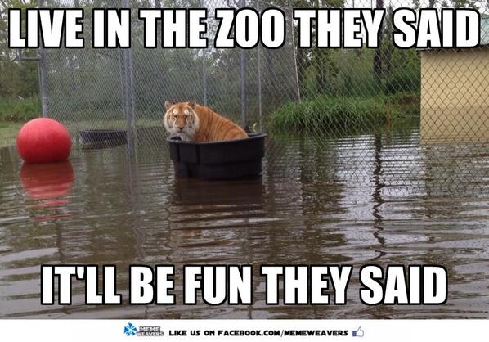
Logical Data Independence
Suppose as a cost cutting measure, Zoo management decides a keeper will be responsible for a cage – and all the animals in that cage.
Programs have to change, because the position in the database after a GN/GNP call may not be the same anymore!
Will see how SQL addresses this

Slide 56

Schemas Change for Many Reasons
Management decides to have “patrons” who buy cages
  Need to add a patronid column
Feds change the rules (OSHA)
  Keepers can keep at most 2 cages
Tax rules change (IRS)
Merge with another zoo

Slide 57
Study break #2
Consider a course schema with students, classes, rooms (each has a number of attributes)
Classes in exactly one room
Students in zero or more classes
Classes taken by zero or more students
Rooms host zero or more classes
Classes
isin
takenby
Students
Rooms

Slide 58
Questions
Describe one possible hierarchical schema for this data
Is there a hierarchical representation that is free of redundancy?
Classes
isin
takenby
Students
Rooms

Slide 59
Solution
Many are possible; one example:
  Classes
    Students
      Rooms
Duplicates data about students,
  Students take multiple classes, rooms host multiple classes
Any other arrangement also duplicates data

Slide 60
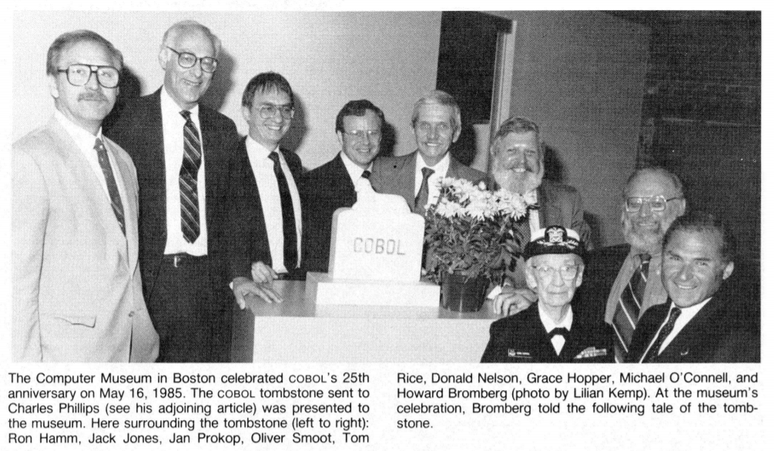
CODASYL
Conference/Committee on Data Systems Languages
  Responsible for COBOL
CODASYL data model developed by consortium of large companies in the 70’s
Designed to address limitations of IMS/PL1
Graph or network-based data model

Slide 61
Example CODASYL Network
Records can either be hashes (allowing equality lookup) or sorted ("clustered") according to some key (allowing a range lookup).

Slide 62
Example: Find Cages Joe Keeps
caredforby
Find keepers (name = 'Joe')
  Until done:
    Find next animal in caredforby
      Find cage in livesin
Programming is finding an entry point and navigating around in multidimensional space
  Each line of code is implicitly at some location in this structure
  Have to remember where you are
livesin

Slide 63

Codasyl Problems
Incredibly complex —
“Navigational Programming”
Programs lack physical or logical data independence
  Can't change schema w/out changing programs;
  Can't change physical representation either b/c different index types might or might not support different operations
Some of this could have been fixed by adding a high-level language to CODASYL
Relational model was a clean-slate approach designed to fix this

Slide 64
Example CODASYL Program
Find the cages that Joe keeps
Find keepers (name = 'Joe')
Until done:
Find next animal in caredforby
Find cage in livesin

Slide 65
Relational Principles
Simple representation
Set-oriented programming model that doesn't require "navigation"
No physical data model description required(!)
  E.g., no specification of sort orders, hashes, etc

Slide 66
Relational Data Model
All data is represented as tables of records (tuples)
Tables are unordered sets (no duplicates)
Database is one or more tables
Each relation has a schema that describes the types of the columns/fields
Each field is a primitive type -- not a set or relation
Physical representation/layout of data is not specified (no index types, nestings, etc)

Slide 67
Zoo Tables
Foreign Keys
Animals
id | name | age | species | cageno | keptby | feedtime
1 | Sam | 3 | Salamander | 1 | 1 | 10:00 am
2 | Tim | 12 | Giraffe | 1 | 2 | 11:00 am
3 | Sally | 1 | Student | 2 | 1 | 1:00 pm
Primary
Key
Cages
Schema: Animals
(id: int,
name: string,
age: int,
species: string,
cageno: int references cages.no,
keptby: int references keepers.id.
feedtime: time )
no | building
1 | 1
2 | 2
Primary
Key
Keepers
id | name
1 | Jane
2 | Joe
Primary
Key

Slide 68
Zoo Tables (original schema)
Animals
id | name | age | species | cageno
1 | Sam | 3 | Salamander | 1
2 | Tim | 12 | Giraffe | 1
3 | Sally | 1 | Student | 2
Primary
Key
Foreign Key
Cages
no | feedtime | building
1 | 12:30 | 1
2 | 1:30 | 2
Primary
Key
Keepers
Keeps
id | name
1 | Jane
2 | Joe
kid | cageno
1 | 1
1 | 2
2 | 1
Primary
Key
Foreign Key
Foreign Key

Slide 69
Relational Algebra
Projection (π(T,c1, …, cn))
  select a subset of columns c1 .. cn
Selection (σ(T, pred))
  select a subset of rows that satisfy pred
Cross Product (T1 x T2)
  combine two tables
Join (⨝(T1, T2, pred)) = σ(T1 x T2, pred)
  combine two tables with a predicate
Plus set operations (UNION, DIFFERENCE, etc)
“Algebra” – Closed under its own operations
  Every expression over relations produces a relation

Slide 70
Join as Cross Product
cageno | no | name | bldg
1 | 1 | Sam | 32
1 | 2 | Sam | 36
1 | 1 | Tim | 32
1 | 2 | Tim | 36
2 | 1 | Sally | 32
2 | 2 | Sally | 36
Animals
Cages
name | cageno
Sam | 1
Tim | 1
Sally | 2
no | bldg
1 | 32
2 | 36
Find animals in bldg. 32
Real implementations do not ever materialize the cross product
σ (
⨝(
    animals,
    cages,
    animals.cageno = cages.no
),
bldg = 32
)

Slide 71
Join as Cross Product
cageno | no | name | bldg
1 | 1 | Sam | 32
1 | 2 | Sam | 36
1 | 1 | Tim | 32
1 | 2 | Tim | 36
2 | 1 | Sally | 32
2 | 2 | Sally | 36
Animals
Cages
name | cageno
Sam | 1
Tim | 1
Sally | 2
no | bldg
1 | 32
2 | 36
Find animals in bldg. 32
1. animals.cageno = cages.no
σ (
⨝(
    animals,
    cages,
    animals.cageno = cages.no
),
bldg = 32
)

Slide 72
Join as Cross Product
cageno | no | name | bldg
1 | 1 | Sam | 32
1 | 2 | Sam | 36
1 | 1 | Tim | 32
1 | 2 | Tim | 36
2 | 1 | Sally | 32
2 | 2 | Sally | 36
Animals
Cages
name | cageno
Sam | 1
Tim | 1
Sally | 2
no | bldg
1 | 32
2 | 36
Find animals in bldg. 32
animals.cageno = cages.no
bldg = 32
σ (
⨝(
    animals,
    cages,
    animals.cageno = cages.no
),
bldg = 32
)
Do you think this is how databases actually execute joins?

Slide 73
Relational Identities
Join reordering
  A ⨝ B = B ⨝ A
  (A ⨝ B) join C = A ⨝ (B ⨝ C)
Selection reordering
  σ₁(σ₂(A)) = σ₂(σ₁(A))
Selection push down
  σ(A ⨝_{pred} B) = σ(A) ⨝_{pred} σ(b)
  σ may only apply to one table
Projection push down
  π(σ(A)) = σ(π(A))
  As long as π doesn’t remove fields used in σ
  Also applies to joins

Slide 74
Push Down Example
σ (
⨝ (
    animals,
    cages,
    animals.cageno = cages.no
),
bldg = 32
)
⨝ (
    animals,
    σ (
      cages,
      bldg = 32
    )
    animals.cageno = cages.no
)

Slide 75
Join Ordering Example
SQL query executor free to choose either ordering!
Text of SQL query is not an ordering
Find buildings Joe keeps
SQL
  SELECT building
  FROM cages JOIN keeps ON no = cageno
  JOIN keepers on kid = id
  WHERE name = ‘Joe’
⨝ (
  ⨝ (
      cages,
      keeps,
      no = cageno
  ),
  σ (
        keepers,
        name = ‘Joe’
        ),
        kid = id
      )
⨝ (
  cages,
  ⨝ (
    σ (
          keepers,
          name = ‘Joe’
          ),
      keeps,
      kid=id
  ),
        no = cageno
        )
Best ordering depends on sizes of tables
Filtered keepers may be much smaller

Slide 76
Study Break # 2
Schema:
classes: (cid, c_name, c_rid, …)
rooms: (rid, bldg, …)
students: (sid, s_name, …)
takes: (t_sid, t_cid)
SELECT s_name FROM student,takes,classes
WHERE t_sid=sid AND t_cid=cid
AND c_name=‘6.830’

Slide 77
Questions
Write an equivalent relational algebra expression for this query
Are there other possible expressions?
Do you think one would be more “efficient” to execute? Why?
SELECT s_name FROM student,takes,classes
WHERE t_sid=sid AND t_cid=cid
AND c_name=‘6.830’

Slide 78
Solution
SELECT s_name FROM student,takes,classes
WHERE t_sid=sid AND t_cid=cid
AND c_name=‘6.830’
⨝ (
  student,
  ⨝ (
    σ (
          classes,
          c_name = ‘6.830’
          ),
      takes,
      t_cid=cid
  ),
        t_sid=sid
        )
Filtering first is probably a good idea
Filtered table is small, so do join with it and classes first
Will formalize this intuition in a few classes

Slide 79
IMS v CODASYL v Relational
 | IMS | CODASYL | Relational
Many to many relationships without redundancy | ❌ | ✓ | ✓
Declarative, non “navigational” programming | ❌ | ❌ | ✓

Slide 80
IMS v CODASYL v Relational
 | IMS | CODASYL | Relational
Many to many relationships without redundancy | ❌ | ✓ | ✓
Declarative, non “navigational” programming | ❌ | ❌ | ✓
Physical data independence | ❌ | ❌ | ✓

Slide 81
Physical Independence
Can change representation of data without needing to change code
Example:
SELECT a.name FROM animals AS a, cages AS c WHERE a.cageno = c.no AND c.bldg = 32
Nothing about how animals or cages tables are represented is evident
  Could be sorted, stored in a hash table / tree, etc
  Changing physical representation will not change SQL
No specification of implementation
Both CODASYL and IMS expose representation-dependent operations in their query API

Slide 82
IMS v CODASYL v Relational
 | IMS | CODASYL | Relational
Many to many relationships without redundancy | ❌ | ✓ | ✓
Declarative, non “navigational” programming | ❌ | ❌ | ✓
Physical data independence | ❌ | ❌ | ✓
Logical data independence | ❌ | ❌ | ✓

Slide 83
Logical Data Independence
What if I want to change the schema without changing the code?
No problem if just adding a column or table
Views allow us to map old schema to new schema, so old programs work
  Even when changing existing fields

Slide 84
Key Idea: View
View is a logical definition of a table in terms of other tables
E.g., a view computing animals per cage
CREATE VIEW cage_count as
(SELECT cageno, count(*)
FROM animals JOIN cages ON cageno=no
GROUP by cageno
)
This view can be used just like a table in other queries

Slide 85
Views Example
Suppose I want to add multiple feedtimes?
How to support old programs?
  Rename existing animals table to animals2
  Create feedtimes table
  Copy feedtime data from animals2
  Remove feedtime column from animals2
  Create a view called animals that is a query over animals2 and feedtimes
CREATE VIEW animals as (
SELECT name, age, species, cageno,
(SELECT feedtime FROM feedtimes WHERE animalid = id LIMIT 1)
FROM animals2
)

Slide 86
Summary: IMS v CODASYL v Relational
 | IMS | CODASYL | Relational
Many to many relationships without redundancy | ❌ | ✓ | ✓
Declarative, non “navigational” programming | ❌ | ❌ | ✓
Physical data independence | ❌ | ❌ | ✓
Logical data independence | ❌ | ❌ | ✓
Next time: Fancy SQL

